Slide 1
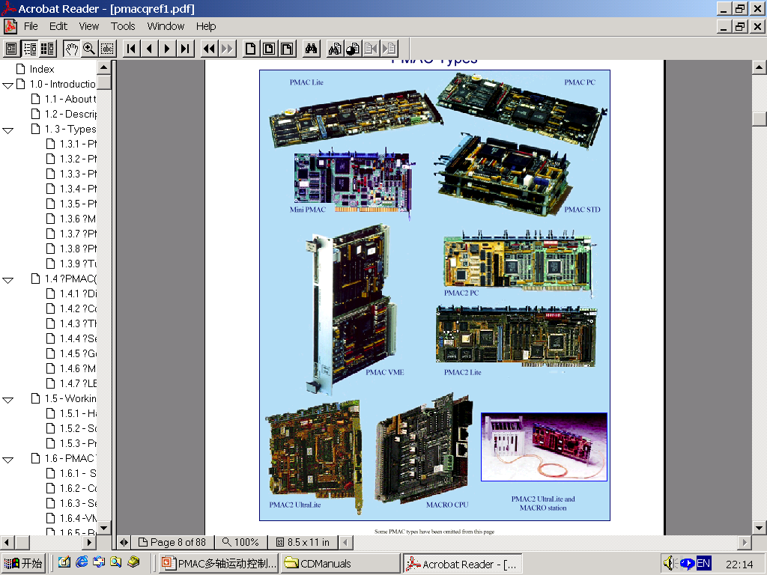
E-MOTION
PMAC多轴运动控制卡
（高级培训）

Slide 2
PMAC 卡主体结构
串行通讯接口
伺服接口电路
RS-232
and / or
RS-422
  PMAC(1)-style ICs
  PMAC2-style ICs
  PMAC(1)-style connectors
  PMAC2-style connectors
  Mini / Lite / (full)
I/O 接口
电路
CPU
Non-Turbo: DSP5600x
(16-bit addressing)
Turbo: DSP5630x
(24-bit addressing)
PMAC(1)-style
PMAC2-style
MACRO 光缆接口
PMAC2 Ultralite
ACC-42P
ACC-5E (UMAC)
总线通讯接口
ISA / VME / PCI
PC104/STD
USB
ETHERNET
(Optional DPRAM)

Slide 3
PMAC1 结构框图
显示端口
面板端口
多路复用口
串行口
光隔I/O
机器接口 2
EPROM
128 k x 8 固件
扩充 SRAM
16 k x 24 参数存储
I/O 控制 ICs
编码器接收
光隔 16-bit DACs
标志信号隔离
标志信号隔离
机器接口 1
Standard CPU only
Option 16
扩展
SRAM
128 k x 24 Active
Memory
CPU
24-Bit 20/40/60/80 MHz DSP
56002
Watchdog 定时器
串行通讯接口
“DSPGATE” 4-Channel
伺服电路
“DSPGATE” 4-Channel 伺服电路
光隔 16-bit DACs
编码器接收
FLASH 512k x 8 Firmware & User Backup
DPRAM 8 k x 16 Interface
EAROM 2 k x 8 Setup Storage
Bus
Comm.
Interface
ADC Port
ADC Port
Option 1
比较端口
Option 4A, 5A, 5B, 5C
Option 2
Standard CPU only
Bus 总线接口

Slide 4
Channels, Motors, and Axes on PMAC
“Channels” －－“通道”为 硬件定义
由放大器,编码器,信号接口组成
“Motors” －－“电机”为 软件定义
非Turbo CPUs PMAC支持8个电机
Turbo CPUs PMAC支持32个电机
“Axes”－－“轴”：为 软件定义
在运动程序中有效，每个坐标系最
多可到 9个轴
NEW IDEAS IN MOTION

Slide 5
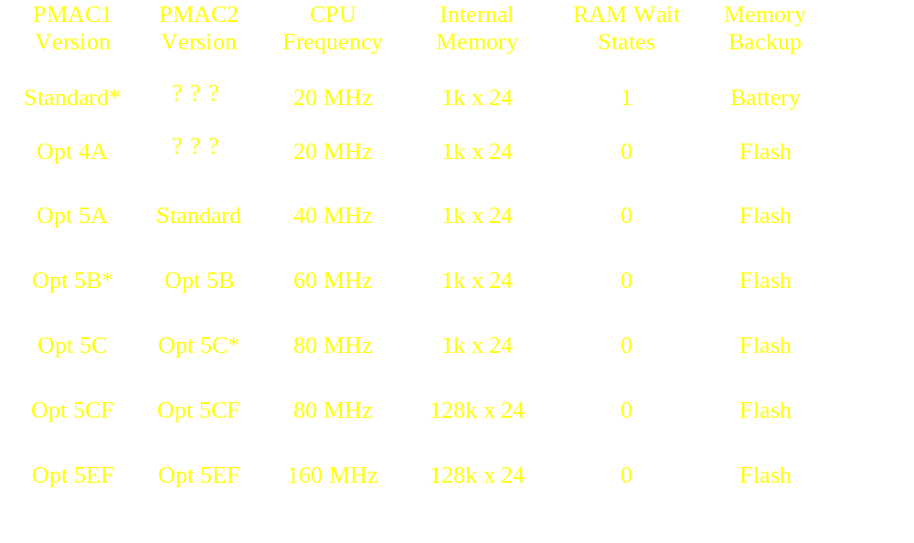
Non-Turbo PMAC/PMAC2 CPU 版本
* Legacy product for existing users only

Slide 6
PMAC参数存储器设定
1. I –变量 设定
2. 转换表设定
3. VME/DPRAM 地址设定
固板软件
的缺省值
参数初始化
1、E51 On: PMAC1
2、E3 On: PMAC2
3、 $$$***指令
EEPROM or Flash不被激活的寄存器
SAVE指令
RAM, DSP, ASIC’s上的激活的寄存器
工作寄存器
复位、初始化
正常复位
PMAC
主机
PMAC复位方式
1. 重新上电
2. INIT/信号低/高
3. $$$ 指令
读
写
NEW IDEAS IN MOTION

Slide 7
PMAC 程序和缓冲区存储
带后备电池
主存储器 [PMAC1]
Flash主存储器
[PMAC1.5, PMAC2]
RAM中激活的缓存
Flash
缓存
SAVE
RAM中激活的缓存
Reset
PMAC
主机
PMAC
主机
读
写
读
写
Programs 和buffers
自动被电池存储
Programs and buffers必须用SAVE
指令进行存储到FLASH中
NEW IDEAS IN MOTION

Slide 8
PMAC(1) 系列板卡
板卡型号
通道数
总线
插槽
串口
DPRAM
注释
PMAC-PC*
PMAC-Lite
Mini-PMAC
PMAC-VME*
PMAC-PCI*
4/8
4
2+
4/8
4/8
ISA
ISA
ISA
VME
PCI
1.5
1
0.7
2
1.5
RS422
RS232/
422
RS232
RS422
RS232
422
Off-Board
On-Board
On-Board
On-Board
On-Board
No JPAN,
Interrupts
* Available with Turbo CPU

Slide 9
PMAC2 结构框图
模拟量
多路复用端口
I/O
MACRO光缆口
串行口
显示端口
手轮接口
比较输出口
I/O 缓存
I/O 缓存
I/O 缓存
I/O 缓存
DRIVERS
8/16
EXTRA SRAM
DSP GATE 2
SERIAL
12-BIT
16Kx24
I/O
COMMUNICATIONS
ADCs
PARAMETER
ASIC
INTERFACE
STORAGE
Option 12/12A
Option 16
EXPANSION
Data & Address Busses
SRAM
CPU
DSP GATE1
DSP GATE1
128Kx24
24-BIT
WATCHDOG
4-Channel
4-Channel
ACTIVE
40/60/80 MHz
TIMER
SERVO
SERVO
MEMORY
DSP56002
ASIC
ASIC
MACHINE PORT 4
MACHINE PORT 3
MACHINE PORT 1
MACHINE PORT 2
FLASH
DPRAM
INPUT/
DSP GATE1
512Kx8
8Kx16
BUS
OUTPUT
INPUT/
FIRMWARE &
INTERFACE
COMMUNICATIONS
BUFFERS
OUTPUT
USER BACKUP
INTERFACE
BUFFERS
Option 2
Option 1
BUS PORT

Slide 10
PMAC2 板卡
板卡型号
通道数*
总线
插槽
串口
MACRO
PMAC2-PC***
PMAC2-Lite
Mini-PMAC2
PMAC2-PCI***
PMAC2-VME***
PMAC2-PC Ultralite***
PMAC2-VME
Ultralite
4/8
4
2
4/8
4/8
0
0
ISA
ISA
ISA
PCI
VME
ISA
VME
1.5
1
0.7
1.5
2
1
1
RS232**
RS232/422
RS232
RS232/422
RS232/422
RS232**
RS232/422
Off-Board
Off-Board
Off-Board
Off-Board
Off-Board
On-Board
On-Board
* 所有型号均有2路附加通道
** RS422 with Option 9L
*** Available with Turbo CPU

Slide 11
MACRO STATIONS
标准 PMAC
RAM
PWM
直接 PWM输出
DIG. 电路
DAC
+/- 10 V.DAC
模拟量输出
ROM
CPU
ENC
COUNTERS
A/B正交编码器反馈
FLASH
机器I/0
PMAC ＋ ( MACRO )
PMAC2 Ultralite
MACRO STATION
RJ45
ENC
ENCODER
A/B QUAD
RAM
TAXI
Optical
TAXI
PWM
PWM
ROM
CPU
MACRO
Optical
MACRO
CPU
DAC
+/- 10 V.
FLASH
TAXI
RJ45
TAXI
NO RAM
OR FLASH
I/O
96 I/O
JEXP
基板 + 2 背板
PMAC2 Ultralite 板卡 !
1) 板卡接口只有 MACRO & I/O 接口
2) 保留了 PMAC2 的基板功能，用MACRO STATION控制8轴。
3) PC & VME 格式
4) TURBO 版本的 PMAC ULTRALITE 能控制 32 轴
MACRO

Slide 12
Delta Tau 3U 矩阵结构
MACRO
Turbo
MACRO
Stack
Turbo
Stack
Stack
UMAC
MACRO
UMAC
Turbo
PACK
NEW IDEAS IN MOTION

Slide 13
PMAC vs. Turbo PMAC
功能 PMAC Turbo PMAC
最大控制轴数 8 32
最大伺服通道接口数 16 (8 off-board) 40 (32 off-board)
最大 MACRO 光缆通讯接口数 16 64 (Turbo Ultralite)
最大坐标系数 8 16
CPU 频率 (MHz) 20, 40, 60, 80 80, 100, 160
CPU 时钟周期（uS) 0.5 0.75
有效 CPU 频率 (MHz) 20, 40, 60, 80 120, 150, 240
I,P,Q & M-变量数 1024 each 8192 each
直接数组调用 {e.g. P(P1)=2}? No Yes
用户 PID 扩展伺服算法功能? No Yes

Slide 14
PMAC vs. Turbo PMAC (cont.)
功能 PMAC Turbo PMAC
固件存储器容量 32k x 24 64k x 24
编译 PLC存储器容量 15k x 24 48k x 24, 432k x 24
用户缓冲存储器容量 34k x 48 26k x 48, 212k x 48
DPRAM 容量 8k x 16 8k x 16, 32k x 16
追加后备电池存储器容量 7k x 48 16k x 48, 64k x 48
Lookahead 功能? 选项 标准配置
串行口数量 1 2 (2nd optional)
同时多端口通讯? No Yes
最大同时数据采集源 24 48
最大转换表行数 32 192
单运动最大同时分配M变量 3 63 (1 个坐标系.)
反向运动学功能? No Yes
快速运动中改变目的位置功能? No Yes

Slide 15
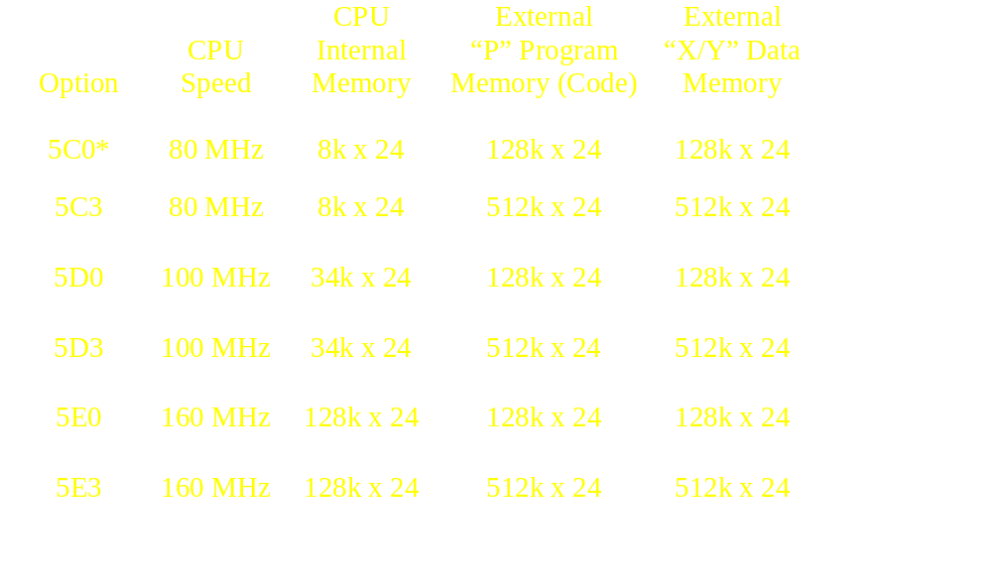
Turbo PMAC CPU 版本

Slide 16

PMAC Watchdog 看门狗计时器
要求电压 > 4.75 V
要求输入频率 > 20 Hz
  计数 > 0实时中断
  触发器计数定时
  后台管理重置计数器最大值 (=512)
在要求电压或输入频率之下时
  强制0值输出
  放大器禁能
  “FEFCO” 输出 (PMAC1)
  “WDO” 输出锁存 (PMAC2)
NEW IDEAS IN MOTION

Slide 17
PMAC 编码器输入电路
+5v
R
2R
无编码器或单端编码器输入：
pin 1 to 2 差分 +2.5 V 输入
开集电极编码器输入：
pin 2 to 3 差分 +5 V 输入
能支持编码器电路外部XOR丢失
差分编码器输入方式直接接卡
A
+
A
−
3
2
2R
1
NEW IDEAS IN MOTION

Slide 18
PMAC(1) 标志信号输入
E89
E90
FLAG INPUTS
FAULTn
+LIMn
-LIMn
HMFLn
必须光隔输入
三路电源线回路
Note: 可定义共源极或共阴极输入
To ASIC
External
PMAC
GND
AGND
FGND
GND
NEW IDEAS IN MOTION

Slide 19
PMAC2 ACC-8x标志信号输入
+V
0V
RETURN
FLAG INPUTS
USERn
PLIMn
MLIMn
HOMEn
+5V
To PMAC2
FLAGn
GND
必须光隔输入
共阴极输出, 连接 RETURN
to +24V
共源极输出, 连接 RETURN
to 0V
4路标志信号共用1个
RETURN
0V
+V
External
ACC-8x
NEW IDEAS IN MOTION

Slide 20
PMAC(1) “DSPGATE”
门阵列 IC
HOME 1-4
+LIM 1-4
-LIM 1-4
FAULT 1-4
AENA 1-4
EQU 1-4
可选频率时钟输入
编码器
采样频率
DAC 1
伺服频率
相频率
DAC/ADC
DAC 2
4
模拟量
输出
16 bit
精度
Input
Flags
光电隔离
标志信号
控制
DAC 3
A
B
C
Encoder 1
Output
Flags
A
B
C
DAC 4
4
编码器
输入
Encoder 2
DAC Shift Registers (4)
Serial
Data Out
A
B
C
DSP-Gate
Serial
Data In
1
Encoder 3
ADC
16 bit
MUX
4
模拟量
输入
ADC Shift Registers (4)
2
A
B
C
3
Encoder 4
4
Clock
Analog
Control
Encoder Control
Mux
Control
ACC-28 Board
24-bit
Data Bus
5-bit
Address Bus

Slide 21
编码器功能: DSP Encoder/Flag 门电路 (1 of 4)
每个门阵列
4路电路
位置比较寄存器
EQU
OUT
相时钟
相位捕获寄存器
“C” 通道信号
位置
捕获
触发
4 标记信号
零位信号捕获寄存器
A
数字
延时
滤波
A/B 正交
译码
W/mode Control
X1,X2,X4,P, D,CLK
计数
24 bit up/down 位置计数器
(30 MHz Max)
B
方向
编码器输入
伺服位置捕获寄存器
伺服时钟
定时器 (2)
1/T 编码器周期测量
时钟, to 30 MHz
总线
数据
控制
状态 & 控制寄存器
24-bit 数据
1) ENC 错误
2) 捕获
3) EQU
5-bit 地址
Flags
5 inputs
3 Status
16 Controls

Slide 22
编码器数字延时滤波
2 of 3
Voting
CHA
D Q
D Q
D Q
D Q
2 of 3
Voting
CHB
D Q
D Q
D Q
D Q
SCLK
NEW IDEAS IN MOTION

Slide 23
PMAC(1) 时钟分配电路
编码器采样时钟
(SCLK)
晶振
E34A
E34
19.6608 MHz
1/2
E35
模拟量通道选择
(ASEL)
1/4
E36
1/4
1/17
E33
1/8
E37
E32
相时钟
(Phase)
1/16
1/2
1
E31
E98
2
1/4
3
DAC/ADC 时钟
(DCLK)
E30
1/8
E29
1/16
伺服时钟
(Servo)
1/n
E3
E4
E5
E6
n = 1 to 16
NEW IDEAS IN MOTION

Slide 24
PMAC2 门阵列 IC “DSPGATE1”
3
E
N
C
O
D
E
R
1
O
U
T
P
U
T
1
A
,
B
,
C
6
9
F
L
A
G
1
A
D
C
I
N
1
A
,
2
B
2
3
E
6
N
C
O
D
E
R
2
O
U
T
P
U
T
2
A
,
B
,
C
9
F
2
L
A
G
2
A
D
C
I
N
2
A
,
2
B
3
E
6
N
C
O
D
E
R
3
O
U
T
P
U
T
3
A
,
B
,
C
9
F
2
L
A
G
3
A
D
C
I
N
3
A
,
2
B
3
E
N
C
O
D
E
R
4
O
U
T
P
U
T
4
A
,
B
,
C
6
9
F
2
L
A
G
4
A
D
C
I
N
4
A
,
B
2
E
N
C
O
D
E
R
/
F
L
A
G
O
U
T
P
U
T
/
A
D
C
I
S
N
2
T
A
T
U
S
&
C
O
N
T
R
O
L
C
O
N
T
R
O
L
C
L
O
C
K
,
P
L
L
24-bit DATA BUS
6-bit
ADDRESS BUS

Slide 25
PMAC2 门阵列 IC 时钟控制
20 MHz
x6 锁相环
120 MHz
PWM 计数
PWM Up/Down 计数器
计数
16
16
方向
PWM 最大 计数
最大相
PWM 死区时间/
PFM 脉冲宽度
8
DT/PW
24
Data
1
3
40 MHz
6 Address
n=0-7
1
2^{n}
采样时钟
编码器
采样时钟控制
PFM
时钟控制
n=0-7
1
2^{n}
PFM 时钟
n=0-7
1
2^{n}
DAC 时钟
DAC
时钟控制
n=0-7
1
2^{n}
ADC 时钟
ADC
时钟控制
Int/Ext Phase
Int/Ext Servo
n=0-15
1
n+1
相
相
时钟控制
伺服
时钟控制
n=0-15
1
n+1
伺服
外部
相
外部
伺服

Slide 26
PMAC2 时钟信号时序
+ Max
Count
PWM
Counter
t
- Max
Count
Max
Phase
Phase
Servo

Slide 27
PMAC/PMAC2 时钟跳线控制
Clock
PMAC(1)
PMAC2
PMAC2 Ultralite
"Max Phase"
E98 (DAC, ADC
I900
[I7m00]
I992
[I6800]
Clock)
Phase
E98, E29-E33
I900, I901
[I7m00,I7m01]
I992, I997
[I6800, I6801]
Servo
E98, E29-E33, E3-E6
I900, I901 , I902
[I7m00,01,02]
I992, I997, I998
[I6800,01,02]
Encoder Sample
E34-E38
I903, I907
MI903, MI907
[I7m03]
DAC
E98
I903, I907
MI903, MI907
[I7m03]
ADC
E98
I903, I907
MI903, MI907
[I7m03]
PFM
--
I903, I907
MI903, MI907
[I7m03]
PWM
--
I900, I906
MI900, MI906
[I7m00]

Slide 28
PMAC2 门电路 IC
输出通道 (1 of 4)
PWM 频率/
死区时间控制*
Output
Select
PWMA TOP
A,B
C
脉宽
调节器
PWMA BOT
Output A
指令值
DAC
调节器
DAC CLK
DAC A
脉宽
调节器
PWMB TOP
PWMB BOT
Output B
指令值
DAC
调节器
DAC STROB
DAC B
脉宽
调节器
PWMC TOP
Output C
指令值
PWMC BOT
脉冲频率
调节器
DIR
PULSE
DAC 频率/
锁存滤波控制*
编码器、定时器
输入复用接口
PFM 频率控制*
*对所有通道有效

Slide 29
PMAC2 门阵列 IC 编码器/标志信号通道 (1 of 4)
EQU
Q T
S
AENA
T
=?
位置比较 A
U
数字
霍尔元件
V
延时
传感器
=?
位置比较 B
滤波器
解码
W
S
辅助标志信号
自动增量比较
(Subcount, Hall,
Fault Code)
通道状态
USER
-LIM
数字
+LIM
延时
标志
HOME
滤波器
捕获
CTRL
通道控制
控制器
24
6
Data
Address
捕获标志
标志捕获位置
FAULT
CTRL
数延器.
Index
CTRL
相位捕获位置
INDEX
选通
CTRL
B
数字
CTRL
延时
伺服捕获位置
A
滤波器
译码
计数器
MUX
控制器
(40MHz)
编码器输入
定时器
最后2位计数时间
脉冲
方向
(40/120MHz)
（脉冲发生器）
最后计数时间
伺服时钟
相时钟

Slide 30
PMAC2 门电路 IC ADC 输入通道(1 of 4)
ADC INA
ADC 输入值 A
ADC 寄存器 A
ADC INB
24 Data
ADC 输入值 B
ADC 寄存器 B
6 Address
ADC 频率控制*
ADC CLK
ADC 锁存
滤波控制*
ADC 滤波锁存
相时钟
*对所有通道有效

Slide 31
PMAC(1) 脉冲加方向控制
PMAC
ACC-8D
Opt 2
Motor
主位置
驱动器
+
DAC
V/F
轨迹规划
+
PID
方向
−
译码/计数
E
NEW IDEAS IN MOTION

Slide 32
PMAC2 PMAC(1) 脉冲加方向控制
PMAC2 Drive & Motor
主位置
脉冲
驱动器
+
累加器r
轨迹规划
+
PID
加法器
方向
−
PFM 电路
Decoder/
Counter
E
NEW IDEAS IN MOTION

Slide 33
PMAC/PMAC2 直驱微步控制
PMAC Drive & Motor
主位置
H-桥
驱动器
H-桥
驱动器
正弦波整流
DAC
+
DAC
轨迹规划
+
PID
模拟位置
−
NEW IDEAS IN MOTION

Slide 34
JTHW Multiplexer Port
ACC–8D Opt 7 R/D Converter
ACC–8D Opt 9 Yaskawa Encoder Interface
ACC–18 Thumbwheel Board
ACC–34 Family I/O Boards
ACC–35 Extenders
JRS232/RS422 Serial Port
ACC–20 Handwheel Terminal
ACC–26 Serial Isolator
JRS232/RS422 Serial Port
ACC–20 Handwheel Terminal
ACC–26 Serial Isolator
JOPTO I/O Port
ACC–21 Opto–22 Interface Cables
JPAN Control Panel Port
ACC–16 Control Panel
ACC–39 Handwheel Interface
JS1, JS2 ADC Port
ACC–28 ADC Boards
JDISP Display Port
ACC–12 Family
LCD, VFD Displays
JMACH Servo Port(s)
ACC–8 Family Breakout Boards
J1
J2
J3
J4
J5
J7
JS1
JS2
JEXP
J8
JEXP Expansion Port
Opt 2 DPRAM (ISA)
ACC–14 I/O Board
ACC–24 Axis Expansion
ACC–29 MLDT Interface
ACC–36 ADC Board
PMAC(1) Accessory Boards

Slide 35
JMACRO Port
ACC–42 MACRO Interface
JRS232/RS422 Serial Port
ACC–20 Handwheel Terminal
ACC–26 Serial Isolator
JTHW Multiplexer Port
ACC–8D Opt 7 R/D Converter
ACC–8D Opt 9 Yaskawa Encoder Interface
ACC–18 Thumbwheel Board
ACC–34 Family I/O Boards
ACC–35 Extenders
JMACH Servo Port(s)
ACC–8 Family Breakout Boards
JDISP Display Port
ACC–12 Family
LCD, VFD Displays
JEXP Expansion Port
ACC–14 I/O Board
ACC–24 Axis Expansion
ACC–36 ADC Board
PMAC2 Accessory Boards

Slide 36
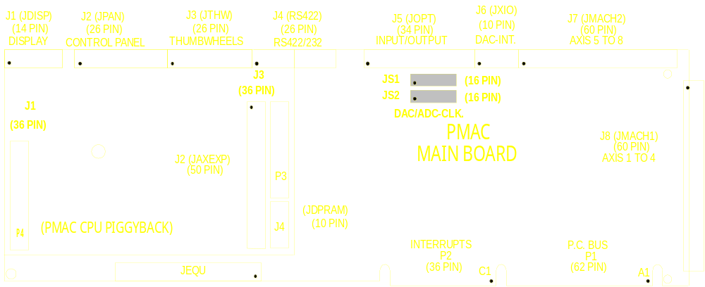
PMAC Accessory ACC - 8D with Options 2,4,6, & ACC - 8P
PMAC ACC-8D
TERMINAL BLOCK BOARD
63
61
59
57
55
53
51
49
47
45
43
41
39
37
35
33
31
29
27
25
23
21
19
17
15
13
11
9
7
5
3
1
64
62
60
58
56
54
52
50
48
46
44
42
40
38
36
34
32
30
28
26
24
22
20
18
16
14
12
10
8
6
4
2
TB1
PMAC ACC-8D OPTION 4
J1A
J3B
QUAD HYDRAULIC VALVE/MOTOR DRIVER
R4
R3
J6
J5
J1B
J3A
J1
JPMAC/VMEBUS
J4B
J2A
J2B
LD1
LD2
E10
E9
LD3
LD4
JPMAC/PCBUS
J4A
U1
U5
U9
U13
TP1
U2
U6
U10
U14
1
U3
1
E2
1
U7
1
E4
1
U11
1
U15
E1
E3
E5
1
E6
E7
1
E8
U4
1
U8
U12
U16
PCBUS
TB1
JPMAC/
PMAC ACC-8P
TERMINAL BLOCKS ONLY
PMAC ACC-8D OPTION 2
4 CHAN. V/F CONVERTER
2
60
J1
J2
1
59
JENC1
JENC2
R3D
R3D
R3D
R3D
JENC3
JENC4
E1
1
0
1
TB1
PMAC ACC-8D OPTION 6
4 CHAN. ENCODER OPTICAL ISOLATORS
TB2
1
26
JENC1
JENC2
1
1
JENC3
JENC4
E1
E2
E3
1
E4
1
TB1
1
26

Slide 37
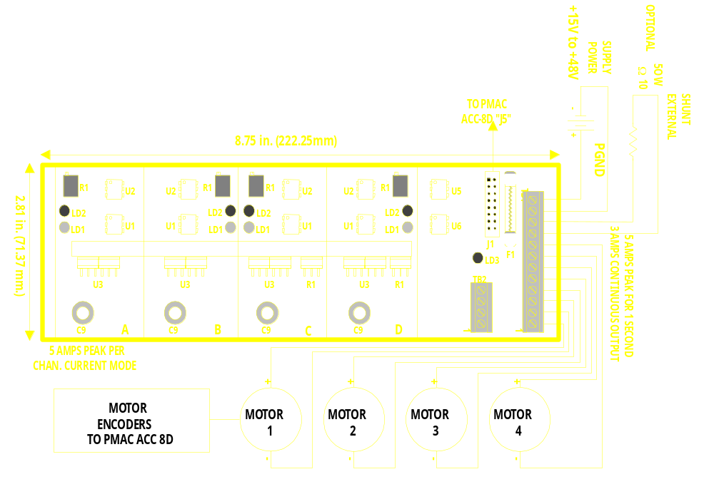
PMAC ACC-8D Option 4A
线性马达驱动器

Slide 38
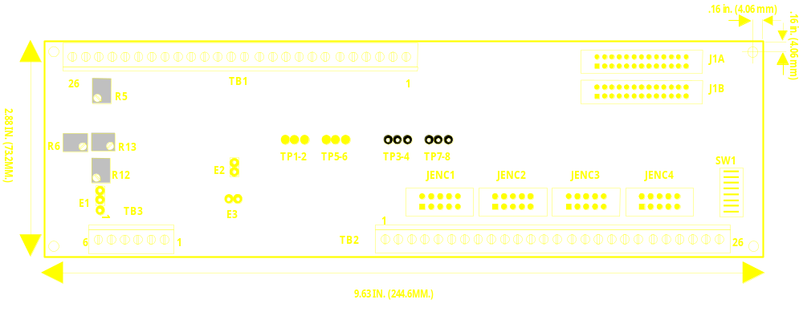
ACC-8D Option 7
旋转变压器－数字转换器
NEW IDEAS IN MOTION

Slide 39
ACC-8D Option 7
旋转变压器－数字转换器
基板提供 2 极点 RDC’s
可选option A , 提供 4 极点 RDC’s
12-bit 精度: 4096 计数 (1024 “线”) /每电子周期
能接收 2.5 kHz, 5 kHz, 10 kHz 激励
单独激励增益调节
2.5 V_{pp} - 10 V_{pp} sin/cos 反馈信号
提供感应同步器接口
NEW IDEAS IN MOTION

Slide 40
ACC-8D Option 7
旋转变压器－数字转换器( 续)
通过PMAC多路复用口读入绝对位置
  从Ix81读入上电相位置
  从Ix10读入上电伺服位置
  从 I9x, I8x读入上电旋变齿轮比
  用户使用M变量读入 TWR 格式
通过PMAC通用编码器口读入增量位置
  类似于编码器输入进行伺服更新
  只有旋变齿轮设定需要这样做
  (Only fine resolver of geared set needs this)
NEW IDEAS IN MOTION

Slide 41
编码器细分: 数字增量编码器
A
解码 /
计数
A
A
2-bits
1
2
3
4
Counter
Value
B
1
2
B
1
B
比较器
“1-Bit A/D”
数字增量
模拟信号
数字细分
编码器
PMAC

Slide 42
编码器细分: 模拟量“Sin / Cos”编码器
A
+
n
n-bit
A/D
-
A
0
2^{n}-1
2^{n}-1
n
n-1, n bits
B
+
n-bit
A/D
-
B
0
差分放大器
Sin / Cos
信号
Flash
A/D
转换
Sin / Cos
数
Arctan
转换表
角度数
Analog
Photo
Current
编码器
PMAC

Slide 43
编码器细分: 高分辨率模拟量“Sin / Cos”编码器
Decoder /
Counter
A
+
-
A
Comparator
“1-Bit A/D”
B
+
n-bit
A/D
-
B
Differential
Amplifier
Sin / Cos
Signals
n-bit
A/D
Analog
Photo
Current
Encoder
Controller

Slide 44
256x 低精度细分器
ACC-8A, ACC-8D-Opt8, ACC-DE, ACC-8FE
128 or 256 细分数/线 (LSB=1/32 software count)
增量计数频率 1x or 2x 倍
最大线输入频率 150 kHz
NEW IDEAS IN MOTION

Slide 45
ACC-51高精度细分器
ACC-51P 用于 PMAC PC/ISA , ACC-51E 用于 UMAC
应用于 sin/cos 增量编码器 或干涉仪
支持 2－4 路（选项）编码器输入
转换表 ( $F 方式) 计算细分插值后的位置
4096 细分数/线 (LSB=1/32 software count)
最大线输入频率 1MHz

Slide 46
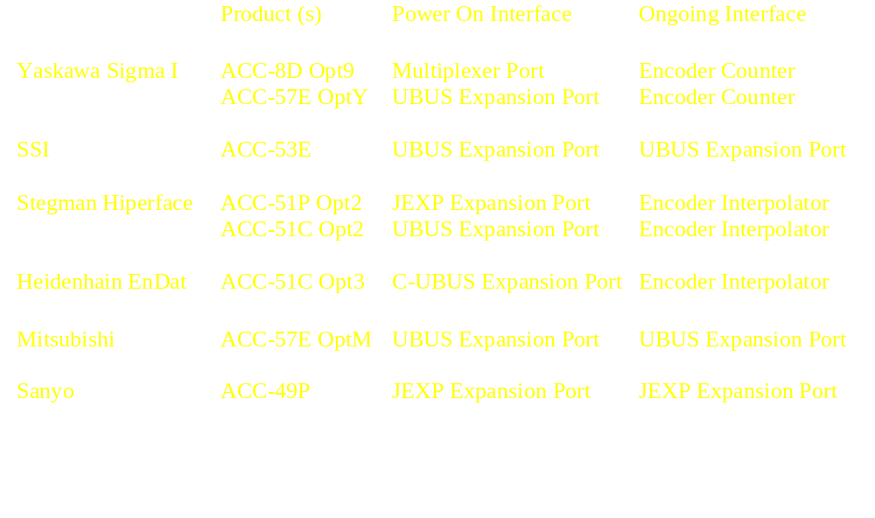
绝对编码器接口

Slide 47
PMAC2 信号转接板
Drive Interface
Signals
Breakout
Style
Breakout
Connector
Board
Notes
ACC – 8A
Single/Dual
Analog
DIN - Rail
D-Sub
- 1 or 2 16 Bit DAC’s per axis
- Opt. 256x Interpolators
ACC – 8E
Dual Analog
DIN - Rail
Terminal
Block 12-point
- 2 18-bit DAC’s per axis
- Relays for amp enable
ACC – 8F
Direct PWM &
Digital Current
DIN - Rail
Mini - D
36-pin
- Loss-of-encoder circuit
- Opt. Yaskawa Hall Decode
ACC – 8S
Pulse &
Direction
DIN - Rail
Term Block
10-point
Optional encoder interface; “Pulse
swallower” for slow drives
ACC – 8FP
Direct PWM &
Digital Current
Panel
Mini - D
36-pin
- Used in PC-Pack
- Loss-of-encoder circuit
- Opt. Yaskawa Hall decode
ACC – 8FE
Direct PWM &
Digital Current
3U - Rack
Mini - D
36-pin
- Used in MACRO Station
- Opt. 256x interpolator

Slide 48
ACC-12 系列显示器件
应用于独立的操作界面
应用于软件调试
液晶屏 (LCD)
高亮、宽视角真空管 (VFD):
显示文本 “{message}”
显示数值 {variable}
直连距离 3m (10ft)
最大距离200m附加 ACC-12D
NEW IDEAS IN MOTION

Slide 49
ACC - 12系列
Characters
Per Row
Character
Height
Type
Display
Rows
ACC – 12
2
24
5 mm
液晶LCD
ACC – 12A
2
40
5 mm
LCD
ACC – 12C1
2
40
6 mm
真空管

Slide 50
ACC - 34 系列I/O板
Voltage
Output
Individual
Input RC
Serial
Board
Mounting
Rating
Current
Isolation
Filter
Parity
ACC – 34A
DIN – Rail
24 V
100
mA
No
No
No
ACC – 34AA
DIN – Rail
24 V
100
mA
Yes
Yes
Yes**
ACC – 34B
DIN – Rail
5 V
20
mA
No*
No*
No
ACC – 34D
Panel
5 V
20
mA
No*
No*
Yes**
* This function usually provided by mating Opto - 22 or compatible board.
** Requires V1.16 or newer firmware.

Slide 51
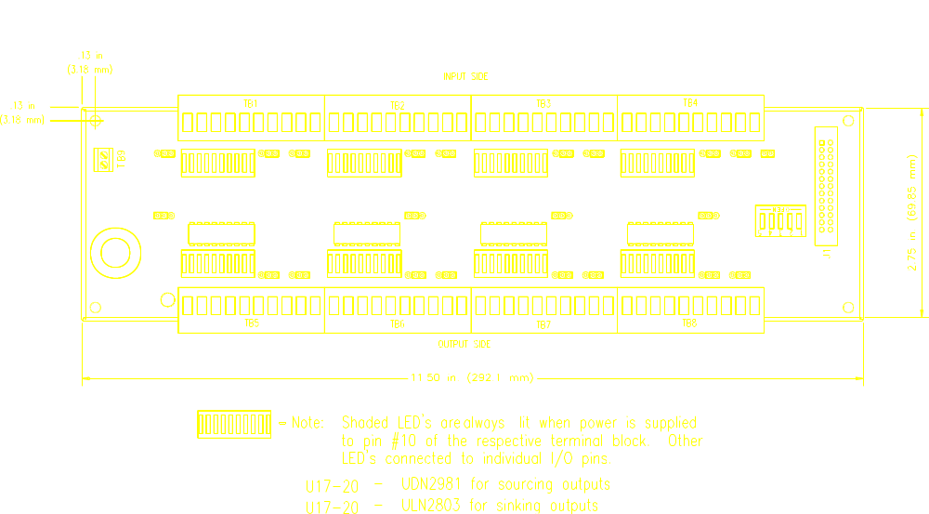
ACC-34A 64 点光电隔离 I/O 板

Slide 52
PMAC/PMAC2 I/O 点选择
Typical
Latency
Type
Direction
Access
Notes
Position Capture Flags
Input
Hardware
50-500 nsec
Latch counted
actual position
Position Compare Flags
Output
Hardware
50-500 nsec
Based on counted
actual position
Onboard I/O Ports
In/Out
Foreground/
Background
Software
200 μsec - 2 msec
Speed limited by
software rates
ACC-14 Family I/O
In/Out
Foreground/
Background
Software
200 μsec - 2 msec
Opt. 3 inputs can
be latched by servo
clock
ACC-34 Family I/O
In/Out
Background
Software
5 - 20 msec
Serial
communications
to PMAC

Slide 53
Working With ACC-34 Family I/O
Only background access permitted (PLC 1-31, on-line)
Foreground access disabled (PLC0, motion program)
100 microseconds to copy 32-bit word to/from ACC-34 (20MHz)
Suggested approach is like real PLC’s:
  At beginning of PLC scan, copy all input words into fixed-point registers in internal memory
  Work with individual bits of internal registers (Use single-bit M-variables)
  Prepare output words in fixed-point registers in internal memory
  At end of PLC scan, copy all output words from internal registers
NEW IDEAS IN MOTION

Slide 54
ACC-34 Family M-Variable Definition
n = Base address of board on multiplexer port
as set by 5-point DIP switch on board
  (n=0 - 248, divisible by 8)
  Input Port (A): Mx -> TWS:{n + 1}
  Output Port (B): Mx -> TWS:{n + 6}
  Example: n=0
  M901->TWS:1
  M902->TWS:6
  M1001=M901 ; copy inputs into image
  M902=M1002 ; copy image to outputs
NEW IDEAS IN MOTION

Slide 55
ACC-35 Multiplexer Port Extenders
ACC-35A Option 1
ACC-35B Option 1
The DB37S Connector Option
The DB37S Connector Option
J2
J1
E1
U1
U2
U1
U2
1
2
3
4
5
1
2
3
4
5
SW1
SW1
OPEN
U3
U4
OPEN
U3
U4
1
2
3
4
5
1
2
3
4
5
SW2
SW2
OPEN
TB1
OPEN
2
J1
1
J2
For use with:
ACC-34 family of I/O input
ACC-18 thumbwheel input
ACC-8D Opt 7 R/D converter
ACC-8D Opt 9 Yaskawa absolute encoder board

Slide 56
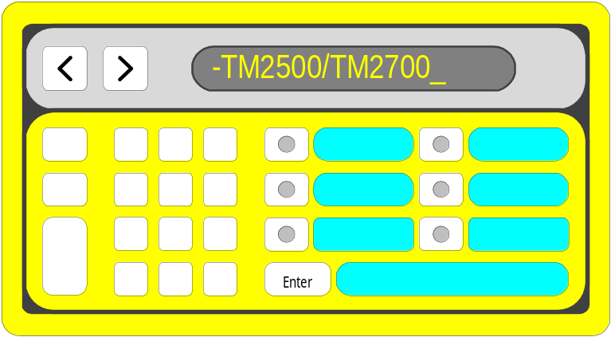
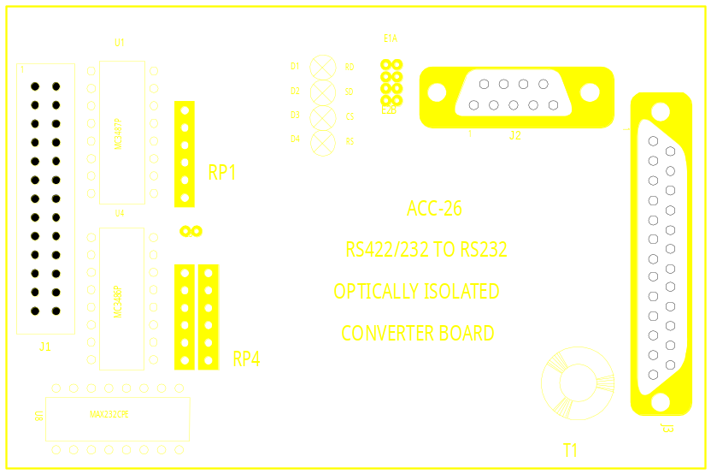
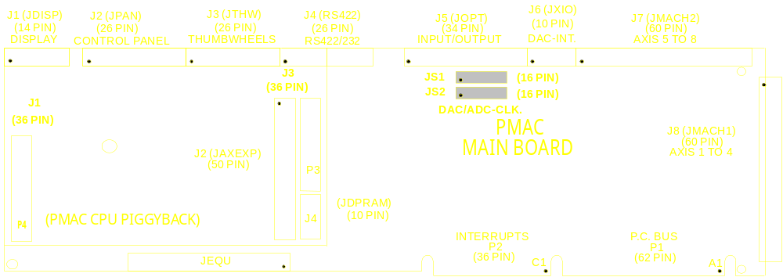
Diagram: PMAC Accessories
ACC-20 and ACC-26
ACC-20
ACC-26
Control Panel
Numeric Input
24 Char. Display
6 Function Keys
Provides Optical Isolation for RS422/232

Slide 57
PMAC/PMAC2 A/D Converter Choices
PMAC
Family
Compatibility
# of
Channels
Resolution
(bits)
Repeatability
(bits)
Voltage
Range
Optical
Isolation?
Type
Mounting
ACC – 28A
4
15
12
±10V
DIN Rail
Yes
1
ACC – 28B
2, 4
16
15
±10V
DIN Rail
Yes
1, 2
ACC – 36P
16
12
11
0-10V, ±5V
ISA Bus
No
1, 2
ACC – 36V
16
12
11
0-10V, ±5V
VME Bus
No
1, 2
Opt. 12, 12A
8/16
12
11
0-5V, ±2.5V
Onboard
Option
No
2
Opt. 15 (V/F)
1
2 on
Mini
11
10
0-10V
(±10V on Lite)
Onboard
Option
No
Yes on
Mini
1

Slide 58
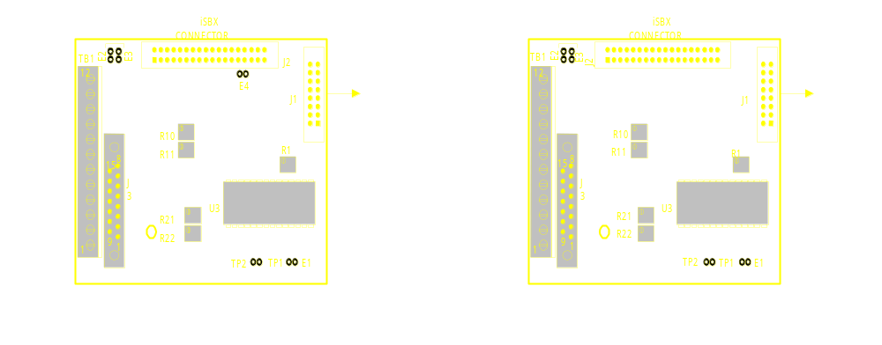
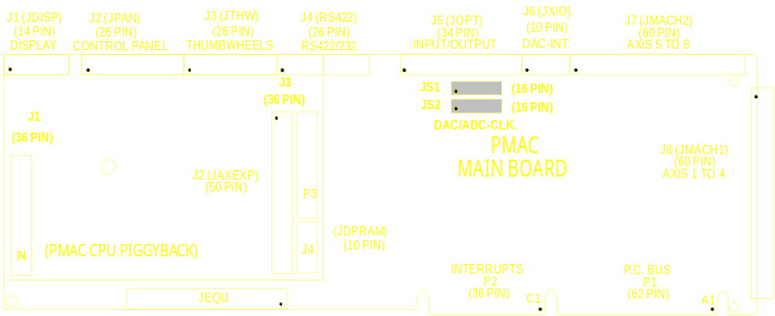
Diagram: ACC-28A 4 channel, 16 Bit, Opto-Isolated A/D Converter
ACC-28A

Slide 59
3U Stack Boards
ACC-1E 2-Axis Servo Interface Board*
ACC-2E 4-Axis Servo Interface Board
ACC-3E 48/96/144 TTL I/O Board
ACC-4E 24-In/24-Out Isolated I/O Board
ACC-6E 16-Channel 12-Bit ADC Board
* For use with MACRO Interface / CPU Board only

Slide 60
UMAC Servo IC Boards
Output
Feedback
Flags
ACC-24E2
3 Phase PWM
AB Quad
Isolated Inputs
Diff Enable/Fault
Dual Analog
Pulse & Direction
Isolated Inputs
Relay Amp Enable
Isolated Amp Fault
ACC-24E2A
AB Quad
ACC-24E2S
Pulse & Direction
AB Quad
Isolated Inputs
Diff Enable/Fault
ACC-51E
Sine/Cosine
Optional Hiperface
None
One Trigger Flag

Slide 61
UMAC Digital I/O Boards
# of
Inputs
Input
Voltage
# of
Outputs
Output
Voltage
Output
Current
ACC-9E
48
12-24VDC
0
---------
---------
ACC-10E
0
----------
48
5-24VDC
+100mA (sourcing)
-100mA (sinking)
ACC-11E
+100mA (sourcing)
-100mA (sinking)
24
12-24VDC
24
5-24VDC
ACC-12E
12-24VDC
24
5-60VDC
<=240VAC
+/-1A
24
ACC-14E
0-48
5V
0-48
5V
10mA

Slide 62
UMAC Analog I/O IC Boards
# of
ADCs
Input
Range
# of
DACs
Output
Range
Resolution
Resolution
ACC-28E
2/4
16-bit
+/-10V
0
---------
---------
ACC-36E
0-10V
+/-5V
---------
---------
16
12-bit
0
ACC-59E
0-10V
+/-5V
12-bit
+/-10V
8
12-bit
8

Slide 63
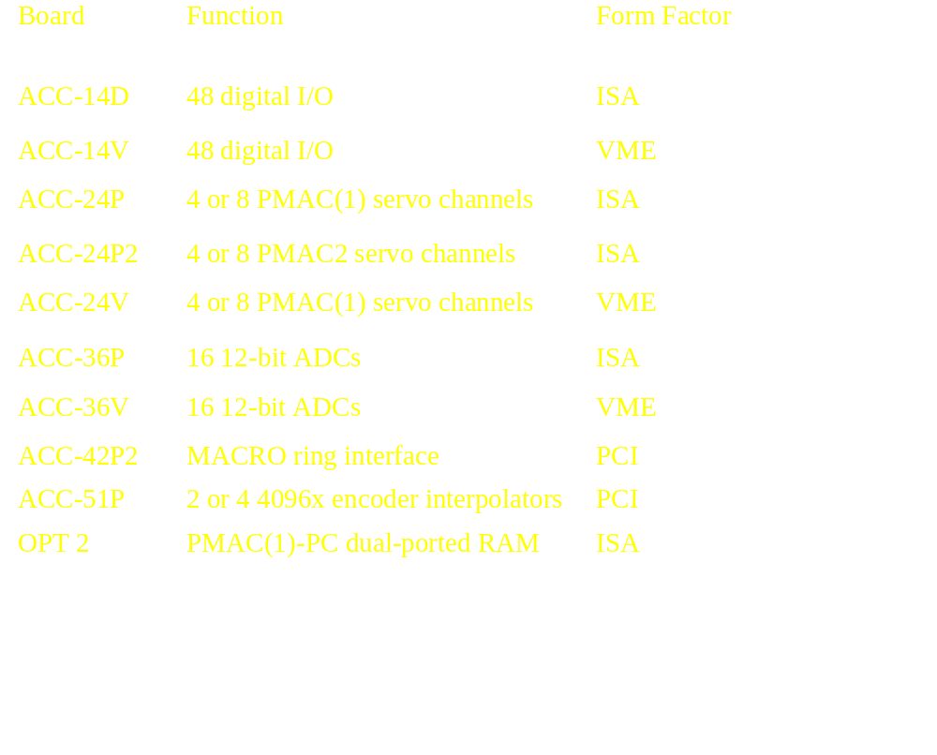
“JEXP” Expansion Port Boards

Slide 64
PMAC2 Integration
ACC-36
16 A/D 转换
MACRO
光纤网络接口
数字电流环 &
PWM发生器
2 路附加
编码器通道
PMAC
4 路附加伺服
更新轴通道
OPT-2
DPRAM
ACC-29
MLDT
（磁致伸缩）接口
ACC-8D Opt2
步进接口

Slide 65
Why Use PMAC2 over PMAC(1)?
Ability to do direct PWM control
Ability to do on-board MACRO interface
More compact for sinewave control
More compact for analog encoder interpolation
Superior pulse-and-direction stepper control
Superior MLDT interface
Enhanced position compare output function
Increased DAC resolution (18-bit vs. 16-bit)
Many accessory boards come on-board:
  DPRAM, ADCs, MLDT interface, supplemental encoder interface, stepper interface
NEW IDEAS IN MOTION

Slide 66
Why Use PMAC(1) over PMAC2?
Existing PMAC customers don’t have to change
More cost-effective for traditional analog drive interface:
  Velocity-mode drives
  Torque-mode drives
Onboard 24V I/O (JOPTO port)
Automatic control panel port
NEW IDEAS IN MOTION

Slide 67
PMAC Command Set
On-line commands
  (executed immediately, not stored)
  Global
  Coordinate system specific (&n…)
  Motor specific (#n…)
  (Note: Motor-specific action commands locked out when motor is in a coordinate system running a motion program)
  Mode setting, move commands, queries, variable setting, buffer control
NEW IDEAS IN MOTION

Slide 68
PMAC Command Set (continued)
Buffered commands (into OPEN buffer)
  (stored for future execution)
  Motion Program
    Moves, modes, math, logic, commands, messages
  PLC Program
    Math, Logic, commands, messages
NEW IDEAS IN MOTION

Slide 69
PMAC Variables
I-Variables (1024) [8192]
  Initialization and setup variables
  Pre-defined meanings
  Some affect whole card
  Some are motor specific
  Some are coordinate system specific
  Some are hardware-channel specific
P-Variables (1024) [8192]
  General purpose user variables
  48-bit floating point format
  Global (whole card) access
NEW IDEAS IN MOTION

Slide 70
PMAC Variables (continued)
Q-Variables (1024) [8192]
  General Purpose user variables
  48-bit floating point format
  Specific to a coordinate system
M-Variables (1024) [8192]
  Provide user access to memory and I/O
  User defines address, offset, and bit width
  Unsigned, 2’s comp, BCD, floating point formats available
NEW IDEAS IN MOTION

Slide 71
P & Q Variable Array Capabilities
Reading:
P0=P(P100+3)
Q99=Q(Q0+P10)
Writing (non-Turbo) :
  Setup:
  M0-> L:$1000 ;Points to P0
  M10-> Y:$BC00, 0, 12;Points to M0 definition
  Action:
  M10=P100+3 ;select P(P100+3)
  M0=P0 ;Same as P(P100+3)=P0
NEW IDEAS IN MOTION

Slide 72
P & Q Variable Array Capabilities (continued)
  Setup:
  M1-> L:$1400 ;Points to C.S.1 Q0
  M11-> Y:$BC01, 0, 12;Points to M1 definition
  Action:
  M11=1024+Q0+P10 ;select C.S.1 Q(Q0+P10) M1=Q99 ;Same as Q(Q0+P10) =Q99
  Writing (Turbo):
  P(P100+3)=P0
  Q(Q0 + P10)=Q99
NEW IDEAS IN MOTION

Slide 73
PMAC Memory & I/O Map
X-Memory
Y-Memory
23
16
15
8
7
0
23
16
15
8
7
0
$0000
Internal DSP
$00FF
Memory
$0100
Fixed-Use Calculation Registers
$17FF
$1800
External
User Buffer Storage Space
Static
RAM
$9FFF
(Battery/Flash Backed)
$A000
Option 16 Battery Backed Parameter Memory
$BBFF
$BC00
User-Written Servo Storage
M-Variable Definitions
$BFFF
$C000
DSP-Gate
$C03F
Registers
$D000
Dual-Ported
$DFFF
RAM
$E000
VME Setup Registers
Mailbox Registers
VME bus
registers
$F000
I/O
Registers
$FFFF

Slide 74
X-Memory
Y-Memory
$000000
23
16
15
8
7
0
23 16 15 8 7 0
$0007FF / $001FFF¹
Internal DSP Memory
$000800 / $002000¹
Fixed-Use Calculation Registers
$005FFF
$006000
Standard P-Variable Registers
$007FFF
Turbo PMAC
Memory &
I/O Map
$008000
Standard Q-Variable Registers
External
$009FFF
Static
$00A000
User-Buffer Storage Space
RAM
(Flash-Backed)
$0107FF / $03FFFF²
$050000
Alternate P & Q-Variable Registers
Optional Battery-
$053FFF / $05FFFF³
Backed RAM
$060000
Optional Dual-
$060FFF / $063FFF⁴
Ported RAM
$070000
Bus Interface ICs
$0701FF
Notes:
1. 56303 CPU / 56309 CPU
2. Standard / Extended Data Memory
3. Standard / Extended BBRAM Option
4. Standard / Extended DPRAM Option
Servo, MACRO,
$078000
$07B31F
& I/O ICs

Slide 75
Accessing PMAC Registers
Servo and Commutation Use
  I-Variables & Conversion Table
  Ix02, Ix03, Ix04, Ix05, Ix10, Ix25 - servo addresses
  Ix81, Ix82, Ix83 - Commutation addresses
  Ix93 - Time base addresses
  I21 through I44 - Data gathering addresses
  Conversion table setup word - Preprocessing
User Program Use (Motion, PLC, & Host)
  M-Variables
  Assigned to registers first
  Used as normal variables in PMAC programs, on-line commands from host
  Direct Memory read/write (Host use only)
  W{address}, {constant}
  R[H] {address}

Slide 76
PMAC I-Variable Groups
I0 - I99 General card setup
I100 - I186 Motor 1 setup
I187 - I199 Coordinate System 1 setup
I200 - I286 Motor 2 setup
I287 - I299 Coordinate System 2 setup
... …
I800 - I886 Motor 8 setup
I887 - I899 Coordinate System 8 setup
I900 - I999 Hardware setup
I1000 - I1023 MACRO & Misc. setup
NEW IDEAS IN MOTION

Slide 77
Turbo PMAC I-Variable Groups
I0 - I99 General Card Setup
I100 - I199 Motor 1 Setup
…
I3200 - I3299 Motor 32 Setup
I3300 - I3349 Motor 1 Supplemental Setup
…
I4850 - I4899 Motor 32 Supplemental Setup
I4900 – I4999 System Configuration Status
I5000 - I5099 Data Gathering & ADC Demux Control
I5100 - I5199 Coordinate System 1 Setup
…
I6600 - I6699 Coordinate System 16 Setup
NEW IDEAS IN MOTION

Slide 78
Turbo PMAC I-Variable Groups (cont.)
I6800 - I6849 MACRO IC 0 Hardware Setup
…
I6950 - I6999 MACRO IC 3 Hardware Setup
I7000 - I7099 Servo IC 0 Hardware Setup
…
I7900 - I7999 Servo IC 9 Hardware Setup
I8000 - I8191 Encoder Conversion Table Setup
NEW IDEAS IN MOTION

Slide 79
PMAC(1) Encoder I-Variables
I900, I905, ….. I975 – Encoder Decoding Control
[I7mn0]
0: Pulse and Direction CW
1: X1 Quadrature CW
2: X2 Quadrature CW
3: X4 Quadrature CW
8 – 15: Timer up/down
4: Pulse and Direction CCW
5: X1 Quadrature CCW
6: X2 Quadrature CCW
7: X4 Quadrature CCW
I901, I906, ….. I976 – Encoder Delay Filter Disable
[I7mn1]
0: Filter enabled, flags transparent
1: Filter disabled, flags latched
Disable for parallel subcount interpolation on both encoder used and encoder whose flags are used for sub-count data
NEW IDEAS IN MOTION

Slide 80
PMAC(1) Encoder I-Variables (continued)
I902, I907, ..I977: Encoder Position Capture Control
[I7mn2]
Used for homing and registration
(1) CHCn
1 or 9
or
(2) CHCn
5 or 13
(3) FLAGn
2 or 6
or
(4) FLAGn
10 or 14
High-true CHCn [(1) & (3)]
3
High-true FLAGn
Low-true CHCn [(2)/ & (3)]
7
High-true FLAGn
High-true CHCn [(1) & (4)/]
11
Low-true FLAGn
Low-true CHCn [(2)/ & (4)/]
15
Low-true FLAGn
NEW IDEAS IN MOTION

Slide 81
PMAC(1) Encoder I-Variable (continued)
I903, I908, ….. I978
Flag Select Control
Determines which FLAGn is used for position capture
[I7mn3]
0: HMFLn
1: -LIMn*
2: +LIMn*
3: FAULTn*
*must disable normal function with Ix25 [Ixx24]
NEW IDEAS IN MOTION

Slide 82
PMAC2 Global Hardware Control I-Variables
I900: Max Phase and PWM 1-4 Frequency Control Max Phase (kHz)=117,968/(2*I900+3) PWM (kHz)=117,968/(4*I900+6)
I901: Phase Clock Frequency Control Phase(kHz)=Max Phase/(I901+1)
I902: Servo Clock Frequency Control Servo (kHz)=Phase/(I902+1)
I903: Hardware Clocks 1-4 Frequency Control Encoder SCLK, DAC_CLK, ADC_CLK, PFM_CLK
[I7m00]
[I7m01]
[I7m02]
[I7m03]
NEW IDEAS IN MOTION

Slide 83
PMAC2 Global Hardware Control I-Variables (cont.)
I904: PWM 1-4 Deadtime/PFM 1-4 Pulse Width Control Dead Time (μsec)=0.135*I904 Pulse Width (μsec)=PFM_CLK period*I904
I905: DAC 1-4 Strobe word (=$7FFFC0 for ACC-8E)
I906: PWM 5-8 Frequency Control (see I900)
I907: Hardware Clocks 5-8 Frequency Control (see I903)
I908: PWM 5-8 Deadtime/PFM 5-8 Pulse Width Control (see I904)
I909: DAC 5-8 Strobe Word (see I905)
[I7m04]
[I7m00]
[I7m03]
[I7m04]
[I7m05]
NEW IDEAS IN MOTION

Slide 84
PMAC2 Channel n Hardware Control I-Variables
(Non-Turbo: n = 1 to 8)
[Turbo: m = 0 to 9, n = 1 to 4]
I9n0: Encoder n Decode Control
0: Pulse & Direction CW 4: Pulse & Direction CCW
1: x1 Quadrature CW 5: x1 Quadrature CCW
2: x2 Quadrature CW 6: x2 Quadrature CCW
3: x4 Quadrature CW 7: x4 Quadrature CCW
8:Internal Pulse & Dir. 12: MLDT Pulse Timing
11: x6 Hall CW 15: x6 Hall CCW
I9n1: Position Compare n Channel Select
0: Use Encoder n
1: Use 1st encoder on IC
I9n2: Encoder n Capture Control
As on PMAC(1)
[I7mn0]
[I7mn1]
[I7mn2]
NEW IDEAS IN MOTION

Slide 85
PMAC2 Channel n Hardware Control I-Variables (cont.)
I9n3: Encoder n Capture Flag Select 0: HMFLn 1: PLIMn 2: MLIMn 3: USERn
I9n4: Encoder n Gated Index Select 0: Use ungated index for capture 1: Use gated index (one quad state wide) for capture
I9n5: Encoder n Index Gate State 0: Gate index with “High-High” quad state 1: Gate index with “Low-Low” quad state
[I7mn3]
[I7mn4]
[I7mn5]
NEW IDEAS IN MOTION

Slide 86
PMAC2 Channel n Hardware Control I-Variables (cont.)
I9n6: Output n Mode Select 0: A&B - PWM; C - PWM 1: A&B - DAC; C - PWM 2: A&B - PWM; C - PFM 3: A&B - DAC; C - PFM
I9n7: Output n Invert Control 0: A&B - Not Inverted; C - Not Inverted 1: A&B - Inverted; C - Not Inverted 2: A&B - Not Inverted; C - Inverted 3: A&B - Inverted; C - Inverted
I9n8: Output n PFM Direction Control 0: Direction output not inverted 1: Direction output inverted
[I7mn6]
[I7mn7]
[I7mn8]
NEW IDEAS IN MOTION

Slide 87
PMAC Motor I-Variable Groups
Ix00 - Ix10 Motor x Definition
        (also Ix25)
Ix11 - Ix19 Motor x Safety variables
Ix20 - Ix29 Motor x Motion variables
Ix30 - Ix35 Motor x PID Gains
Ix36 - Ix39 Motor x Notch Filter
Ix40 - Ix59 Motor x Pole Placement
      (Option 6 required)
Ix60 - Ix69 Motor x Servo loop Modifiers
Ix70 - Ix84 Motor x Commutation
Parameters (only used if Ix01=1)
Ix85 - Ix86 Motor x Backlash
NEW IDEAS IN MOTION

Slide 88
Basic Motor Definition I-Variables
Ix00 Motor x Activation
Ix00=0 Motor x Deactivated
No servo calculations done
No position reported
Ix00=1 Motor x Activated
Servo calculations can be performed
Not necessarily enabled
NEW IDEAS IN MOTION

Slide 89
Basic Motor Definition I-Variables (continued)
Ix01 Motor x Commutation
Ix01=0 Not commutated by PMAC
No phasing calculations done
One output for the motor
Ix01=1 Commutation performed by PMAC
Phasing calculations done each
phase update.
2 analog or 3 PWM outputs used
Ix70-Ix84 must be used
NEW IDEAS IN MOTION

Slide 90
PMAC Address I-Variables
(Non-Turbo)
Low 16 bits (4 hex digits) specify the address
When high 8 bits are zero, address is used in normal mode
When one or more high bit=1, address used in different mode
I9=2 or 3: PMAC reports variable value in hex
Hex ($)
Binary
Applies to
  I21-I44
  Ix02,Ix03,Ix04,Ix05,Ix10,Ix25,
  Ix81, Ix82, Ix83, Ix93
NEW IDEAS IN MOTION

Slide 91
Motor Address I-Variables
PMAC vs. Turbo PMAC
Ix02 Command Output Address
& Mode
Ix03 Position-Loop Feedback
Address & Mode
Ix05 Master Position Address
& Mode
Ix06 Master Following Enable
Ix10 Absolute Servo Position
Address & Mode
Ix25 Flag Address & Modes
Ix81 Absolute Phase Position
Address & Mode
Ixx02 Command Output Address
Ixx96 Command Output Mode
Ixx03 Position Feedback Address
Ixx97 Position Capture Mode
Ixx05 Master Position Address
Ixx06 Master Following Enable & Mode
Ixx10 Absolute Position Address
Ixx95 Absolute Position Format
Ixx25 Flag Address
Ixx24 Flag Modes
Ixx81 Absolute Phase Position Address
Ixx91 Absolute Phase Position Format

Slide 92
Motor Address I-Variables
Ix02 Command Output Address
Bits 0-15 specify address of first command
register (of one, two or three)
usually DAC, PWM, PFM, or MACRO output registers
Bit 16=1 specifies unipolar output, with sign
on AENA/DIRn (if Ix01=0)
Bit 16=1 specifies direct microstepping control
(if Ix01=1)
Ixx96
Bit 0
NEW IDEAS IN MOTION

Slide 93
Motor Address I-Variables (continued)
Ix03 Position Loop Feedback Address
Bits 0-15 specify (X) register for position
loop feedback
(usually in conversion table)
Bit 16=1 specifies software position capture
on trigger (not hardware capture)
Bit 17=1 specifies trigger on warning following error (not capture trigger)
Ixx97
bit 0
Ixx97
bit 1
NEW IDEAS IN MOTION

Slide 94
Address I-Variables (continued)
Ix04 Velocity Loop Feedback Address
Bits 0-15 specify (X) register for velocity
loop feedback
(usually in conversion table,
register must contain position data)
NEW IDEAS IN MOTION

Slide 95
Diagram: Ix02, Ix03, Ix04 DAC Output, Position and Velocity Loop Feedback
Ix02 COMMAND output address
Ix03 POSITION loop feedback address
Ix04 VELOCITY loop feedback address
DAC Locations
Ix02
CP
FE
CV
+
DACn
AMP
+
PI
DACn+1
-
-
AP
D
Y: $C002-$C03B
LOAD
ENC
MOT
AV
Encoder Table
Ix04
LIN ENC
ENCn
ENCn+1
X: $0720-$073F
Ix03
NEW IDEAS IN MOTION

Slide 96

DELTA TAU
Data Systems, Inc.
CLOSED LOOP SERVO
(Evolution of the Controller Amplifier Interface)
Desired Position (Motion Program Input)
Desired Velocity (Classic +/-10 Volt)
Desired Torque (+/-10 Volt)
Amplifier
Evolution
Desired Phase Currents (Sine & Sine+120)
Desired PWM Values
(1 to 15 KHz)
Current Sensors
Trajectory
Generator
Interpolated
Position
Filter
Velocity
Filter
Current
Filters
Power
Blocks
A
Commutator
B
Motor
Phases
C
d
dt
A/D
Actual
Position
Actual
Velocity
Act. Rotor
Angle
Act. Phase
Current
A/D
Gear
Ratio
E
Motor
Load
PMAC2
PMAC
SMCC
MCC
Linear Scale
(Postion)
(Velocity)
(Torque)
(Commutation)
(PWM)
MACRO
SERCOS
PWM
AMPLIFIER
Classic Amplifier

Slide 97
速度模式放大器
放大器上闭合速度环和电流环
由电机换向 (brush DC)或放大器换相(brushless)
速度环参数单独设置
  必须由机器制造人员设定
替代模拟速度环的原因在于
  模拟速度环的增益不能由数字量控制
  模拟速度环的增益不能轻易改变
NEW IDEAS IN MOTION

Slide 98
转矩模式放大器
放大器上闭合电流环
电机换向 (brush DC)或放大器换相(brushless)
速度环在PMAC上闭合
  由数字量控制
Amplifier tasks not load-dependent
  Can be set by amp manufacturer
NEW IDEAS IN MOTION

Slide 99
什么情况下要用到转速计?
非常低速平滑运动时
(当数字量速度估算不充分时)
克服扰动 （e.g. 转矩不平衡, 摩擦）
  (当数字速度环增益值不够时)
更高精度
当负载上的编码器与负载连接不好时
NEW IDEAS IN MOTION

Slide 100
Address I-Variables (continued)
Ix05 Master (Position) Address
  For position following (electronic gearing)
Bits 0-15 specify (X) register for master
Bit 16=1 specifies offset mode following
      (reported position does not change with following; can superimpose on programmed moves)
    Bit 16=0 (default) specifies normal mode
      (reported position changes with following; next programmed move cancels effect of following)
Ixx06
bit 1
Ixx06
bit 1
NEW IDEAS IN MOTION

Slide 101
Position Following Parameters
Ix05 Master (HW) Position Address & Mode
Encoder Table
Ix06 Following Enable
Ix05
Ix07 Master Scale Factor
Ix08 Position Loop (Load) Scale Factor
HW
Ix09 Velocity Loop (Motor) Scale Factor
Ix06
$0720-$0739
Can be
Ix07
changed on
Trajectory
the fly
Command
CP
+
+
FE
+
To DAC
Ix08
PI
Cannot be
-
-
changed on
AP
D
Actual
Motor
Position
the fly
Ix09
Ix08
Actual
Load
Position
NEW IDEAS IN MOTION

Slide 102
PMAC Position Following
(Electronic Gearing)
ΔCP_{n}
ΔMP_{n}
Ix08
Ix07
Master
Mechanical Analogy
Follower

Slide 103
PMAC Position Following
}
{
Motor
Commanded
Position
Master
Position
follows
Ix07
ΔCP_{n}= *ΔMP_{n}
Ix08
Ix08*ΔCP_{n}= Ix07 *ΔMP_{n}
With 1/T:
32*Ix08*ΔCP_{n}= 32*Ix07 *ΔMP_{n}
NEW IDEAS IN MOTION

Slide 104
Coordination Concept
Coordination
Algorithm
Axis #1
Desired
Action
Axis #2
Desired
Action
Feedback
Algorithm
Feedback
Algorithm
Axis #1
Actual
Action
Axis #2
Actual
Action
Desired
Relation
NEW IDEAS IN MOTION

Slide 105
Master - Slave Concept
Master Desired Action
Slaving
Algorithm
Master Actual Action
Slave Desired Action
Feedback
Algorithm
Desired
Relation
Slave Actual Action
NEW IDEAS IN MOTION

Slide 106
Use Coordination when:
Have good control of all axes
No axis is predominant in function
  If you cannot decide which should be master, coordinate!
Easy to describe simultaneous motion
  i.e. start, stop, turn together
NEW IDEAS IN MOTION

Slide 107
Use Master-Slave when:
Too expensive for tight control of an axis
  e.g. high power spindle or conveyor motor
Too difficult for tight control of an axis
Writing a master/slave motion program is substantially easier (slaving to commanded position recommended here)
  Examples: coil winding, thread cutting
NEW IDEAS IN MOTION

Slide 108
Diagram: Ix25 Address and Modes
Ix25 - Motor x Flag Address and Modes
[Ixx25 Flag Address / Ixx24 Flag Modes]
Modes
PMAC address of flags
Hex($)
5
2
C
0
0
4
Binary
0
1
0
1
0
0
1
0
1
1
0
0
0
0
0
0
0
0
0
0
0
1
0
0
=0 Use amplifier enable function
=1 Do not use amplifier enable function
=0 Enable hardware position limits
=1 Disable hardware position limits
=0 Direct Flag Interface
=1 Flag interface thru MACRO
=0 Enable amplifier fault input
=1 Disable amplifier fault input
=00 Kill all PMAC motors on fault or F.E.
=01 Kill all C.S. motors on fault or F.E.
=1x Kill this motor only on fault or F.E.
=0 Low true fault input
=1 High true fault input
NEW IDEAS IN MOTION

Slide 109
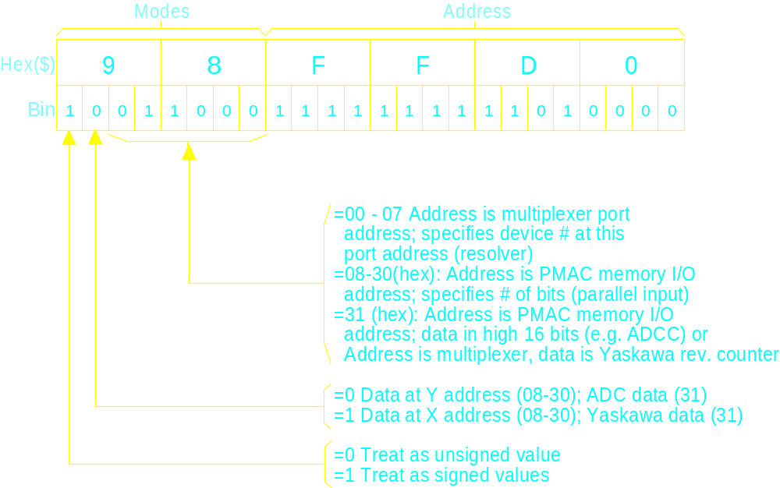
Diagram: Ix10 Address and Modes
Ix10 - Motor Absolute Power-On Position Address
[Ixx10 Address / Ixx95 Format]
Note: If Ix10=0, power-on position is set to 0
NEW IDEAS IN MOTION

Slide 110
Absolute Position Read on Power-Up
Power-up servo position read with Ix10
  Resolvers
  Absolute encoders
  Analog input devices
Geared resolver support with I9x and I8x
  I9x [Ixx99] is gear ratio of second to first resolver
  I8x [Ixx98] is gear ratio of third to second resolver
Power-up phase position read with Ix81
  Resolvers
  Absolute encoders
  Ix75 holds position offset
NEW IDEAS IN MOTION

Slide 111
PMAC Direct Register Mapping
Output A
DAC, PWM
Output B
DAC, PWM
Output C
PFM, PWM
Ix02
Control
AMP Enable
Ix25
Motor X
Calculation
Registers
Ix25
Status
Flags
Ix03
Ix04
Ix83
Ix82
ADC A
Current Feedback Signals
ADC B
Encoder
Conversion
Table
Position Feedback Signal
Encoder

Slide 112
PMAC/MACRO Station Register Mapping
Motor x Calculation Registers
MACRO Station Machine Interface Channel x Registers
Channel Interface Signals
Servo & Commutation Address
I-variables
Station SW1 Setting, Conversion Table, MI10x
PMAC MACRO Node n Registers
MACRO Station Node n Registers
MACRO Ring Connection
I996 bits 20-23 = Station SW2 Setting
Turbo: I6841, I6891, I6941, I6991 bits 20-23 = Station SW2 Setting
PMAC Node n = Station Node n
PMAC
MACRO Station
NEW IDEAS IN MOTION

Slide 113
PMAC MACRO Servo and Commutation Addressing
Flag Holding registers
Ix25 Flag Registers
I1000, I1002 (Turbo I70 - I77)
Ix02 Command Output
Command
Registers
0
1
2
3
MACRO OUT
Motor x Calculation Registers
PMAC Node n Registers
Feedback Registers
0
1
2
3
MACRO IN
Ix83 Commutation Feedback
Ix84 Current Feedback
Encoder Conversion Table
Ix03, Ix04 Servo Position Feedback
Table Entry
NEW IDEAS IN MOTION

Slide 114
PMAC/MACRO Station Node Matching
MACRO hardware automatically copies every phase cycle
Command (output) Registers
Command (input) registers
0
1
2
3
0
1
2
3
PMAC Node n Registers
Station Node n Registers
0
1
2
3
0
1
2
3
Feedback (input) Registers
Feedback (output) Registers
PMAC Node Master Number set by I996 bits 20-23
Station Node Master Number set by SW2
Turbo PMAC Node Master Number set by I6841, I6891, I6941, I6991 bits 20-23
Node Slave Number n automatically matches between PMAC and MACRO Station
NEW IDEAS IN MOTION

Slide 115
MACRO Station Node-to-Channel Mapping
Machine Interface Channel x Registers
Node n to Channel x mapping is determined by station SW1 setting
Output A
DAC, PWM
Output B
DAC, PWM
Output C
PFM, PWM
Control
AMP Enable
MACRO IN
0
1
2
3
Station Node n Registers
MACRO OUT
0
1
2
3
Status
Flags
ADC B
Current Feedback Signals
ADC A
Station Encoder Conversion Table MI120-MI151
Position Feedback Signal
MI10x
Encoder

Slide 116
Motor x Safety Variables
Ix11: Fatal Following Error Limit
(Units: 1/16 ct)
=0 disables
When exceeded:
    Coordinate system program aborted
    Motor(s) killed as set by Ix25 [Ixx24]
    bits 22 and 21
      (1x): This motor only
      (01): All motors in C.S.
      (00): All PMAC motors
NEW IDEAS IN MOTION

Slide 117
Motor x Safety Variables (continued)
Ix12: Warning Following Error Limit
(Units: 1/16 ct)
=0 disables
When exceeded:
    Sets motor and C.S. status bits
    Can set output and interrupt
    Can be used for trigger condition
NEW IDEAS IN MOTION

Slide 118
Motor x Safety Variables (continued)
Ix13: Software Positive Position Limit
Ix14: Software Negative Position Limit
(Units: counts, referenced to motor zero)
=0 disables
When exceeded:
    Aborts motion program or motor move
    Decelerates motor(s) at Ix15 rate
Ix15: Deceleration Rate on Abort or Limit
(Units: cts/msecs²; floating point)
DO NOT SET TO ZERO!
(MOTOR WOULD NOT DECELERATE)
!

Slide 119
Motor x Safety Variables (continued)
Ix16: Maximum Permitted Program Velocity
(Units: cts/msec; floating point)
  For linear blended program moves only
  (with I13=0)
  Limit scales with feedrate override (% value)
  Also serves as RAPID velocity if I50=1
NEW IDEAS IN MOTION

Slide 120
Motor x Safety Variables (continued).
Ix17: Maximum Permitted Program Acceleration
(Units: cts/msec²; floating point)
  For linear blended program moves only
  (with I13=0)
  Limit scales with feedrate override (% value)
  Of limited effectiveness (without special lookahead) when acceleration/deceleration requires more than one programmed move
NEW IDEAS IN MOTION

Slide 121
Motor x Safety Variables (continued)
Ix19: Maximum Permitted Jog/Home/Rapid Acceleration
(Units: cts/msec²; floating point)
  Can override TA (Ix20) and TS (Ix21)
  Used always if Ix20≅0 and Ix21≅0
NEW IDEAS IN MOTION

Slide 122
Motor x Motion Variables
Ix20 Acceleration Time (Jog, Home)
Ix21 S-Curve Time (Jog, Home)
V
Case 1: Ix21=0
Ix20
Ix20
T
NEW IDEAS IN MOTION

Slide 123
Motor x Motion Variables
Ix20 Acceleration Time (Jog, Home)
Ix21 S-Curve Time (Jog, Home)
V
Case 3: Ix20>2*Ix21
T
Ix21
Ix21
Ix21
Ix21
Ix20
Ix20
NEW IDEAS IN MOTION

Slide 124
Motor x Motion Variables
Ix20 Acceleration Time (Jog, Home)
Ix21 S-Curve Time (Jog, Home)
V
Case 2: Ix20<2*Ix21
T
Ix21
Ix21
Ix21
Ix21
2*Ix21
Note that Ix20 is not used
2*Ix21
NEW IDEAS IN MOTION

Slide 125
PMAC
“S” 曲线加速
加速度
2a
1.5a
a
0
TIME
MAX.
速度
0
t_{S}
t_{S}
TIME
t_{S}
t_{S}
TA

Slide 126
Motor x Motion Variables (continued)
Ix22: Jog Speed (Absolute value)
(Units: cts/msec; floating point)
Ix23: Home Speed (Sign is direction)
(Units: cts/msec; floating point)
Ix25: LIMIT/HOME/FAULT/AENA
[Ixx25, Ixx24] Flag Address and Modes
(See Separate Slide)
Ix26: Home Offset (Units: 1/16 ct)
Distance from home trigger (or absolute
sensor zero) to motor zero position
NEW IDEAS IN MOTION

Slide 127
Basic Jog Commands
J+ - Jog positive indefinitely
J- - Jog negative indefinitely
J/ - Jog stop (or close loop)
J= - Jog back to prejog (last programmed) position
J={constant} - Jog to specified position (in counts)
J^{constant} - Jog to specified distance from present actual position
J:{constant} - Jog specified distance from present
commanded position
Variables Ix19 through Ix22 control the jog. These may be changed on the fly, but do not take effect until the next jog command
NEW IDEAS IN MOTION

Slide 128
Variable Jog Commands
Variables Ix19 through Ix22 control the jog. These may be changed on the fly, but do not take effect until the next jog command
J=* - Jog to position (in counts) specified in variable jog register
J^* - Jog distance (from present actual) specified in variable jog register
J:* - Jog distance (from present commanded) specified in variable jog register
Mx72 is suggested M-variable for variable jog register
Example:
M172 = P1+500
#1J=*
NEW IDEAS IN MOTION

Slide 129
Jog Move Trajectory
Move Timer Active=0
Jog Stop
Vel
(if command was J+ or J-)
given (J/)
Move Timer Active=1
Move Timer Active=1
Desired Velocity Zero=0
In Position=0
Max Accel
Max Accel
Desired Velocity Zero=1
=Ix19
=Ix19
Running a Program=0
Ix22
In Position=1
(when FE in range)
Time
Ix21
Ix21
Ix21
Ix21
Jog Start
Ix20
Ix20
given (J+)
I12
I12
Note: If the jog command is not of
Note: Rate of acceleration
indefinite length (not J+ or J-) then
limited by Ix19 - can override
the "Running a Program" status bit will
Ix20 and Ix21
be high for the entire jog move
NEW IDEAS IN MOTION

Slide 130
PMAC Triggered Moves
Move relative to trigger-captured position
Three types of triggered moves:
  -Homing search move
  -On-line jog-until trigger
  -Program move-until-trigger (RAPID mode)
Two types of trigger:
  -Input trigger: Index and/or flag
  -Error trigger: Warning following error exceeded
Two methods of position capture:
  -Hardware capture: Immediate; encoder counter only
  -Software capture: Up to 1 background cycle delay
NEW IDEAS IN MOTION

Slide 131
Triggered Moves: Input Trigger vs. Error Trigger
Input Trigger (flag and/or index edge)
  -Ix03 bit 17 [Ixx97 bit 1] = 0 (default) selects
  -Ix25 specifies index/flag-set address
  -Enc/flag I-variable 2 [I7mn2] selects use/polarity of flag and/or index
  -Enc/flag I-variable 3 [I7mn3] selects which flag used
  -Flag “capture” status bit = 1 is trigger
Error Trigger (warning following error-WFE)
  -Ix03 bit 17 [Ixx97 bit 1] = 1 selects
  -Ix12 sets magnitude of WFE limit
  -Must select “software capture” (Ix03 bit 16 [Ixx97 bit 0] = 1)
  -Motor WFE status bit = 1 is trigger
NEW IDEAS IN MOTION

Slide 132
Triggered Moves: Hardware Capture vs. Software Capture
Hardware Capture
  -Ix03 bit 16 [Ixx97 bit 0] = 0 (default) selects
  -Requires input trigger, not error trigger
  -Requires position feedback through encoder counter
  -Requires position and flags from same hardware channel
  -Captures exact count at any speed
Software Capture
  -Ix03 bit 16 [Ixx97 bit 0] = 1 selects
  -Permits input trigger or error trigger
  -Any type of position feedback
  -Potential capture error proportional to speed
NEW IDEAS IN MOTION

Slide 133
Homing Search Move Trajectory
Vel
Trigger
Home Complete=1
Occurs
Home Search in Progress=0
Home Complete=0
Home Search
In Progress=1
Net distance from
Ix23
trigger position
= Ix26
Time
Ix21
Ix21
Ix21
Ix20
Desired Velocity Zero=1
Ix23
In Position=1
(when FE in range)
Note: Rate of acceleration
limited by Ix19 - can override
Ix21
Ix21
Ix21
Ix20 and Ix21
Ix20
Ix20
NEW IDEAS IN MOTION

Slide 134
Motor x Motion Variables (continued)
0°
315°
45°
2
ABS
….
A315
A45
1
Without rollover
1
180°
2
With rollover
Ix27: Position Rollover Range
(Units: cts)
For rotary axes (A,B,C) only
If Ix27>0, axis will make short move within range for ABS moves
(<=Ix27/2 counts)
NEW IDEAS IN MOTION

Slide 135
Motor x Motion Variables (continued)
Ix28: In Position Band (Units: 1/16 ct)
For indicator purposes only
A motor is “in-position” if:
    Closed loop
    Desired vel =0
    Prog timer off
    |FE|<Ix28
    Above conditions true for (I7+1) [Ixx88 +1]
    consecutive background scans
Example use in program:
X10 ;move
DWELL0 ;stop lookahead
WHILE(M140=0)WAIT ;while not in position
M1=1 ;action on in-position
NEW IDEAS IN MOTION

Slide 136
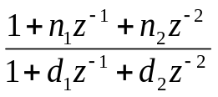

PMAC PID + Notch Servo Filter
K_{vff}(1-z⁻¹)
“Notch” Coefficients
n₁: Ix36
n₂: Ix37
d₁: Ix38
d₂: Ix39
+
Σ
K_{aff}(1-2z⁻¹+z⁻²)
+
Out to DAC
+
+
+
+
Reference
Position
Σ
K_{P}
Σ
Σ
-
+
-
IM
K_{d}
K
Velocity Loop Feedback
(Usually the same)
Position Loop Feedback
1
−
z
i
−
1
K_{P}: Proportional Gain (Ix30)
K_{d}: Derivative Gain (Ix31)
K_{vff}: Vel Feedforward Gain(Ix32)
K_{i}: Integral Gain(Ix33)
IM: Integration Mode (Ix34)
K_{aff}: Acceleration Feedforward Gain(Ix35)

Slide 137

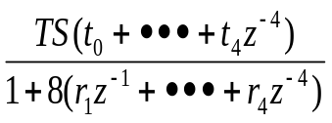


PMAC Extended Servo Algorithm
1-z⁻¹
Ix68
h₀+h₁(1-z⁻¹)
+
+
+
+
+
+
+
32 x Ix08
s₀
-
-
-
s₁(1-z⁻¹)
Sensor #1
Feedback Loop #1 Ix03
32*Ix08
Sensor #2
+
+
f₀
GS(g₀+g₁z⁻¹)
-
-
F₁(1-z⁻¹)
Feedback Loop #2 Ix04
32*Ix09
Sensor #1
Sensor #2

Slide 138
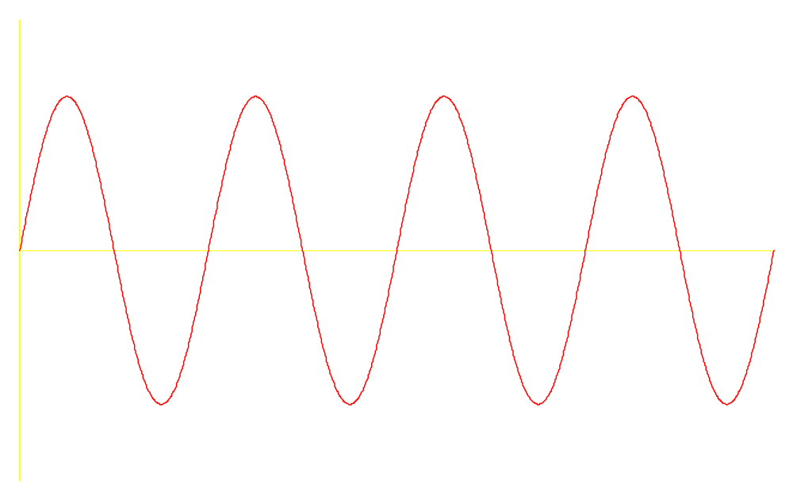
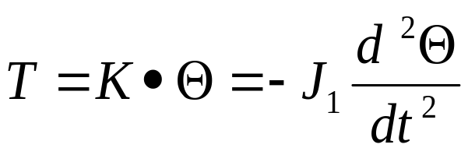
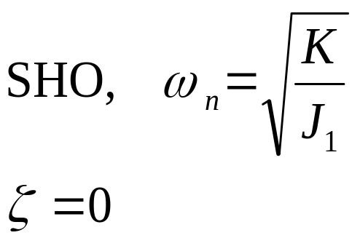
Proportional Control
K
J₁
Θ₂
T
Θ₁
Θ
t
SHO: Simple Harmonic Oscillator

Slide 139
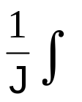


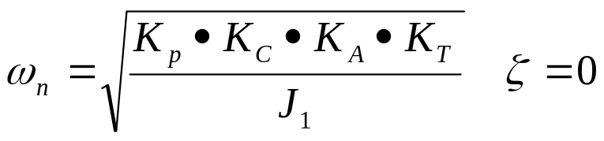
Proportional Control
T(t)
e(t)
Θ
+
K_{P}
K_{C}
K_{A}
K_{T}
-
This is an undamped SHO
  Thus the proportional gain K_{P} → spring stiffness
  Higher K_{P} → higher stiffness

Slide 140
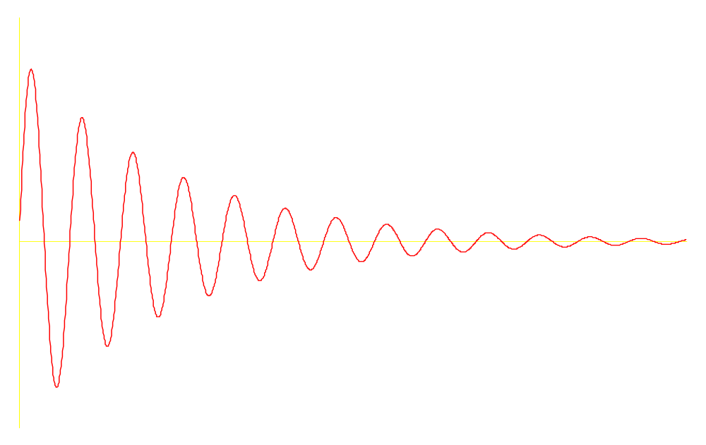
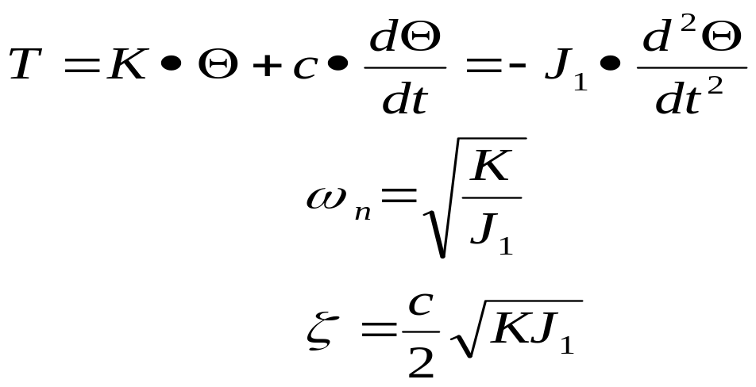
Derivative Control
K
J₁
Θ₂
T
Θ₁
c
Θ
t

Slide 141
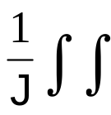
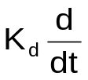
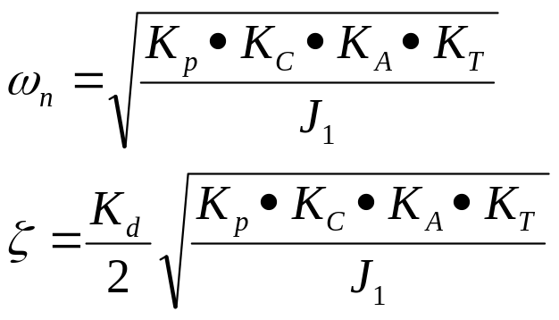
Derivative Control
e(t)
T(t)
+
+
Θ
K_{P}
K_{C}
K_{A}
K_{T}
-
-
This is a damped SHO

Slide 142
Integral Term
Without Integral:
F
mg
e
T(t)
Θ
+
+
K_{P}
K_{c}
K_{A}
K_{T}
-
-
m•g•r

Slide 143
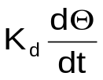
Errors at Steady State Due to Constant Speed Trajectory Tracking
e_{ss}=
Θ_{d}=V_{d}t
e
T(t)
Θ
+
+
K_{P}
K_{A}K_{c}K_{T}
-
-

Slide 144

Integral Term
e
T(t)
+
+
Θ
K_{P}
DAC
K_{A}
K_{T}
-
m•g•r
Therefore as t → ∞, e(t)→ 0

Slide 145
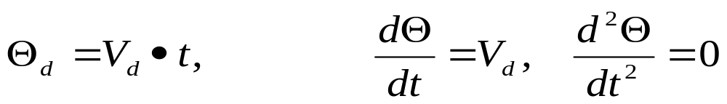
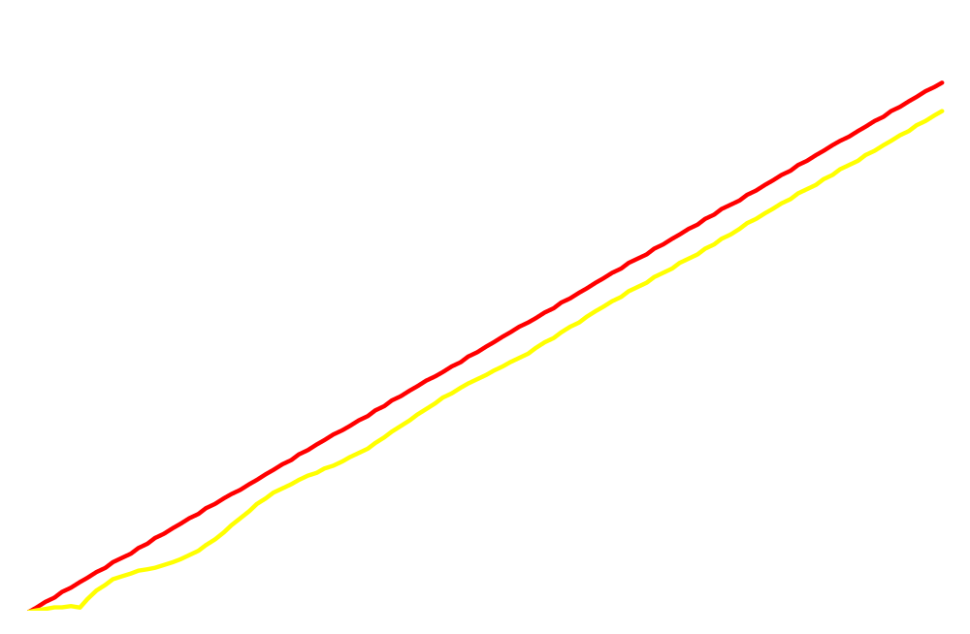
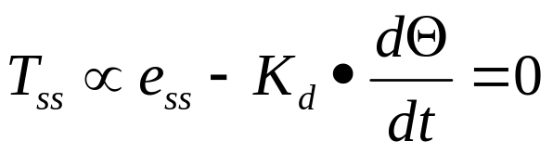
Errors at Steady State Due to Constant Speed Trajectory Tracking
Ramp Input:
Results(assuming friction = 0):
E_{ss} = K_{d}Θ

Slide 146

速度前馈的作用
K_{vff} = K_{d} →e_{ss}=0
由于恒速跟踪引起的不稳定误差

Slide 147

速度前馈
Θ_{d}=V_{d}t
e_{ss}= 0
T(t)
Θ
+
+
K_{P}
K_{A}K_{c}K_{T}
-
-

Slide 148

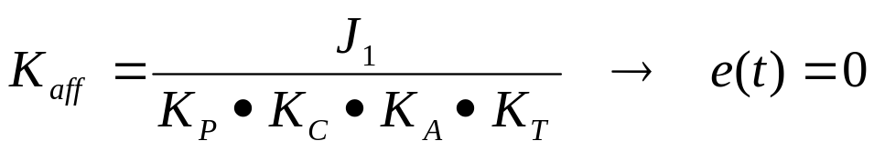
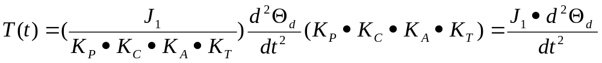
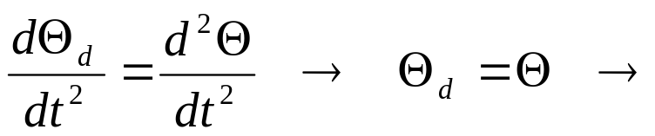
加速度前馈的作用
In general, the trajectories contain higher order time functions:
e.g.: Constant jerk trajectory
By choosing,
This results in no tracking error for the Ideal system.
Since,
No Tracking errors

Slide 149

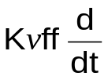
Acceleration Feedforward
Θ_{d}=V_{d}t
T(t)
Θ
+
+
K_{P}
K_{A}K_{c}K_{T}
-
-

Slide 150
Step Move Tuning

Slide 151
Step Move Tuning 1
POS
1/2 to 1/4
motor rev
Time
Commanded Position
POS
POS
1/2 to 1/4
1/2 to 1/4
motor rev
motor rev
Time
Time
Overshoot and Oscillation
Position Offset
Cause: too little Damping
Cause: Friction or Constant
or too much proportional gain
Force
P
Fix: Increase K (Ix31)
Fix: Increase K (Ix33)
d
i
Decrease K (Ix30)

Slide 152
Step Move Tuning 2
POS
1/2 to 1/4
motor rev
Time
Commanded Position
POS
1/2 to 1/4
1/2 to 1/4
motor rev
motor rev
Time
Time
Sluggish Response
Physical System Limitation
Cause: Too much Damping or
Cause: Limit of the Motor/Amplifier/Load
too little Proportional
and gain combination
P
Fix: Evaluate Performance and maybe
Fix: Increase K (Ix30) or
i
d
use more K (Ix30)
Decrease K (Ix31)

Slide 153
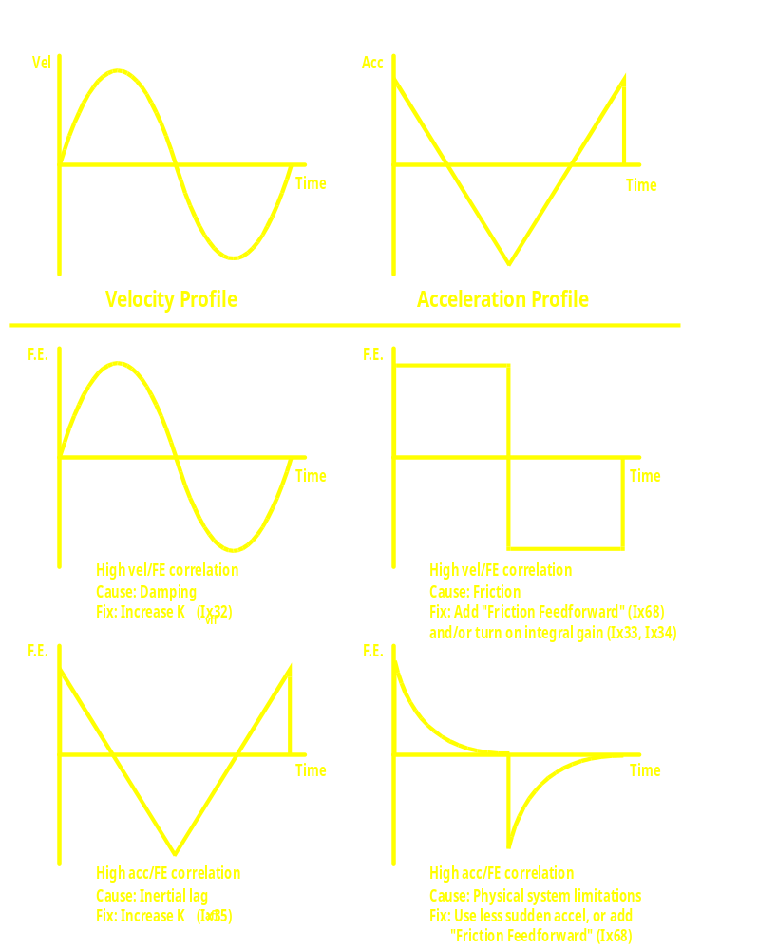
Parabolic Move Tuning

Slide 154
Parabolic Move Tuning (continued)
Vel
Acc
Time
Time
Velocity Profile
Acceleration Profile
F.E.
F.E.
Time
Time
Negative vel/FE correlation
High vel/FE correlation
Cause: Too much vel FF
Cause: Damping & Friction
vff
vff
F.E.
Fix: Decrease K (Ix32)
F.E.
Fix: Increase K (Ix32) first
Time
Time
Negative acc/FE correlation
Mod. vel/FE & acc/FE correlation
Cause: Too much acc FF
Cause: Inertial lag and friction
aff
aff
Fix: Decrease K (Ix35)
Fix: Increase K (Ix35) first

Slide 155
PMAC Current Limit Parameters
Ix69: Instantaneous Current Limit
    Saturation limit, no error
    Works as velocity limit for velocity-mode drives
Ix57: Continuous Current Limit
    Current values over Ix57 increase current integrator
    Current values under Ix57 decrease current integrator
    Measured current used in direct PWM mode
    Commanded current used in other modes
Ix58: Current Integrator Limit
    When current integrator exceeds Ix58:
      Motor killed as amplifier fault error
      “Integrated current fault” bit set also
NEW IDEAS IN MOTION

Slide 156
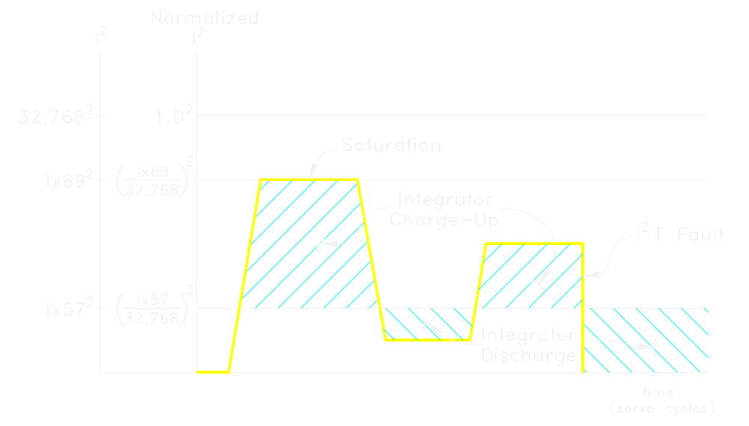
PMAC I²T Protection Feature
NEW IDEAS IN MOTION

Slide 157
Servo Loop Modifier Variables
Ix59: User-Written Servo/Phase Enable =0: Use standard PID phase algorithms =1: Use custom servo, standard
    phase algorithms
    =2: Use standard PID, custom phase algorithms
    =3: Use custom servo, phase algorithms
Ix60: Servo Cycle Extension Period Loop closed every (Ix60+1) servo interrupts
Useful for slow, low-resolution axes
Useful for process control “axes”
NEW IDEAS IN MOTION

Slide 158
Servo Loop Modifier Variables (continued)
Ix63: Integration Limit Maximum integrated error accumulated When negative, killed on saturation
Ix64: “Deadband Gain” Region of modified gain
Ix65: Deadband Size Region of modified gain
NEW IDEAS IN MOTION

Slide 159

PMAC Dead Band Compensation
Total Dead band set by Ix65 in units of 1/16 count ( a value of 16 is actual encoder count)
Proportional Gain Set by value of Ix30
n>0 Provides stiffer servo when
near in-position
To create or overcome dead band
Error Output
n=0 disables any deadband effect
Desired Position
n<0 Reduces gain when near in-position
(n=-16 provides true deadband)
n<-16 provides negative gain when near in-position (This is of no known use)
n=16
n=0
Following Error
n=-16
n=-32
Dead Band Gain Control
Ix64=n
Where deadband gain = *Ix30
DEAD BAND
GAIN
DEAD BAND
NO GAIN DISCONTINUITIES
n=16
n=0
Ix30
n=-16
FOLLOWING
ERROR

Slide 160
Servo Loop Modifier Variables (continued)
Ix67: Position Error Limit Limits error that filter “sees”
Ix68: Direction-Sensitive Bias “Friction Feedforward”
Ix69: Output Command (DAC) Limit Limits output of filter
    Acts as torque (current) limit if commutating
NEW IDEAS IN MOTION

Slide 161
PMAC PID Servo Loop Modifiers
"Friction
SIN
Θ
Phase A Bias
Command
Feedforward"
Velocity
1
1-Z
-1
-1
SIN
(Θ−Φ)
Ix29
Position
Error Limit
Ix68
Phase B Bias
Input
Deadband
Compensation
"Big Step”
Output
Ix79
Command
Limit
Limit
(Ix01=1)
DAC Bias
Position
+
+
+
+
P
-
+
-
+
Ix02
=
Ix29
Ix64,65
Ix67
Ix69
Bit 16
Actual
Integration
Mode
1
Position
Integration
D
Cmd Vel = 0?
Limit
Ix79
Ix34
Ix29
I
Motor Position
Ix63
Load Position
NEW IDEAS IN MOTION

Slide 162
Closing a Force Loop Around a Position Loop
Motor 2 (Position Loop)
Commanded
Force Loop
Force
Output Command
Trajectory
+
(to open register)
Σ
PID
(this is usually a
dt
-
velocity command)
Master
Position Loop
Position
Output Command
Actual
Signal
(to open register)
Force
Commanded
+
Signal
Motor 1 (Force Loop)
Position
+
PID
DAC
AMP
Trajectory
Actual
-
M
Motor
Position
ENC1
Signal
E
Encoder
SG
Strain Gage
ADC1
I102 = $07F0 (Open Y register $07F0)
I202 = $C003 (DAC1)
I103, I104 = $072A (Converted ADC1)
I203, I204 = $0720 (ENC1)
I105 = $072B (Converted ADC2)
I205 = $1072D to use integrated force
command superimposed on
position trajectory
Conversion Table to do integration
Example
Set up: WY$072C, $5007F0,$0
Conversion Table must process all
Result in X:$072D
encoders and ADCs that are used

Slide 163
为什么需要换向整流控制 ?
电机需要AC交流电流定相
DC直流控制电机
Commutation switches direction of current in motor
phases to maintain desired torque direction
Optionally, it also controls magnitude of current in
motor phases to maintain desired torque level
有刷电机机械换向
无刷电机电子换向
NEW IDEAS IN MOTION

Slide 164
PMAC的整流控制?
不需要将位置反馈到驱动器上
驱动器更简单经济
高效能的正弦整流算法
同步电动机使用增量编码器信号整流
感应电机由伺服驱动器做矢量控制
反馈丢失或反向会引起转矩减小,而不会引起飞车
NEW IDEAS IN MOTION

Slide 165
电机的电枢和励磁
电枢
  大电流（快速变化）
  在有刷电机的转子上
  在无刷电机的定子上
励磁绕组
  小电流（ 慢速变化）
  在有刷电机的定子上
  在无刷电机的转子上
NEW IDEAS IN MOTION

Slide 166
整流: 转子励磁控制
电机励磁有两种方式：
  永磁体: aligned electron “spin”
  Electromagnet: circulating electric current
Rotor magnetic field strength (λ_{R}) determines:
  Torque constant K_{T} : (T=K_{T}I_{A})
  Back EMF constant K_{E} : (E=K_{E}ω)
(Note: EI=Tω, so K_{T}=K_{E})
Electromagnetic rotor field strength can be varied
dynamically
  Strong field for high-torque at low speed
  Weak field for low back EMF at high speed
  Technique is called “field weakening”
  Creates “software transmission”
NEW IDEAS IN MOTION

Slide 167
Motor Torque Capabilities – Constant Field
Torque
T
Current-Limited
Voltage
Limited
K_{T}I
Speed 
Voltage
V
DC Supply Voltage
Voltage
Limited
IR
K_{E}
K_{E} 
Speed 

Slide 168
Motor Torque Capabilities – Varying Field
Torque
T
K_{T1}I
K_{T2}I
K_{T3}I
Speed 
Voltage
V
V_{DC}
K_{E2}
K_{E3}
K_{E1}
Speed 

Slide 169
What Is Vector Control?
Commutation algorithm applied to induction motor
provides positioning servo motor capability
AKA “flux vector control”, “field oriented control”
Two issues not present in permanent magnet brushless
motors:
  Must induce rotor current for electromagnetic field
  Must create “slip” between rotor field and rotor
  mechanics
Rotor field strength dynamically controllable by
“magnetization current” parameter
“Slip gain” parameter must be set to match motor
dynamics
NEW IDEAS IN MOTION

Slide 170
Induction Motor Principle of Operation
Open loop (w_{e}=const):
Load torque => decel =>
slip => motor torque
T
Closed loop:
Desired Motor torque =>
slip => motor torque
Linear torque/slip
relationship
60
50
40
30
20
10
0
w_{s}=w_{e}-w_{m} (Hz)
0
300
600
900
1200
1500
1800
w_{m} (rpm)

Slide 171
为什么要用矢量控制?
Induction motors are a substantial cost benefit,
especially in large sizes
Induction motors are available in very large sizes
Induction motors are very rugged
Induction motors cannot be demagnetized
Technique eliminates most possible runaway conditions
Field strength control permits flexible torque/speed
range
NEW IDEAS IN MOTION

Slide 172
PMAC Commutation Algorithm
I. Compute rotor field orientation
A. Synchronous motor
1. Read encoder position
2. Compare to reference position
(power-on or absolute)
B. Asynchronous motor
1. Read encoder position
2. Compute slip frequency
3. Add slip advance to rotor position
N
Rotor
S
Stator
NEW IDEAS IN MOTION

Slide 173
PMAC Commutation Algorithm
II. 分配定子电流
  A. Torque command (“quadrature”)
  current
  Magnitude from servo filter or
  open loop
  Aligned perpendicular to rotor field
  B. Magnetization (“direct”) current
  Used mainly for induction motors
  Aligned parallel to rotor field
  C. Components added vectorially
B
C
A
N
Rotor
S
Stator
NEW IDEAS IN MOTION

Slide 174
PMAC Commutation Algorithm
B
III. Align Current to Phases
A. Graphically, drop perpendicular
to each phase line from net
current vector
B. Mathematically, take dot product
of net current vector and each
unit phase vector
C. Only compute 2 phases; 3rd
(&4th) phase(s) can be generated
by balance loop
I
B
I
C
I
A
A
C
NEW IDEAS IN MOTION

Slide 175
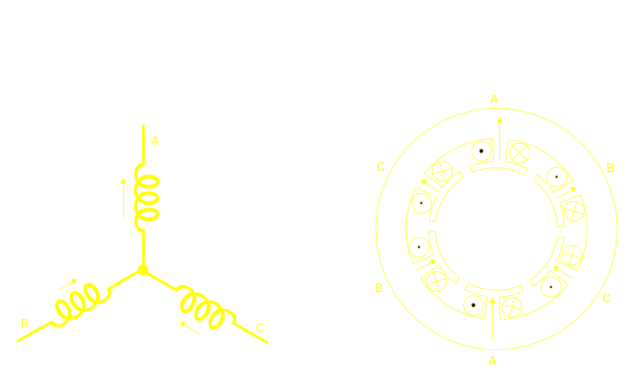
Relationship of Winding Diagram to Actual Motor Winding

Slide 176
PMAC/PMAC2 Commutation with Analog Current Loop
DC
AC
Magnetization
I
'
'
+
d
I
a
DAC
PI
V
a
PWM
v
a
Current
Direct Current
Ix77
Command
dq
-
I
a
to
Phase A Current Loop
Torque Command
I
'
abc
+
q
I
'
V
v
from Position/
b
DAC
PI
b
PWM
b
E
Velocity Servo
Quadrature
-
I
b
Current Command
Θ
e
Phase B Current Loop
-
-
Ix78
SG
-
-
V
c
PWM
v
c
-
+
+
Θ
r
Balance Loop
1/s
+
PMAC
Amplifier
NEW IDEAS IN MOTION

Slide 177
PMAC2 Commutation with Digital Current Loop
DC
AC
I
V
V
v
a
Magnetization
d
+
+
d
a
Current
Direct Current
PI
PWM
Ix77
Command
-
-
dq
V
b
v
b
P
to
PWM
E
abc
V
q
V
c
v
PWM
c
Direct Current Loop
Θ
Torque Command
I
q
+
+
I
d
I
a
i
a
from Position/
PI
ADC
Velocity Servo
Quadrature
-
-
abc
Current Command
to
P
I
q
dq
I
i
b
ADC
b
Quadrature Current Loop
Θ_{e}
SG
1/s
+
+
Θ_{r}
Ix78
PMAC
Amplifier
NEW IDEAS IN MOTION

Slide 178
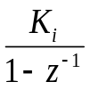
PMAC2 数字电流环
Forward Path
PWM
Current
Command
Proportional
Scale
Gain
Factor
Voltage
+
K_{pf}
+
U
Ix66
Command
(I’_{d} or I’_{q})
Prescaled to range
-1.0< I < 1.0
+
(V_{d}or V_{q})
-
+
-1.0 < U < 1.0
K_{pb}
Back Path
Proportional
Integral
+
Gain
Gain
Measured
Current
(Id or Iq)
K_{pb}= Ix76•4 (0.0 <Ix76 <1.0)
K_{pf}=Ix62•4 (0.0< Ix62<1.0)
K_{i}=Ix61•8 (0.0< Ix61 <1.0)

Slide 179
PMAC2 Digital PWM Generation (单相)
New Command Loaded
Ix66
at Counter Turnaround
I900+1
PWM
or
Command
I906+1
PWM
PWM
Command
Counter
Range
Range
Time
4xI900+6
Servo
PWM_CLK
Interrupt
Cycles
PWM
Generated
-I906-2
Up/Down
Here
or
Counter Clock is 120MHz
Counter
-I900-2
-Ix66
PWM
Top Signal
PWM
Bottom Signal
Deadtime
(I904 or I908)
NEW IDEAS IN MOTION

Slide 180
Why Digital Current Loop in PMAC?
All calculations in same processor minimizes delays
  • Higher gains possible
  • Greater stiffness, bandwidth, acceleration
DC (field frame) loop closure
  Minimizes high frequency problems
  Permits higher maximum velocity
No control functions in drive
  No pot tweaking or personality modules
  No “laptop tuning”
  Drive selected for power level only
NEW IDEAS IN MOTION

Slide 181
Motor x Commutation Variables
Ix70: Number of Commutation Cycles
Ix71: Counts per Ix70 Commutation Cycles
Counts/Electrical Cycle=Ix71/Ix70
EXAMPLE: 1 pole pair, 4096 cts/mech rev
=>Ix71/Ix70 = 4096/1
2 pole pairs, 4096 cts/mech rev
=>Ix71/Ix70 = 4096/2 = 2048/1
3 pole pairs, 4096 cts/mech rev
=>Ix71/Ix70 = 4096/3
NEW IDEAS IN MOTION

Slide 182
Motor x Commutation Variables (continued)
B
Ix72: Commutation Phase Angle
Angle between A & B phases
Non-Turbo: 1/256 commutation cycle
[Turbo: 1/2048 commutation cycle
3 phases: 85 or 171 [683 or 1365]
2 or 4 phases: 64 or 192 [512 or 1536]
B
64
[512]
A
85
[683]
A
A
A
192
[1536]
B
171
[1365]
B
NEW IDEAS IN MOTION

Slide 183
Phase Referencing I-Variables
For synchronous motors with incremental sensors only
Ix73: Phasing Search Command Output
Magnitude of searching effort
Ix74: Phasing Search Time
Duration of search
For synchronous motors with absolute sensors
Ix81: Power-On Commutation Feedback Address & Mode [Ixx81, Ixx91] Location and format of absolute sensor
Ix75: Phasing Offset (units: counts)
Difference between sensor zero and commutation zero
NEW IDEAS IN MOTION

Slide 184
Induction Motor Setup Variables
Ix77: Magnetization Current Sets rotor field strength (&K_{T}, K_{E}) Required for induction motor field
Can be used on top of permanent magnet field
Ix78: Slip Gain Relationship between commanded torque and slip frequency Must be zero for synchronous motors
NEW IDEAS IN MOTION

Slide 185
Ix79: 2nd Phase Bias (DAC bits) [Ix29: 1st Phase Bias (DAC bits)]
Ix80: Power-on Mode (whether commutated or not) 0,2= not enabled, requires enabling command
1,3= enabled immediately 0,1= “Two-Guess” phasing search 2,3= “Stepper-Motor” phasing search
Ix82: Current-Loop Feedback Address [PMAC2 only]
If zero, current loop not closed in PMAC
Ix83: Ongoing Commutation Feedback Address
NEW IDEAS IN MOTION

Slide 186
Phase Referencing of Brushless Motors
I. Power-On Phasing Search
A. Two Guess Method (Ix80=0,1)
      Arbitrary guess of phase reference
      Open loop command, measure acceleration
      Change guess 90⁰, repeat
      Calculate phase reference from accelerations
    B. Stepper Motor Method (Ix80=2,3)
      Drive like stepping motor with phase bias terms
      Bias terms control phase current magnitude
      Drive to zero position in phase cycle in two steps
      Force phase angle register to zero
Ix73 controls magnitude; Ix74 controls time
NEW IDEAS IN MOTION

Slide 187
Phase Referencing of Brushless Motors (continued)
II. Absolute Power-On Referencing
A. Phase Search on Assembly
      Use second search method above
      (end at zero position of phase cycle)
      Read absolute sensor at this position
      Set Ix75=-Pos/Ix70 (offset term)
    B. No-Movement Referencing at Power-On
      PMAC automatically reads absolute sensor to do
      phase referencing at power-on
      Ix81 specifies address of sensor
      Ix75 added to sensor position to get phase position
NEW IDEAS IN MOTION

Slide 188
PMAC Phase Referencing Methods
Correction
Required
Method
Repeatability
Notes
Hall Sensor
Read
+/- 30°e
Yes
Correct on 1st Hall edge or index
Resolver
Read
+/- 3 cts
No
Reference established by stepper or
symmetry search
Abs Encoder
Read
+/- 1 ct
No
Reference established by stepper or
symmetry search
Two Guess
Search
Two Guess
Search
+/- 5-10°e
+/- 5-10°e
Maybe
Requires low external loads
Slight movement
Stepper
Search
+/- 1-2°e
Maybe
Up to 1/2-cycle movement
Symmetry
Search
+/- 1 ct
No
“Fine Phasing” - Not feasible in actual
applications; only to establish reference

Slide 189
PMAC 补偿表
标准螺距补偿
e.g. Δx=f(x)
Get linear encoder accuracy (almost!) with rotary encoder
Characterize system with linear sensor
Enter errors into PMAC
Δx
Δx
Δx
Δx
Δx
E
M
DEFINE COMP 200, #1, #1, 100000
Table Length
Table Span in Counts
源电机
目标电机
NEW IDEAS IN MOTION

Slide 190
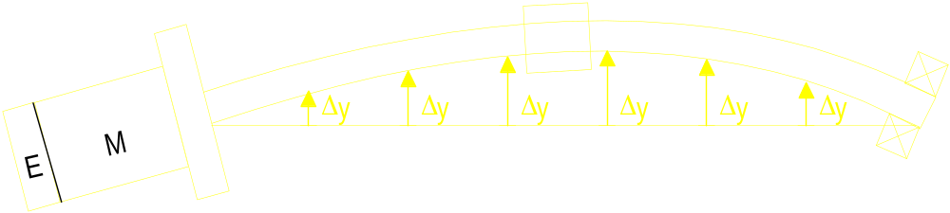
PMAC Compensation Tables
Cross-axis compensation
  e.g. Δy=f(x)
Useful for bowed leadscrews
Can be used to build electronic cam tables
DEFINE COMP 100, #1, #2, 100000
Table Length
Table Span in Counts
Source Motor
Target Motor
NEW IDEAS IN MOTION

Slide 191
PMAC 补偿表
2D (平面) 转换表:
e.g. Δz=f(x,y)
Δz
Δz
DEFINE COMP 20. 15, #1, #2, #3, 20000, 15000
Table columns
2nd motor span in counts
Table rows
1st motor span in counts
1st source motor
Target motor
2nd source motor
NEW IDEAS IN MOTION

Slide 192
PMAC Compensation Tables
Used for laser marking systems
uncompensated
compensated
L2
Y
L1
X
Table 1: Δy=f(y)=arctan(y/L2)-(y/L2)
Table 2: Δx=f(x,y)=arctan[x/(L1+√ L2²-y²)]-[x/(L1+L2)]
NEW IDEAS IN MOTION

Slide 193
PMAC Motor Backlash Parameters
Ix86: Backlash Size (1/16 count)
    Added {hidden} position change on reversal
Ix85: Backlash Take-Up Rate (1/16 count/background cycle)
    Rate of change of backlash on reversal
    Set as high as possible without rough transition
I99: Backlash Hysteresis (1/16 count) (global)
[Ixx87] Required size of reversal before backlash change
    Set non-zero to prevent dithering
NEW IDEAS IN MOTION

Slide 194
PMAC Motor Backlash Tables
#x DEFINE BLCOMP {#entries}, {count span}
  Position-dependent backlash
  Added to Ix86 {constant} backlash
  Table backlash is zero at motor zero
  Used with COMP table for bidirectional compensation
NEW IDEAS IN MOTION

Slide 195
Coordinate System Concept
A coordinate system is a set of motors grouped together to achieve coordinated motion
Motors requiring independent motion should be in separate coordinate systems
Coordinate systems execute motion programs
Motors assigned to coordinate system by “axis definition statement”
NEW IDEAS IN MOTION

Slide 196
PMAC Axis Definition Statement
&1 {addresses C.S.}
#1->X {mapping of motor to axis in C.S.}
#1->10000X {scale factor defines X user units}
#1->10000X+5000 {fixed offset between motor and axis zero points}

Slide 197
PMAC Coordinate Definition
Scaling and Translation
Y
(in)
cts
#1->10000X+40000
#2->10000Y+20000
Motor#2 (10,000 )
in
4”
X(in)
2”
cts
Motor#1 (10,000 )
in
NEW IDEAS IN MOTION

Slide 198
PMAC Coordinate Definition (continued)
Scaling and Rotation
#1->7071.07X-7071.07Y
#2->7071.07X+7071.07Y
cts
Motor#2 (10,000 )
in
Y(in)
X(in)
45º
cts
Motor#1 (10,000 )
in
NEW IDEAS IN MOTION

Slide 199
PMAC Coordinate Definition (continued)
Orthogonality Correction
Y(in)
cts
Motor#2 (10,000 )
in
#1->10000.00X-2.91Y
#2->10000.00Y
X(in)
1 arc min
(exaggerated)
cts
Motor#1 (10,000 )
in
NEW IDEAS IN MOTION

Slide 200
Kinematic Calculations with Turbo PMAC
Allows you to
Program Tip
Motion Directly
Y
Tip, (X,Y)
L₂
Inverse Kinematics
B
C
L₁
X²+Y²-L₁²-L₂²
2L₁L₂
B = +cos⁻¹
A
X
A+C = atan 2(Y,X)
Forward Kinematics
X²+Y²+L₁²-L₂²
2L₁ X₂+Y₂
X = L₁cos(A) + L₂cos(A+B)
Y = L₁sin(A) + L₂sin(A+B)
C = +cos⁻¹
A = (A+C) - C
Calculates tip position
Based on A, B, L₁ & L₂
Calculates A & B Angles
Based on X & Y Tip Position

Slide 201
Kinematic Subroutines in Turbo PMAC
&1
OPEN FORWARD
CLEAR
Xaxispos = f₁ (Motor1pos, Motor2pos)
Yaxispos = f₂ (MotorIpos, Motor2pos)
CLOSE
OPEN INVERSE
CLEAR
Motor1pos = g₁ (Xaxispos, Yaxispos)
Motor2pos = g₂ (Xaxispos, Yaxispos)
CLOSE
MotorNPos is stored in variable PN
A,B,C,U,V,W,X,Y, Zaxispos stored in variable Q1-Q9 for C.S.

Slide 202
Motor-to-Axis Conversion Without Forward-Kinematic Program
Motor Pos. Axis Pos.
Motor 1: 5000 #1->1000X X=5
Motor 2: 10000 #2->1000Y Y=10
(executed on PMATCH)
Axis Definition
Equations
Motor-to-Axis Conversion With Forward-Kinematic Program
Motor Pos. Axis Pos.
Motor 1: 5000 (P1=5000) (Q7=f1[P1,P2]) X=(Q7)
Motor 2: 10000 (P2=10000) (Q8=f2[P1,P2]) Y=(Q8)
Forward-Kinematic
Algorithm

Slide 203
Axis-to-Motor Conversion Without Inverse Kinematics
Axis Pos. Motor Pos.
X10 Y20 #1->1000X Motor 1: 10000
#2->1000Y Motor 2: 20000
(executed every move / segment)
Axis Definition
Equations
Axis-to-Motor Conversion With Inverse Kinematics
Axis Pos. Motor Pos.
X10 Y20 (Q7=10) #1->I (P1=f1[Q7,Q8]) Motor 1: (P1)
(Q8=20) #2->I (P2=f2[Q7,Q8]) Motor 2: (P2)
Inverse-Kinematic
Algorithm

Slide 204
PMAC Axis Properties
Permitted Axis Names: X,Y,Z,U,V,W,A,B,C
All axes support mapping, scaling, and offset
X,Y,Z: Traditionally Main Linear Axes
  Matrix Axis Definition
  Real Time Matrix Axis Transformation
  Circular Interpolation
  Cutter Radius Compensation
NEW IDEAS IN MOTION

Slide 205
PMAC Axis Properties (continued)
U,V,W: Traditionally Secondary Linear Axes
  Matrix Axis Definition
A,B,C: Traditionally Rotary Axes
  (A rotates about X, B about Y, C about Z)
  Position Rollover (Ix27)
NEW IDEAS IN MOTION

Slide 206
Multiple Axis Definitions
&1
#1->X
&2
#2->X
{
This is permitted.
The two motors will act as
X-axes in independent
coordinate systems.
{
This is permitted.
The motors will act on identical
X-axis trajectories, as in a
gantry system.
&1
#1->X
#2->X
NEW IDEAS IN MOTION

Slide 207
Multiple Axis Definitions (continued)
{
This is NOT permitted.
The second axis definition
command will cancel out
the first.
&1
#1->X
#1->Y
&1
#1->X
&2
#1->X
{
This is NOT permitted.
The motors could receive conflicting
commands. PMAC will reject the
second definition.
NEW IDEAS IN MOTION

Slide 208
Programmable Axis Offsets
Axis origin for programming purposes can be changed
Change made by redefining present commanded position
On-Line command {axis}={constant}
e.g. X=10 Y=20
Buffered motion program command PSET {axis}{data}…
e.g. PSET X10 Y(P1)
These commands change “position bias” register–difference
between motor origin and axis origin
Also possible to write directly to position bias register (must
then use PMATCH command to re-align motor and axis)
NEW IDEAS IN MOTION

Slide 209
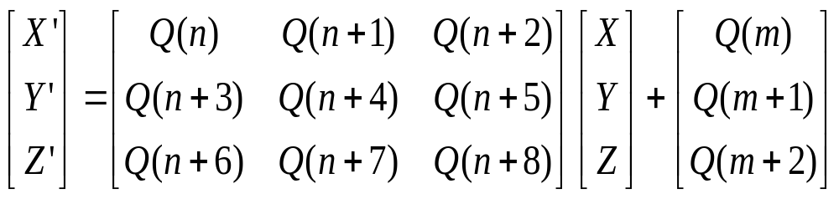
Axis Matrix Transformations
Working from base coordinate definition:
Rotation Matrix
Displacement
Vector
AROTn : Absolute Rotation
ADISm : Absolute Displacement
NEW IDEAS IN MOTION

Slide 210
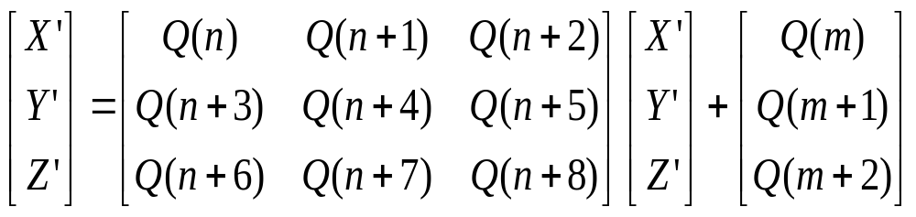
矩阵轴转换
Working from present transformed coordinates:
Rotation Matrix
Displacement
Vector
IROTn : Incremental Rotation
IDISm : Incremental Displacement
NEW IDEAS IN MOTION

Slide 211
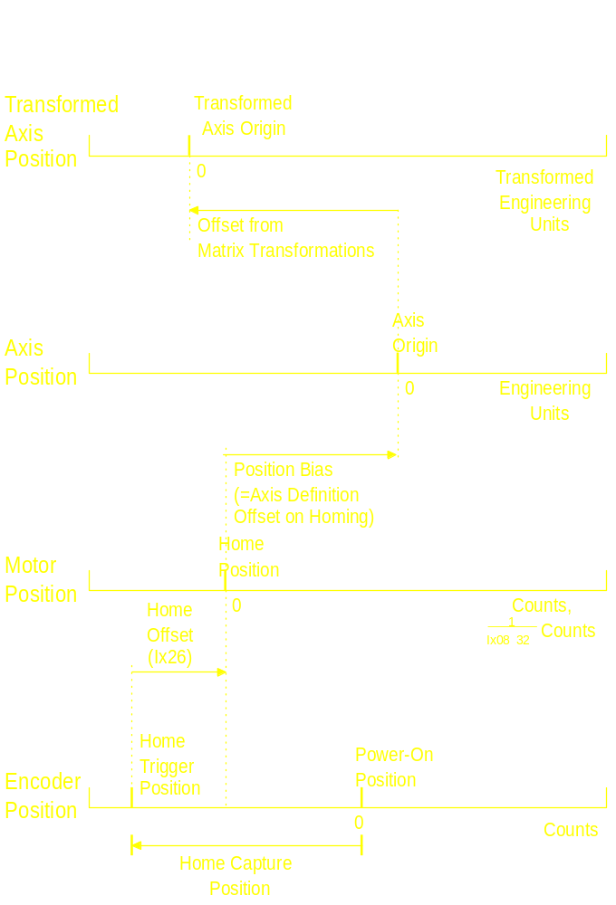
PMAC Position Scales

Slide 212
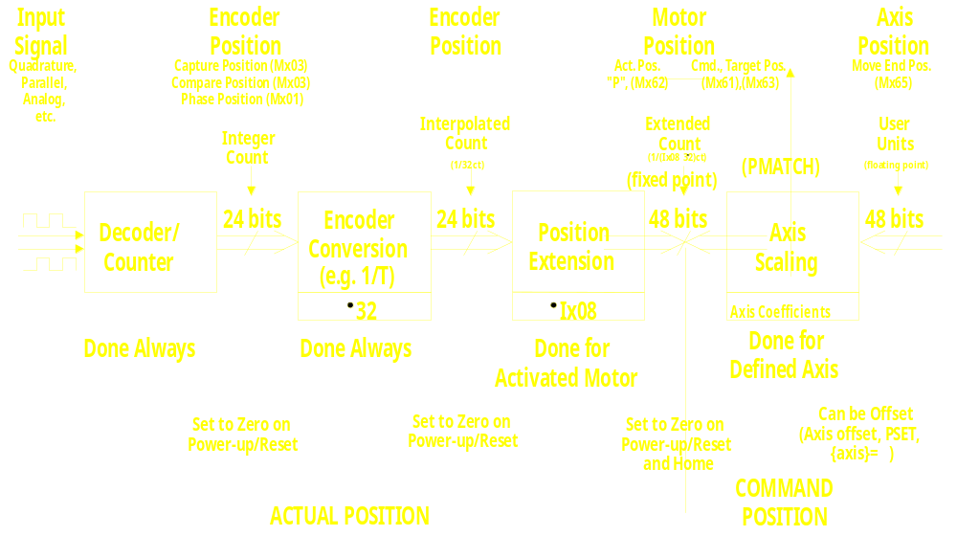
PMAC 位置处理
Transformed
Axis Pos.
User
Units
(floating point)
Axis
Transformation
MATRIX
48 bits
NEW IDEAS IN MOTION

Slide 213
PMAC Motion Programs
Automatic sequenced execution of motions
Program math and logic executed with move sequence (at move boundaries)
Motion statements like machine tool “G codes”
Math and logic statements like BASIC
Program run by a coordinate system
Axes commanded in engineering units
NEW IDEAS IN MOTION

Slide 214
PMAC PLC Programs
Automatic repetitive execution of non-motion commands
For actions not synchronous with programmed motion sequence
Math and logic statements like BASIC
NEW IDEAS IN MOTION

Slide 215
PMAC Motion Program Statements
Move Commands
X1000 Y2000 Z3000
U(P1*3.14159) V(20*SIN(Q6))
DWELL, DELAY
Modal Commands
ABS, INC, FRAX, NORMAL
LINEAR, RAPID, CIRCLEn, SPLINEn, PVT
TA, TS, TM, F
Variable Value Assignment
{variable} = {expression}
NEW IDEAS IN MOTION

Slide 216
运动程序逻辑控制
分枝: IF ({condition})
[ELSE]
ENDIF
循环: WHILE ({condition})
ENDWHILE
标志 N {constant}
O {constant}
子程序: GOSUB {data}
CALL {data}
G, M, T, D
RETURN
跳转: GOTO {data}
NEW IDEAS IN MOTION

Slide 217
Motion Program Move Sequencing
程序运算开始于下一中断周期结束后:
  1) 接受运行指令
  2) 当运行（插补）到新程序块（Block）时，
  块请求标志被设定。
NEW IDEAS IN MOTION

Slide 218
Motion Program Move Sequencing (continued)
程序运算持续到:
  1) 下一个运动, DELAY or DWELL is found
  and computed (块请求标志被清除;Calculation
  resumes after next Block Request flag)
  2) Two jumps back in program are found
    a) ENDWHILES (including implied)
    and/or
    b) GOTO’s to higher lines
    (Block Request flag is left set;
    Blending is disabled;
    Calculations resume after move stops;
    if stopped already, resume at next RTI)
NEW IDEAS IN MOTION

Slide 219
Motion Program Sequencing Example
X0 Y0
Q1 = Q10 * COS(Q20)
Q2 = Q10 * SIN(Q20)
X(Q1) Y(Q2)
WHILE (M11=0)
ENDWHILE
X(-Q1) Y(-Q2)
IF (M12=1)
Q3=100
ELSE
Q3=50
ENDIF
DWELL (Q3)

Slide 220
Observing the PMAC “Double Jump Back” Rule
P1=1
WHILE (P1<11)
P2=0
WHILE (P2<360)
P3=10+P1*COS(P2)
X(P3)
P2=P2+10
ENDWHILE
P1=P1+1
ENDWHILE
P1=1
WHILE (P1<11)
P2=0
WHILE (P2<350)
P3=10+P1*COS(P2)
X(P3)
P2=P2+10
ENDWHILE
P3=10+P1*COS(P2)
X(P3)
P1=P1+1
ENDWHILE
(Blending stops each time
inner loop is exited: two Endwhile encountered before next move)
(Blending is continuous thru entire
example)
NEW IDEAS IN MOTION

Slide 221
PMAC Motion Program Execution
Active Registers
Calculating
Suspended
Here
At Program Calculation Time
•••
X5 Y5
LINEAR
F10 TA50
M1=1
P1=P2*SIN(P3)
M2==1
SEND ”P1=“
CMD ”P1”
X(P1) Y10
F20
•••
At Program Calculation Time
At Move
Execution
Time
}
Output
Queue
At Program Calculation Time
At Move
Execution
Time
Motion
Equation
Queue
Interpolation
Registers
}
}
At Program Calculation Time
}
}
Command
Queue
Executed next
Background
cycle
At Program Calculation Time
Response
Queue
Read by
Host Computer
at will
NEW IDEAS IN MOTION

Slide 222
“n” moves ahead for Blended Moves
PMAC Motion Program Precalculation
2
3
4
"R"
1
Execute
n+2
n+3
n+4
time
1
n
n+1
Calculate
How big is “n”?
0 for point-to-point moves, no radius compensation
Add 1 for blending
Add 1 for basic acceleration control
Add 1 for Cutter radius compensation
As big as necessary to cover stopping distance for robust acceleration control
NEW IDEAS IN MOTION

Slide 223
No moves ahead Ix92=1, RAPID, HOME, DWELL, “S”
PMAC Motion Program Precalculation
"S"
1
2
2
3
Execute
"R"
a
I11
I11
DWELL
I11
time
2
2a
time
3
Calculate
1
NEW IDEAS IN MOTION

Slide 224
Example 1: A Simple Move
This example shows how to program a simple move on the program specifies how to do the move, then commands the move.
********************* Set-up and Definitions *********************
DEL GAT ; Erase any defined gather buffer
&1 ; Coordinate System 1
CLOSE ; Make sure all buffers are closed
#1->X ; Assign motor 1 to the X-axis - 1 program unit
; of X is 1 encoder count of motor #1
********************* Motion Program Text *************************
OPEN PROG 1 ; Open buffer for program entry, Program #1
CLEAR ; Erase existing contents of buffer
LINEAR ; Blended linear interpolation move mode
ABS ; Absolute mode - moves specified by position
TA500 ; Set 1/2 sec (500 msec) acceleration time
TS0 ; Set no S-curve acceleration time
F5000 ; Set feedrate (speed) of 5000 units(cts)/sec
X10000 ; Move X-axis to position 10000
DWELL500 ; Stay in position for 1/2 sec (500 msec)
X0 ; Move X-axis to position 0
CLOSE ; Close buffer - end of program
To run this program:
&1 B1 R ; Coord. System 1, point to Beginning of Program 1, Run

Slide 225
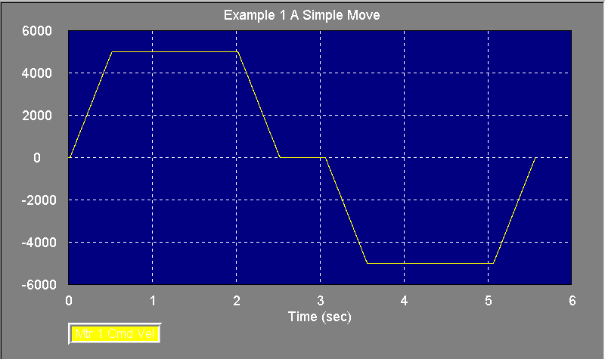
Example 1: A Simple Move Graph
Velocity (counts/ sec)
Motor 1 CMD Velocity

Slide 226
Example 2: A More Complex Move
This example introduces incremental and time-specification of moves, looping logic, using variables, scaling of axes, and simple arithmetic. Note that logical and mathematical operations do not delay moves.
;*************** Set-up and Definitions ****************
&2 ; Coordinate system 2
; NOTE: No motor can be simultaneously defined
; in more than one coordinate system
CLOSE ; Make sure all buffers are closed
#5->1000X ; 1 unit (cm) of X is 1000 counts of motor 5

Slide 227
Example 2: A More Complex Move (continued)
;****************** Motion Program Text *******************
OPEN PROG 2 ; Open buffer for entry, Program #2
CLEAR ; Erase existing contents of buffer
LINEAR ; Blended linear interpolation move mode
INC ; Incremental mode - moves specified by distance
TA500 ; 1/2 sec (500 msec) acceleration time
TS250 ; 1/4 sec in each half of S-curve
P1=0 ; Initialize a loop counter variable
WHILE (P1<10) ; Loop until condition is false (10 times)
X10 ; Move X-axis 10 cm (=10,000 cts) positive
DWELL500 ; Hold position for 1/2 sec
X-10 ; Move X-axis back 10 cm negative
DWELL500 ; Hold position for 1/2 sec
P1=P1+1 ; Increment loop counter
ENDWHILE ; End of loop
CLOSE ; Close buffer - end of program
To run this program:
&2 B2 R ; Coordinate System 2, point to Beginning of Program 2,

Slide 228
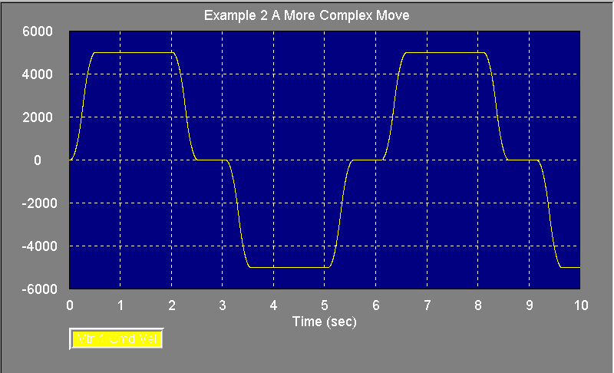
Example2 Graph
Velocity (counts/ sec)
Motor 1 CMD Velocity

Slide 229
Rotary Motion Program Buffers
For real-time downloading of programs
  DEFINE ROT {size} reserves the specified number of words of memory for the addressed C.S.’s buffer
  B0 tells the coordinate system to be ready to execute the rotary buffer. (All buffers must be CLOSED for this command.)
  OPEN ROT prepares all rotary buffers for entry
  CLEAR erases any existing contents
NEW IDEAS IN MOTION

Slide 230
Rotary Motion Program Buffers (continued)
  {program lines} are entered into buffer for addressed C.S.
  R starts execution for addressed C.S.
  PR returns the number of lines yet to be executed in addressed C.S.
  <BREQ> interrupt generated until I17 lines ahead; generated again when execution catches up within I16 lines; for addressed C.S. when I2=1
  CLOSE prevents entry into buffer; does not stop execution
NEW IDEAS IN MOTION

Slide 231
Running “Naked” Rotary Buffer
Rotary buffer that has executed all moves
sent to it is in indefinite “wait” state
New move sent to it is immediately executed
Makes “buffered” program commands
execute like on-line commands
End of move evaluated by status bits
NEW IDEAS IN MOTION

Slide 232
PMAC 运动模式
LINEAR 直线运动模式
  梯形/三角形速度曲线
  Straight-line path in Cartesian system
  Blends with LINEAR + CIRCLE moves
CIRCLE mode
  Sinusoidal velocity profiles
  Circular arc path in Cartesian system
  Blends with LINEAR + CIRCLE moves
NEW IDEAS IN MOTION

Slide 233
PMAC Move Modes (continued)
RAPID mode
  Trapezoidal/triangular velocity profiles
  (Near) straight-line path in Cartesian system
  Minimum time point-to-point; no blending
SPLINE modes
  Parabolic velocity profiles
  Cubic B-spline path
  Blends with SPLINE moves, continuous acceleration
PVT mode
  Parabolic velocity profiles
  Hermite spline path
  Blends with PVT moves, continuous velocity
NEW IDEAS IN MOTION

Slide 234
LINEAR Mode Moves
End-point (ABS) or distance (INC) specification
Vector Speed (F) or move time (TM) specification
Acceleration time(TA, TS) or rate (Ix17) specification
With F specification, constant vector speed, regardless of move direction
With TM=TA, TS=0, quadratic B-spline path
NEW IDEAS IN MOTION

Slide 235
Linear Mode Trajectories
Small acceleration time
V
TM or
Δ
P/F
time
TA
TA
V
TM or
Δ
P/F
TM or
Δ
P/F
time
TA
TA
TA

Slide 236
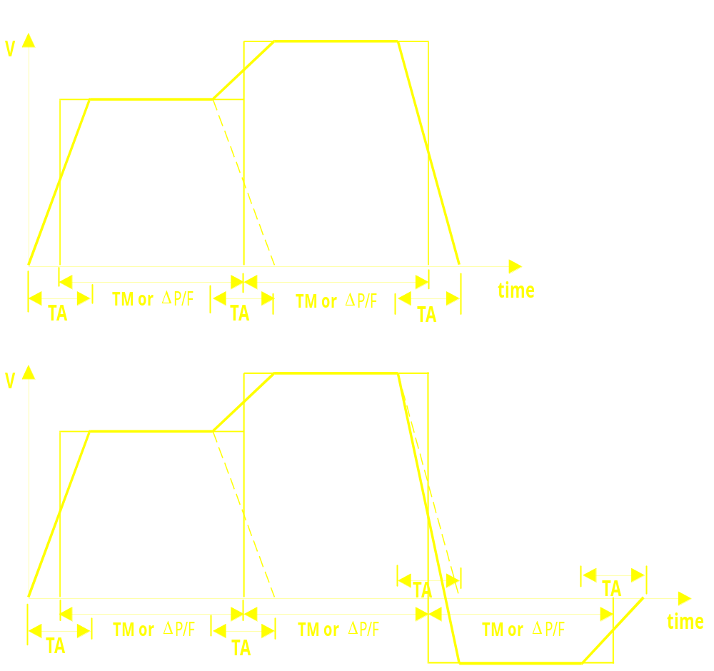
Linear Mode Trajectories (continued)
Small acceleration time

Slide 237
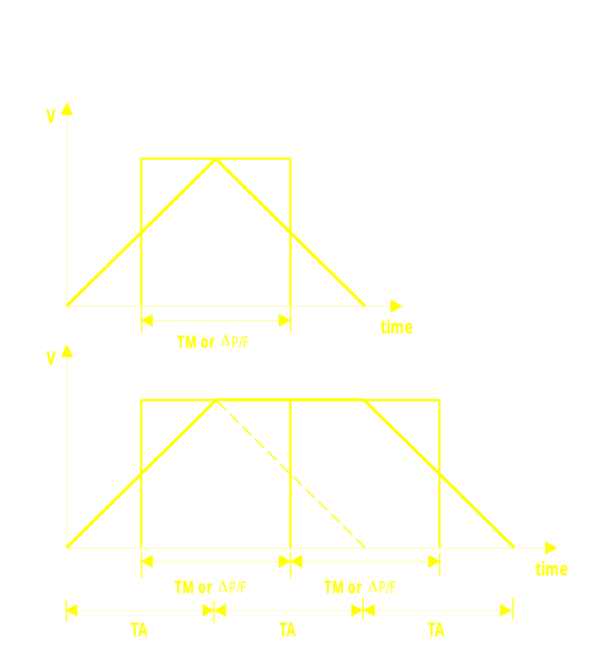
Linear Mode Trajectories
Acceleration Time Matches Move Time

Slide 238
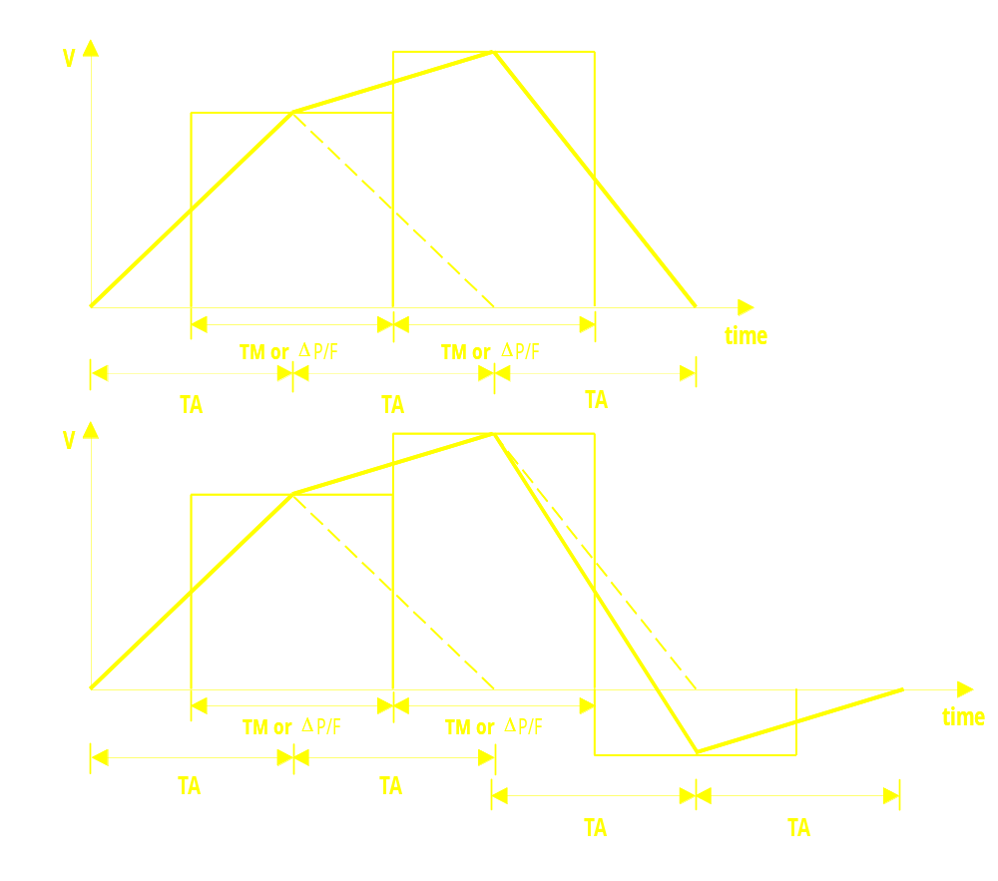
Linear Mode Trajectories (continued)

Slide 239
Linear Mode Trajectories
Large (velocity limiting) acceleration time
V
TM or
Δ
P/F
time
TA
TA
V
TM or
Δ
P/F
TM or
Δ
P/F
time
TA
TA
TA

Slide 240
Linear Mode Trajectories (continued)
Large (velocity limiting) acceleration time
V
TM or
Δ
P/F
TM or
Δ
P/F
time
TA
TA
TA

Slide 241
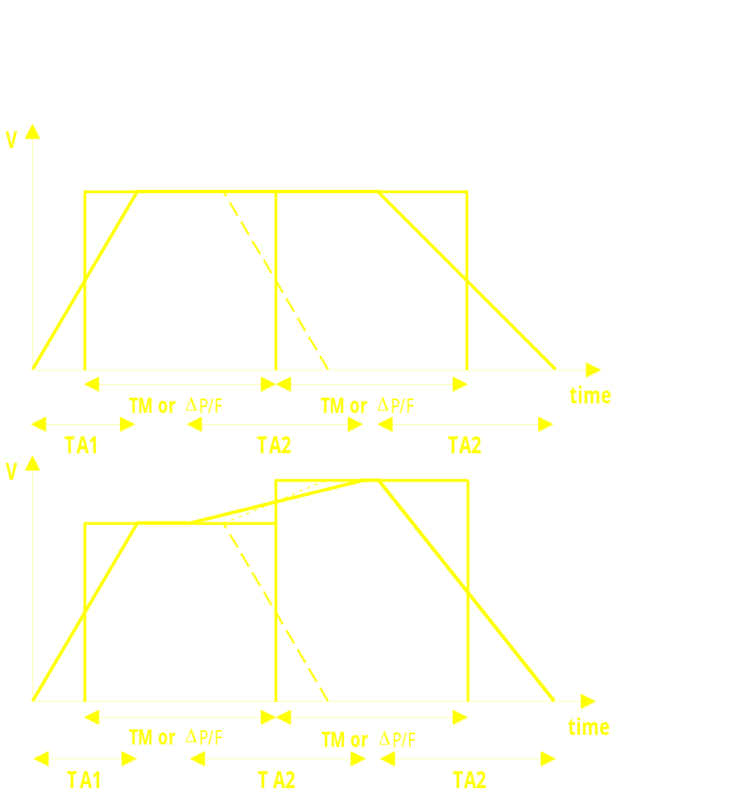
Linear Mode Trajectories
Changing acceleration times

Slide 242

Linear Mode Trajectories (continued)
Changing acceleration times

Slide 243

Profiled Linear Interpolation

Slide 244
PROFILED CIRCULAR INTERPOLATION
1
Vprof
Y
Θ
2
X
t
V
Θ
Vy
2
Vx (t) = Vx (
Θ
) Vprof (t)
π
π
= R (-sin
Θ
) Vprof (t)
2
Vy (t) = Vy (
Θ
) Vprof (t)
Θ
1
= Rcos
Θ
Vprof (t)
Vx
1
2

Slide 245
MultiAxis Linear Moves
Non-Blended vs. Blended
Y
Y
X
X
Vx
Vx
t
t
Vy
Vy
t
t
Non-Blended
Blended

Slide 246

y vs. x Position Plot
Quarter Circle Approximation - Small Accel Time
Motor 1 Cmd Pos (cts)

Slide 247

Quarter Circle Approximation - Small Accel Time
Velocity (counts / sec)
Motor 1 Cmd Velocity
Motor 2 Cmd Velocity
Velocity vs. Time Plots

Slide 248

Quarter Circle Approximation - Half Accel Time
Motor 1 Cmd Pos (cts)
y vs. x Position Plot

Slide 249

Quarter Circle Approximation - Half Accel Time
Velocity (counts / sec)
Motor 1 Cmd Velocity
Motor 2 Cmd Velocity
Velocity vs. Time Plots

Slide 250

Quarter Circle Approximation - Full Accel Time
Motor 1 Cmd Pos (cts)
y vs. x Position Plot

Slide 251

Quarter Circle Approximation - Full Accel Time
Velocity (counts / sec)
Motor 1 Cmd Velocity
Motor 2 Cmd Velocity
Velocity vs. Time Plots

Slide 252
Vector Feedrate Axes
Note: X,Y & Z are default feedrate axes
INC Dist= 3²+4²=5
FRAX(X,Y) Move Time = 5/10 = 0.5
X3 Y4 F10 Vx= 3/0.5 = 6
Vy= 4/0.5 = 8
INC Dist= 3²+4²= 5
FRAX(X,Y) Move Time = 5/10 = 0.5
X3 Y4 Z12 F10 Vx= 3/0.5 = 6
Vy= 4/0.5 = 8
Vz= 12/0.5 = 24
NEW IDEAS IN MOTION

Slide 253
Vector Feedrate Axes (continued)
INC Dist= 3²+4²+12²= 13
FRAX(X,Y,Z) Move Time = 13/10 = 1.3
X3 Y4 Z12 F10 Vx= 3/ 1.3 = 2.31
Vy= 4/ 1.3 = 3.08
Vz= 12/1.3 = 9.23
INC Dist = 0
FRAX(X,Y,Z) Move Time = 0/10 = 0(<TA)
C10 F10 Non-Turbo: C is feedrate axis for this move
Turbo: Isx86 (alternate feedrate) controls speed
NEW IDEAS IN MOTION

Slide 254
CIRCLE Mode Moves
Circle plane specification (NORMAL)
End-point (ABS) or distance (INC) specification
Center vector (I,J,K) or radius (R) specification
Vector speed (F) or move time (TM) specification
Acceleration time specification (TA, TS)
Axes not in circle plane linearly interpolated
NEW IDEAS IN MOTION

Slide 255
Diagram Circular Interpolation
CIRCULAR INTERPOLATION: Plane Specification
+Z
+Z
G17
CW
CW
+X
+Y
+X
+Y
NORMAL K-1
NORMAL K1
+Z
+Z
CW
G18
+X
+Y
+X
CW
+Y
NORMAL J-1
NORMAL J1
+Z
+Z
CW
G19
+X
+Y
+X
CW
+Y
NORMAL I-1
NORMAL I1
NORMAL VECTORS FOR CIRCULAR MOVES:
THE PLANES AND CLOCK WISE ARCS THEY DEFINE
(NRML-VEC)

Slide 256

Diagram Circular Interpolation

Slide 257

Blending Between Lines and Arcs
NEW IDEAS IN MOTION

Slide 258
Why Use Segmentation Mode (I13>0)?
[Isx13>0 on Turbo]
Permits circular interpolation (I13 is “fit” time)
Permits cutter radius compensation (I13 is “fit” time)
Permits jog during feedhold (“\” command to feedhold)
Permits quit at end of executing move (“/” command)
Permits reporting of currently executing move command
In rotary buffer, permits change from calculated deceleration of final move to blending into newly sent move.
Permits inverse kinematics (I13 is “fit” time)
Permits segment buffering for special lookahead and retrace
NEW IDEAS IN MOTION

Slide 259
Example 4: Linear and Circular Interpolation
This example introduces linear and circular interpolation in a Cartesian X-Y application
;************ Set-up and Definitions *************
CLOSE ; Make sure all buffers are
; closed
&1 ; Coordinate System 1
#3->10000X ; Use motor 3 for X-axis
#4->10000Y ; Use motor 4 for Y-axis
NEW IDEAS IN MOTION

Slide 260
Example 4: Linear and Circular Interpolation (continued)
OPEN PROG 4 CLEAR ; Prepare buffer for entry
RAPID X1 Y4 ; Fast move to starting point
F500 ; Speed for linear and circular moves
LINEAR Y13 ; Straight move
CIRCLE1 X2 Y14 I1 J0 ; CW arc
LINEAR X3 ; Straight move
CIRCLE1 X4 Y13 I0 J-1 ; CW arc
LINEAR Y7 ; Straight move
CIRCLE1 X7 Y4 I3 J0 ; CCW arc
LINEAR X13 ; Straight move
CIRCLE1 X14 Y3 I0 J-1 ; CW arc
LINEAR Y2 ; Straight move
CIRCLE1 X13 Y1 I-1 J0 ; CW arc
LINEAR X4 ; Straight move
CIRCLE1 X1 Y4 I0 J3 ; CW arc
DWELL100 ; Hold 100 ms
RAPID X0 Y0 ; Return home
CLOSE
;To run this program:
&1 B4 R ; Coord. System 1, point to Beg. of Program 4, Run

Slide 261

Example 4 Graph
Motor 4 Cmd Position (cts)

Slide 262
What Is Lookahead?
Standard feature on all Turbo PMACs
Algorithm that “scouts ahead” in motion programs
Checks for violations of motor limits:
  Position (software overtravel) limits
  Velocity limits
  Acceleration limits
When violation is detected, motion is slowed at problem point
Algorithm re-calculates motion leading up to problem point to keep all motion within limits
NEW IDEAS IN MOTION

Slide 263
What Can Lookahead Do?
Lookahead permits acceleration and deceleration over multiple move blocks
Lookahead permits deceleration into tight corner and acceleration out of it
Tight corners can be made within acceleration constraints without slowing moves away from corners
Lookahead permits stopping at position limits, not past them
Lookahead does not change the programmed path, just how fast the path is traversed
NEW IDEAS IN MOTION

Slide 264
What is “Segmented Lookahead”?
Lookahead utilizes PMAC’s segmentation (coarse interpolation) function
Lookahead buffer stores relatively uniform motion segments, not arbitrary program move blocks
Uniformity of segments permits:
  More efficient calculations
  Better optimized solutions with long and short blocks
Tight spacing of segments permits:
  Accel and decel within program blocks, not just at boundaries
  Linear approximations for arc moves
Segments are reversible; motion program is not!
NEW IDEAS IN MOTION

Slide 265
Lookahead for Multi-Block Accel/Decel
V
ACCEL & DECEL TIME MUST BE EQUAL TO
OR SHORTER THAN BLOCK MOVE TIME
Before Lookahead
F100
X1
X2
X3
X4
X5
X6
X7
X8
X9
X10
DWELL50
1
2
3
4
5
6
7
8
9
10
T
V
After Lookahead
ACCEL & DECEL ARE CONTROLLED BY
SPECIFIED ACCEL LIMIT (G’s)
1
2
3
4
5
6
7
8
9
10
T
NEW IDEAS IN MOTION

Slide 266
Lookahead & Small, Tight Corners
Y
F50
X10 Y10
X0 Y20
V_{X}
5
4
Time
3
1
2
3
4
5
2
V_{Y}
1
X
Before Lookahead
Time
F50
X10 Y10
X0 Y20
Y
7
V_{X}
6
Time
5
ACCEL & DECEL
CONTROLLED BY
SPECIFIED G’s
AT CORNER
4
3
1
2
3
4
5
6
7
2
V_{Y}
1
X
Time
After Lookahead
Note how “Y” decelerates
to make the corner
NEW IDEAS IN MOTION

Slide 267
Lookahead Key Variables
Ixx13 Motor xx Positive Position Limit
Ixx14 Motor xx Negative Position Limit
Ixx16 Motor xx Maximum Velocity
Ixx17 Motor xx Maximum Acceleration
Isx13 C.S. ‘x’ Segmentation Time
DEFINE LOOKAHEAD {# of segs.}, {# of outputs}
Isx20 C.S. ‘x’ Lookahead Distance (segments)
NEW IDEAS IN MOTION

Slide 268
How Much Lookahead is Needed?
Need to look ahead the stopping distance/time
Worst-case stopping time is max velocity (Ixx16) divided by max acceleration (Ixx17)
Select the largest time for all motors
Number of segments needed ahead is:
Stopping Time / (2 * Segment Time)
Tell PMAC to look ahead 4/3 this number of segments so always have the proper number correct
Size the lookahead buffer to hold this number of segments plus any segments to reverse through
NEW IDEAS IN MOTION

Slide 269
Turbo Lookahead Speed Capability
2 axes: 2000 blocks/second (1 msec seg, 200%)
3 axes: 1000 blocks/second (1 msec seg)
4 axes: 500+ blocks/second (2 msec seg)
5 axes: 500+ blocks/second (2 msec seg)
6 axes: 500 blocks/second (2 msec seg)
8 axes: 333 blocks/second (3 msec seg)
12 axes: 250 blocks/second (4 msec seg)
16 axes: 200 blocks/second (5 msec seg)
Segment time = minimum block time;
Default servo update 2.25 kHz, no commutation
NEW IDEAS IN MOTION

Slide 270
Turbo Lookahead Length Capability
Length of lookahead limited only by memory capacity!
Longer lookahead does not require more processor speed!
Standard data memory, 90% for lookahead:
  2 axes: 3000 segments
  4 axes: 2000 segments
  6 axes: 1500 segments
Expanded data memory, 90% for lookahead:
  2 axes: 24,000 segments
  4 axes: 16,000 segments
  6 axes: 12,000 segments
NEW IDEAS IN MOTION

Slide 271
Reversal (Retrace) in Lookahead
Oversized lookahead buffer provides “history” of trajectory
Position information in buffer is reversible (unlike actual motion program)
The ‘<’ command causes reversal along path
Reverse operation obeys same limits as forward operation
Reversal length limited only by buffer memory
Can only reverse in continuous blended sequence
Quick stop in either direction with ‘\’ command
Forward operation again by ‘>’, ‘R’, or ‘S’
Seamless continuity into new parts of program
NEW IDEAS IN MOTION

Slide 272
Lookahead on Non-Turbo PMAC
Option 6L is lookahead firmware
Slight incompatibility with standard firmware
Lookahead limited to 1 coordinate system
Lower speed than on Turbo
No position limits at lookahead time
Available on any PMAC or PMAC2 version
Most important is availability on low-cost Mini and Lite controllers
NEW IDEAS IN MOTION

Slide 273
Non-Turbo Lookahead Speed Capability
40 MHz, 3 axes: 100 blocks/second
60 MHz, 3 axes: 200 blocks/second
80 MHz, 3 axes: 333 blocks/second
Scales proportionately with number of axes
Testing done with standard 2.25 kHz servo update, 9 kHz phase update
NEW IDEAS IN MOTION

Slide 274
Altdest.pmc
; This program allows altered destination in moves.
; The card is always moving toward an X position of
; P1 and a Y position of P2, but it does it in small
; increments so when P1 or P2 is changed, it will
; change direction within a few milliseconds. P1
; and P2 can be changed from the host on the fly.
NEW IDEAS IN MOTION

Slide 275
Altdest.pmc
CLOSE
OPEN PROG 2
CLEAR
P9=100 ; Vector distance per increment
P11=0 ; Starting X position
P12=0 ; Starting Y position
TA10 ; C.S. 1 accel time in msec
TS0 ; C.S. 1 S-curve time in msec
TM10 ; Increment time in msec
WHILE (M1=1) ; Whatever condition you like
P21=P1-P11 ; X distance to go
P22=P2-P12 ; Y distance to go
P0=SQRT(P21*P21+P22*P22) ; Vector distance to go
IF(P0>P9) ; If longer than increment
P0=P9/P0 ; Fraction of distance
P11=P11+P21*P0 ; X increment
P12=P12+P22*P0 ; Y increment
ELSE ; Distance < increment
P11=P1 ; Just go to destination
P12=P2
ENDIF
X(P11) Y(P12) ; Make move
ENDWHILE
CLOSE

Slide 276
ChgSpeed
This program is an example of moving at high speed
until some sort of external command, then reacting
very quickly to the command, but changing speed
very slowly. It works by splitting the move into
very small segments, and using WHILE loops to
continue in one mode until the signal is received.
NEW IDEAS IN MOTION

Slide 277
CLOSE
OPEN PROG 10
CLEAR
P4=150000
P5=3000
P6=600
INC(X) ; X-axis in incremental mode
TM(P5/P6) ; move segment time (5 msec here!)
TA(P5/P6) ; accel time (<= TM)
P3=P4/(P6*P6) ; multiplier to get distance
P1=0 ; start at zero speed
P2=0 ; start at zero distance
N10 WHILE (P0 != 0) ; P0=0 is signal to decelerate
IF (P1<P6) ; not up to full speed?
P1=P1+1 ; increment to increase speed
P2=P1*P3 ; distance to travel in segment
ENDIF
X(P2) ; incremental move segment
ENDWHILE
WHILE (P0=0) ; P0=1 is signal to accelerate
IF (P1>0) ; still moving?
P1=P1-1 ; decrement to decrease speed
P2=P1*P3 ; distance to travel in segment
ENDIF
X(P2) ; incremental move segment
ENDWHILE
GOTO 10 ; loops back up when P0=1 again
CLOSE

Slide 278
Rapid Mode Moves
Endpoint (ABS) or distance (INC) specification
Max. speed (Ix16) or jog speed (Ix22) specification
Acceleration time (Ix20, Ix21) or rate (Ix19) specification
Only axis with highest distance/speed ratio goes at specified speed; others match this time
Straight-line path if acceleration times match
Not constant vector speed at different directions
Move until trigger: e.g. X100^2.5
Altered destination: e.g. ! X19.93 Y31.25
NEW IDEAS IN MOTION

Slide 279
SPLINE Mode Moves
End-point (ABS) or distance (INC) specification
Non-Turbo: Move time (TA) specification, nearest millisecond
Turbo: Move time (TM) specification, ¼ µsec resolution
SPLINE1 mode requires constant move time
SPLINE2 mode permits variable move time, should be only slowly changing
Position, velocity, and acceleration continuous at move boundaries
Blending rounds to inside of programmed points
Generates cubic B-spline path
Most efficient computation of any PMAC mode
NEW IDEAS IN MOTION

Slide 280
Cubic Spline Trajectories
V
V
TA (added)
TA
TA (added)
time
TA (added)
TA
TA
TA (added)
time
One Programmed Segment
Two Programmed Segments
V
TA (added)
TA
TA
TA
TA (added)
time
Three Programmed Segments
V
TA (added)
TA
TA
TA
TA
TA (added)
time
Four Programmed Segments

Slide 281
PMAC Splined Moves
All segments same time
If segment were
done at constant
velocity:
V =
Δ
P
VEL
etc.
c
TA
No velocity or acceleration
discontinuities at segment
boundaries
etc.
INC
SPLINE1
TA500
X10000
X9000
X10500
X12000
TA
TA
TA
TA
TA
TA
TIME
(added)
(added)
NEW IDEAS IN MOTION

Slide 282
PVT 模式运动
End-point (ABS) or distance (INC) specification
Signed end velocity specification each axis
[Non-Turbo]: Movetime (TA) specification, millisecond resolution
[Turbo]: Movetime (TM) specification, 1/4-microsecond resolution
Position and velocity continuous at move boundaries
NEW IDEAS IN MOTION

Slide 283
PVT Mode Moves (continued)
Blending passes exactly through programmed points
Good to create arbitrary profiles
Generates Hermite-spline path
Very efficient computation
NEW IDEAS IN MOTION

Slide 284

Position, Velocity, and Time (PVT mode) [Parabolic Velocity]
A₀ (calculated)
P₀ V₀ (from before)
P₁ (specified)
V₁ (specified)
A₁ (calculated)
….
PVT200
X1000:30
….
NEW IDEAS IN MOTION

Slide 285

PVT Mode: Positions and Velocities Specified
NEW IDEAS IN MOTION

Slide 286

Common PVT Segment Shapes

Slide 287
Diagram: PVT Mode Contouring
P_{i+3}
V_{i+2}
PVT Mode Contouring
(Hermite Spline)
P_{i+2}
R_{i+2}
V_{i+1}
C_{i+2}
C_{i}
  To compute axis velocities at point P:
  1. Find common center of P_{i-1}, P_{i,} and P_{i+1}
  2. Compute velocity vector as normal
  to radius vector
  3. Resolve velocity vector into components
C_{i+1}
P_{i+1}
R_{i+1}
V_{i}
R_{i}
VY_{i}
Θ
P_{i}
VX_{i}
P_{i-1}

Slide 288

Contouring Interpolation Methods

Slide 289

Contouring Interpolation Methods (continued)

Slide 290
Subroutines and Subprograms
GOSUB 300 jumps to:
  N 300 of same motion program,
CALL 500 jumps to:
  PROG 500, at the top (N0)
CALL 500.1 jumps to:
  PROG 500, label N10000
CALL 500.12 jumps to:
  PROG 500, label N12000
CALL 500.12345 jumps to:
  PROG 500, label N12345
On-line command B700 points to:
  PROG 700, (N0) ready to run
On-line command B700.34 points to:
  PROG 700, N34000, ready to run
NEW IDEAS IN MOTION

Slide 291
Passing Arguments to Subroutines
{PROG 1}
CALL 500 D10E20
{PROG 500}
READ (D,E)
sets Q104 to 10
sets Q105 to 20
A argument reads into Q101
B argument reads into Q102
• • •
Y argument reads into Q125
Z argument reads into Q126
NEW IDEAS IN MOTION

Slide 292
PMAC Subroutine Parameter Pass Check
• Bit (n-1) of Q100 set to 1 if “nth” letter
passed argument in last READ statement
IF(Q100 & 16>0)
is true when “E” (5th letter) has been passed (1=2⁵⁻¹)
Q100 set to 0 at beginning of READ
Successful read of letter value sets
corresponding bit of Q100 to 1
Z
Y
F
E
D
C
B
A
Letter
0
0
0
1
1
0
0
0
Q100
25
24
5
4
3
2
1
0
Bit #
2
25
2
24
32
16
8
4
2
1
Bit Value (Dec)
2
25
2
24
20
10
8
4
2
1
Bit Value (Hex)
PROG1
PROG500
CALL 500 D10 E20
READ (D,E)

Slide 293
G,M,T and D Codes
For RS-274 compatible motion programs
CALL 1000.73000
CALL 1001.03000
CALL 1002.01000
CALL 1003.12000
G 73 is equivalent to
M 3 is equivalent to
T 01 is equivalent to
D 12 is equivalent to
NEW IDEAS IN MOTION

Slide 294
G, M, T, and D Codes (continued)
System designer writes custom routines in PROG 1000 to PROG 1003
Part programmers and machine operators can treat system as regular “G-Code” machine
PROG 1000 and up can password protected (also PLC’s 0 - 15)
NEW IDEAS IN MOTION

Slide 295
Example 5: A Simple G-Code Program
;*************** Part Program Text ******************
;Note that the part program does not need to know ;how the G-codes and M-codes are executed
OPEN PROG 5 CLEAR ;Prepare motion program 5 for entry
G17 G90 ; XY plane, absolute move spec
G97 S1800 ; Set spindle speed of 1800 rpm
F500 ; Cutting speed 500 mm/min
G00 X10.00 Y5.00 ; Rapid move to (10, 5)
M03 ; Start spindle
G04 P2.0 ; Wait 2 seconds
G01 Z0 ; Lower cutter
X30.25 Y5.00 ; Linear XY move
NEW IDEAS IN MOTION

Slide 296
Example 5: A Simple G-Code Program (continued)
G03 X35.25 Y10.00 J5 ; CCW arc move
G01 X35.25 Y50.10 ; Linear move
G03 X30.25 Y55.10 I-5 ; CCW arc move
G01 X10.00 Y55.10 ; Linear move
G03 X5.00 Y50.10 J-5 ; CCW arc move
G01 X5.00 Y10.00 ; Linear move
G03 X10.00 Y5.00 I5 ; CCW arc move
G01 Z5 M05 ; Cutter up, stop
G00 X0 Y0 ; Back to home
CLOSE
NEW IDEAS IN MOTION

Slide 297
Example 5: A Simple G-Code Program (continued)
OPEN PROG 1000 CLEAR ; prepare buffer 1000 for entry
RAPID RETURN ; G00Rapid mode (N0 is implied)
N01000 LINEAR RETURN ; G01 Linear interpolation mode
N02000 CIRCLE1 RETURN ; G02 CW circle mode
N03000 CIRCLE2 RETURN ; G03 CCW circle mode
N04000 READ(P) ; G04 Dwell for P seconds
IF (Q100 & 32768 > 0) ; P parameter specified?
DWELL (Q116*1000) ; PMAC specifies dwell in msec
ENDIF
RETURN
N17000 NORMAL K-1 RET ; G17 Specify XY plane
N18000 NORMAL J-1 RET ; G18 Specify ZX plane
N19000 NORMAL I-1 RET ; G19 Specify YZ plane
N90000 ABS RET ; G90 Absolute mode
N91000 INC RET ; G91 Incremental mode
N97000 READ(S) ; G97 Spindle speed set
IF (Q100 & 262144 > 0); S parameter specified?
I422=Q119/30 ; #4 jog speed in cts/msec
ENDIF
RETURN
CLOSE

Slide 298
Example 5: A Simple G-Code Program (continued)
OPEN PROG 1001 CLEAR ; Prepare buffer 1001 for entry
N03000 CMD "#4J+" RET ; Start spindle clockwise
; (closed loop)
N04000 CMD "#4J-" RET ; Start spindle
; counterclockwise (ditto)
N05000 CMD "#4J/" RET ; Stop spindle
CLOSE
;To run this program:
&1 B5 R ;Coordinate System 1, point to Beginning of Program 5, Run
NEW IDEAS IN MOTION

Slide 299

Example 5 Graph
Motor 1 Cmd Position (cts)

Slide 300
Coordinate System Variables
Ix87 Default Acceleration Time (Program)
  (Units: msec); Integer
  Overridden by TA in Program
Ix88 Default S-Curve Time (Program)
  (Units: msec); Integer
  Overridden by TS in Program
V
T
Ix88
Ix88
Ix88
Ix88
Ix87
Ix87
NEW IDEAS IN MOTION

Slide 301
Ix90 through Ix92
Ix90 FEEDRATE TIME UNITS (Unit: msec)
LENGTH UNIT
AXIS DEF. SCALING
F UNIT = ---------------------- => -------------------------------
TIME UNIT
Ix90 (msec)
EXAMPLE: #1 -> 2000X
Ix90 = 1000
2000cts
mm
F UNIT = -------------- => -------
1000msec
sec
Ix92 BLEND DISABLE
Ix92 = 0 => Blend enable
Ix92 = 1 => Blend disable

Slide 302
PMAC 1/T EXTENSION
Servo
Interrupts
A
B
T
T
T
T
1
2
1
2
K
T₂
V_{n} =
T₁
P_{n} = Counter
T₁
NEW IDEAS IN MOTION

Slide 303


Slide 304


Slide 305


Slide 306


Slide 307


Slide 308


Slide 309


Slide 310

INTERPOLATED ENCODER FEEDBACK
NEW IDEAS IN MOTION

Slide 311

PMAC Encoder Conversion Table Principle
Pre-processing of raw feedback data before
servo use
NEW IDEAS IN MOTION

Slide 312

PMAC Encoder Conversion Table

Slide 313
Conversion Methods
NEW IDEAS IN MOTION

Slide 314
Conversion Methods (continued)
NEW IDEAS IN MOTION

Slide 315
Conversion Methods (continued)
NEW IDEAS IN MOTION

Slide 316
What is PMAC Time-Base Control?
Interpolation function computes commanded positions each servo cycle as:
  CP_{n} = CP_{n-1} + CV_{n}Δt
Δt represents time elapsed in servo cycle
  24-bit register: 2²³ = 1 msec
Physical time between servo cycles set by hardware
Varying Δt register value from true time elapsed provides “time base control” (a.k.a. “feedrate override”)
1st Time Base
Slide
NEW IDEAS IN MOTION

Slide 317
PMAC Time-Base Control Variables
I10 Servo Interrupt Time
  Tells interpolator true time of servo cycle
  Scaled so that 2²³ (8M) = 1msec
  Default I10 = 3,713,707 (442 μsec)
Ix93 C.S.x Time-Base Address
  Tells what register is read for time base value
  Contents of register have units of I10
2nd Time Base
Slide
NEW IDEAS IN MOTION

Slide 318
What are Common Time-Base Sources?
% Commands (default)
Operator Pot thru A/D or V/F
Operator Switch thru PLC program
Master Encoder Count Frequency
External Clock Frequency
Process variable servo loop output
3rd Time Base
Slide
NEW IDEAS IN MOTION

Slide 319
Time Base Host Commands
% {constant} command puts (I10*{constant}/100) into special register for addressed C.S.
%100 is “real time”
% query command reports back preset time base value (regardless of source)
Ix93 = default, this value is used for time base Δt
Time base value slews to new command at Ix94 units per servo cycle
4th Time Base
Slide
NEW IDEAS IN MOTION

Slide 320
What is External Time Base?
PMAC’s motion language describes commanded position as function of time:
    CP=f(t)
PMAC’s basic units of time are milliseconds
In Slaving applications, we want to describe commanded position as function of master position:
    CP=f(MP)
5th Time Base
Slide
NEW IDEAS IN MOTION

Slide 321
What is External Time Base? (continued)
Since language is still in terms of time, we must define relationship between “time” (units: msecs) and master position (units: cts)
This is Real Time Input Frequency (RTIF) in cts/msec
If we use a RTIF of 32 cts/msec, when we refer to a msec in the program, we are really referring to 32 counts of the master
6th Time Base
Slide
NEW IDEAS IN MOTION

Slide 322

External Time Base Concept
Position
Time referenced trajectory
Time (msec)
7th Time Base
Slide
Position
Real-Time Input Frequency (cts/msec)
Position referenced trajectory
Master Position (cts)

Slide 323
How Does External Time Base Work?
Conversion Table computes
    ΔMP_{n} = 2*SF*(MP_{n} - MP_{n-1})
Ix93 contains address of ΔMP_{n} register in conversion table
Coordinate system uses ΔMP_{n} as “Δt” in
    CP_{n} = CP_{n-1} + CV_{n}Δt
Trajectories are now function of master position
NEW IDEAS IN MOTION

Slide 324
Time Base Conversion Table Setup
HEX
DEC
X-Register
Y-Register
$720
1824
•••
•••
$723
1827
Interpolated
Cts(n)
$00 C00C
•••
•••
{1/T} {
Enc 4 counter}
$728
1832
Interpolated
Cts(n-1)
$40 0723
8A Time Base
Slide
{Time Base} {Int. Enc. 4}
$729
1833
Result (MP)
$001000
{Scale factor}
I193=1833
Result =2*S.F.*[Interp Cts(n)-Interp Cts(n-1)]
=2*(2¹⁷/RTIF)*(2⁵*IF*I10/2²³)
=I10*(IF/RTIF)

Slide 325


PMAC External Time Base Example
Cutting on the fly: rotary cutter slaved to web
Web encoder wheel: 5 inch circumference
500 lines/rev = 2000 cts/rev (often power of 2)
Maximum web speed= 200 in/sec
Define “real time input frequency” (RTIF)
RTIF= 128 cts/msec (usually power of 2)
Calculate “time-base scale factor (TBSF)
9th Time Base
Slide
NEW IDEAS IN MOTION

Slide 326



PMAC External Time Base Example (continued)
At RTIF, web speed is:
Assume this web speed to write cutter program:
To match web speed with 10-inch circumference cutter:
To cut an 11-inch piece, cutter cycle must be:
10th Time Base
Slide
NEW IDEAS IN MOTION

Slide 327
Example 10: Precision Slaving
This example shows how the PMAC can use an external time-base source
for sophisticated precision slaving applications. Here it is used for
multiple-pass screw threading on a lathe with an open-loop spindle. Coil
winding applications are virtually identical as are cut-on-the-fly applications
for conveyorized or extruded material. The PMAC slaves its cutter axes (X&Z)
to an encoder on the spindle so that cutter speed tracks spindle speed,
resulting in constant pitch. This is done simply in time-base mode. Define a
"real-time" speed for the master (spindle) and set the time-base constant based on this. Write the program for the slave axes as if the master were always operating at the real-time speed. The time base control will compensate automatically for changes in the spindle speed.
11th Time Base
Slide
NEW IDEAS IN MOTION

Slide 328

NEW IDEAS IN MOTION

Slide 329
Example 10: Precision Slaving (continued)
;********************* Set-up and Definitions *********************
&1 ; Define axes in Coordinate System 1
#1->10000X ; Motor 1 is X at 10000 cts/in (radial)
#2->10000Z ; Motor 2 is Z at 10000 cts/in (traverse)
Spindle encoder has 1024 lines/rev or 4096 cts/rev. At real-time speed of 3000 rpm (50 rps), encoder frequency is 204.8 cts/msec. By formula, the time base constant is 131,072/204.8 = 640.
WY:1833,640 ; Set time base constant (at address 1833)
I193=1833 ; Tell Coordinate System 1 to use this
; address as the time-base source.
;********************* Motion Program Text ************************
This program is written to cut a 5-pitch (5 threads per inch) screw. It assumes the spindle speed is 3000 rpm, or 50 rps. Cutting speed is therefore 50(rev/sec)/5(rev/in)=10 in/sec. Programmed time for each loop must be an exact multiple of 20 msec for cutter to match thread each pass (50rev/sec <=> 20msec/rev).
12th Time Base
Slide
NEW IDEAS IN MOTION

Slide 330
Example 10: Precision Slaving (continued)
OPEN PROG 77 CLEAR ; Prepare buffer 77 for entry
P100=3.00 ; X (radial) dimension of outside of stock
P101=P100 ; Starting location of cut
RAPID X(P100-0.1) Z2 ; Move quickly to starting position
LINEAR
WHILE (P101<3.10) ; Loop until 0.1 inches deep
P101=P101+0.01 ; Increase depth 0.01 inch
TM100 ; 100 msec "plunge" time
X(P101) ; Radial axis into stock ("plunge")
TM(24*1000/10) ; 24 inches at 10 in/sec (in msec)
Z26 ; Make threading pass for 24 inches (26-2)
TM60 ; 60 msec retract time
X(P100-0.1) ; Retract to just outside of stock
TM(24*1000/30) ; 24 inches at 30 in/sec (in msec)
Z2 ; Reverse move for next pass
; Total time for moves in loop is
; 100+2400+60+800=3360 msec, which is an
; exact multiple of 20 msec, or 1 spindle rev.
ENDWHILE ; End of loop
RAPID X0 Z0 ; Return to home position
CLOSE
13th Time Base
Slide
NEW IDEAS IN MOTION

Slide 331




Constraints on Choosing Time Base Real-Time Input Frequency
The choice of RTIF in master counts per millisecond is quite arbitrary. There are only a few constraints:
1) The Time Base Scale Factor (2¹⁷/RTIF) must be an integer to prevent drift
a) RTIF=100cts/msec=>TBSF=1310.72 (BAD)
b) RTIF=128cts/msec=>TBSF=1024 (Good)
2)
to prevent saturation
∴RTIF>
a) SUF=2.25 kHz, MIF = 100 , RTIF =32 =>RTIF< (BAD)
b) SUF=2.25 kHz, MIF = 100 , RTIF =64 =>RTIF> (Good)
✗
✓
14th Time Base
Slide
Maximum
Input
Frequency
<
Servo
Update
Frequency
(
kHz
)
Real
Time
Input
Frequency
✗
✓
NEW IDEAS IN MOTION

Slide 332


Constraints on Choosing Time Base Real-Time Input Frequency (continued)
3) SPLINE and PVT segment times (at RTIF) must be an integer number of milliseconds, so here master cycle time must be an integer number of milliseconds
a) Master Encoder = 4000 Max Speed = 3000 rpm = 50 rps
RTIF=MIF=200 =>TBSF655.36 (BAD)
b) Master Encoder = 4000 Max Speed = 3000 rpm = 50 rps
Real Time Speed = 64 rps RTIF = 256 TBSF=512
Rev Time=15.625 msec (BAD)
c) Master Encoder =4096 Max Speed = 3000 rpm = 50 rps
RTIF=MIF=204.8 => TBSF=640 Rev Time=20msec (GOOD)
    Glossary:
      RTIF: Real Time Input Frequency (cts/msec)
      TBSF: Time Base Scale Factor
      MIF: Maximum Input Frequency (cts/msec)
      SUF: Servo Update Frequency
✗
15th Time Base
Slide
✗
✓
✓
NEW IDEAS IN MOTION

Slide 333
Time Base I-Variables (continued)
Ix94 Time Base Slew Rate / Slew Limit
  Determines maximum rate of time base change
  Expressed in (units of I10)/servo cycle
  Set relatively low for host-commanded time-base (default is 1644) to prevent step velocity change
  Set high for external time base to prevent loss of synchronization
16th Time Base
Slide
NEW IDEAS IN MOTION

Slide 334
Time Base I-Variables (continued)
Ix95 Feed Hold Slew Rate
  Works like Ix94, has same units
  Affects only deceleration on ‘H’ command and re-acceleration on following ‘R’
  ‘Hold’ is effectively a ‘%0’ command
  Ix95 permits controlled hold even when
  Ix94 is high for external time base
17th Time Base
Slide
NEW IDEAS IN MOTION

Slide 335

Dwell vs. Delay
DWELL
Always uses fixed time base (I10)
Time does not include preceding deceleration time
Next move not calculated until after end of DWELL
Does not keep sync in external time base
Move Time TM or Δ P/F
TA
DWELL
Time
I11 Time
Move Time TM or Δ P/F
NEW IDEAS IN MOTION

Slide 336
Dwell vs. Delay
DELAY
Uses variable time base (% value)
Time includes preceding deceleration time
Minimum time is current TA time
Upcoming move calculated at beginning of DELAY
Move Time TM or Δ P/F
DELAY
Time
Move Time TM or Δ P/F
NEW IDEAS IN MOTION

Slide 337
Triggered Time Base
Untriggered time base is not well referenced to a starting master position
Triggered time base uses hardware-captured master position as starting reference
Subsequent movement is referenced to this starting master position
18th Time Base
Slide
NEW IDEAS IN MOTION

Slide 338
Setting up Triggered Time-Base
Conversion table entry
  Method $A0 (running triggered)
  Address of channel in DSPGATE (e.g. $C000)
  Scale factor as for untriggered time base
Trigger Control
  Encoder capture control (I902 etc. / I9n2)
  Capture flag select (I903 etc. /I9n3)
Ix93 contains address of entry’s second line
Define M-Variable to method byte in table
NEW IDEAS IN MOTION

Slide 339
Implementing Triggered Time Base
1. Motion Program freezes time base and calculates
first move
DWELL 20 ; Stop motion and look ahead
M99 = $90 ; Freeze time base
X10 ; Calculate first move
2. PLC program arms time base
IF (M99 = $90) ; If frozen
M99 = $B0 ; then arm
ENDIF
3. Conversion table releases time base on trigger
• Captured position is starting pos (time)
• Method byte changed to $A0 (running)
NEW IDEAS IN MOTION

Slide 340
PMAC Memory Map
X-Memory
Y-Memory
23
16
15
8
7
0
23
16
15
8
7
0
$0000
Internal DSP
$00FF
Memory
$0100
Fixed-Use Calculation Registers
$17FF
$1800
External
Static
User Buffer Storage Space
RAM
$9FFF
(Battery/Flash
Backed)
$A000
Option 16 Battery Backed Parameter and Memory
$BBFF
$BC00
User-Written Servo
Storage
M-Variable Definitions
$BFFF
$C000
DSP-Gate
$C03F
Registers
$D000
Dual-Ported
$DFFF
RAM
$E000
VME Setup Registers
Mailbox Registers
VME bus
registers
$F000
I/O
Registers
$FFFF

Slide 341
PMAC Dual-Ported RAM Memory Map
Host
PMAC
Turbo PMAC
Address
Address
Address
Offset
0x0000
Control Panel Functions
$D000
$060000
0x0024
Servo Data Reporting Buffer
$D009
0x0228
Background Data Reporting
$D08A
Buffer
0x062C
ASCII Command Buffer
$D18B
(Host to PMAC)
0x06D0
ASCII Response Buffer
$D1B4
(PMAC to Host)
0x07E8
Pointers to Variable-Size
$D1FA
Buffers
0x0810
Room for Variable-Size Buffers
$D240
1) Data Gathering
2) Background Variable Data
3) Binary Rotary Program
0x3FFC/
0xFFFC
Open Use Space
$DFFF
$060FFF/
$063FFF

Slide 342
DPRAM Address Mapping
Host Mapping
Physical IC Mapping
PMAC Mapping
16k x 8
8k x 16
4k x 32
X & Y register at each Numerical address
Fixed address range $D000-$DFFF
[$60000-$60FFF]
For byte addressing
Only even addresses used
User-defined base address
13 address lines
16 data lines

Slide 343
PMAC ‘P’ Memory Space
Machine code instructions only
Compiled and assembled software
Non-Turbo
PMAC
Turbo PMAC
$000000
$00FFFF
$050000
$05FFFF(std.)
$0BFFFF(ext.)
$040000
$0407FF
$040800
$040BFF
$0000
PMAC
Firmware
$7FFF
$8000
Compiled
up to 15k words without
user-written servo; up to
PLC's
14k words with user-written
servo
$B7FF
$B800
User-Written
Up to 1k words without jumping
Servo
back to compiled PLC space
$BAFF
$BB00
$BBFF
User-Written Phase
Up to 256 words without
$BC00
jumping back
$BFFF
M-Variable Definitions
Also X:$BC00 to X:$BFFF

Slide 344

PMAC User Program and Buffer Space
Data Memory
(including interpreted programs)
Turbo PMAC
Address
$006000 (I46 = 3)
$008000 (I46 = 1,2)
$00A000 (I46 = 0)
PMAC
Address
$0107FF (Standard)
$03FFFF (Extended)

Slide 345
M-Variable Definition Types
X: {address}, {offset}, {width}, {format}
Y: {address}, {offset}, {width}, {format}
integer 1-24 bits wide
{offset} is starting bit number
default width 1; default format U (unsigned)
D: {address}
signed integer, 48 bits wide
NEW IDEAS IN MOTION

Slide 346
M-Variable Definition Types (continued)
L: {address}
floating-point value 48 bits wide
DP: {address} (dual ported RAM)
signed integer 32 bits wide
low 16 bits of X, low 16 bits of Y (Intel format)
F: {address} (dual ported RAM)
floating-point value IEEE 32-bit format
low 16 bits of X, low 16 bits of Y (Intel format)
NEW IDEAS IN MOTION

Slide 347
Suggested M-Variable Definitions
This file contains a suggested set of M-Variable definitions.
These definitions can be very useful for getting access to important
I/O and registers. It is not required that you use these particular
definitions. Most example programs will use these definitions.
NEW IDEAS IN MOTION

Slide 348
Suggested M-Variable Definitions
CLOSE ; To ensure commands are on-line
M0..1023->* ; To clear all existing definitions
M0->X:$0,0,24,U ; Servo cycle counter
; General Purpose inputs and outputs (PMAC-PC,-Lite,-VME)
M1->Y:$FFC2,8,1 ; Machine Output 1
M2->Y:$FFC2,9,1 ; Machine Output 2
M3->Y:$FFC2,10,1 ; Machine Output 3
M4->Y:$FFC2,11,1 ; Machine Output 4
M5->Y:$FFC2,12,1 ; Machine Output 5
M6->Y:$FFC2,13,1 ; Machine Output 6
M7->Y:$FFC2,14,1 ; Machine Output 7
M8->Y:$FFC2,15,1 ; Machine Output 8
M9->Y:$FFC2,8,8,U ; Machine Outputs 1-8 treated as byte
M11->Y:$FFC2,0,1 ; Machine Input 1
M12->Y:$FFC2,1,1 ; Machine Input 2
M13->Y:$FFC2,2,1 ; Machine Input 3
M14->Y:$FFC2,3,1 ; Machine Input 4
M15->Y:$FFC2,4,1 ; Machine Input 5
M16->Y:$FFC2,5,1 ; Machine Input 6
M17->Y:$FFC2,6,1 ; Machine Input 7
M18->Y:$FFC2,7,1 ; Machine Input 8
M19->Y:$FFC2,0,8,U ; Machine Inputs 1-8 treated as byte
NEW IDEAS IN MOTION

Slide 349
Suggested M-Variable Definitions
; Registers associated with Encoder/DAC1 (Usually Motor #1)
M101->X:$C001,0,24,S ; ENC1 24-bit counter position
M102->Y:$C003,8,16,S ; DAC1 16-bit analog output
M103->X:$C003,0,24,S ; ENC1 capture/compare position register
M104->X:$0720,0,24,S ; ENC1 interpolated position (1/32 ct)
M105->Y:$C006,8,16,S ; ADC1 16-bit analog input
M106->Y:$C000,0,24,U ; ENC1 time between counts (SCLK cycles)
M110->X:$C000,10,1 ; ENC1 count-write enable control
M111->X:$C000,11,1 ; EQU1 compare flag latch control
M112->X:$C000,12,1 ; EQU1 compare output enable
M113->X:$C000,13,1 ; EQU1 compare invert enable
M114->X:$C000,14,1 ; AENA1/DIR1 Output
M116->X:$C000,16,1 ; EQU1 compare flag
M117->X:$C000,17,1 ; ENC1 position-captured flag
M118->X:$C000,18,1 ; ENC1 Count-error flag
M119->X:$C000,19,1 ; ENC1 3rd channel input status
M120->X:$C000,20,1 ; HMFL1 input status
M121->X:$C000,21,1 ; -LIM1 input status
M122->X:$C000,22,1 ; +LIM1 input status
M123->X:$C000,23,1 ; FAULT1 input status
NEW IDEAS IN MOTION

Slide 350
Suggested M-Variable Definitions
; Motor #1 Status Bits
M130->Y:$0814,11,1 ; #1 Stopped-on-position-limit bit
M131->X:$003D,21,1 ; #1 Positive-end-limit-set bit
M132->X:$003D,22,1 ; #1 Negative-end-limit-set bit
M133->X:$003D,13,1 ; #1 Desired-velocity-zero bit
M135->X:$003D,15,1 ; #1 Dwell-in-progress bit
M137->X:$003D,17,1 ; #1 Running-program bit
M138->X:$003D,18,1 ; #1 Open-loop-mode bit
M139->Y:$0814,14,1 ; #1 Amplifier-enabled status bit
M140->Y:$0814,0,1 ; #1 In-position bit
M141->Y:$0814,1,1 ; #1 Warning-following error bit
M142->Y:$0814,2,1 ; #1 Fatal-following-error bit
M143->Y:$0814,3,1 ; #1 Amplifier-fault-error bit
M145->Y:$0814,10,1 ; #1 Home-complete bit
NEW IDEAS IN MOTION

Slide 351
Suggested M-Variable Definitions
; Motor #1 Move Registers
M161->D:$0028 ; #1 Commanded position (1/[Ix08*32] cts)
M162->D:$002B ; #1 Actual position (1/[Ix08*32] cts)
M163->D:$080B ; #1 Target (end) position (1/[Ix08*32] cts)
M164->D:$0813 ; #1 Position bias (1/[Ix08*32] cts)
M165->L:$081F ; &1 X-axis target position (engineering units)
M166->X:$0033,0,24,S ; #1 Actual velocity (1/[Ix09*32] cts/cyc)
M167->D:$002D ; #1 Present master pos (1/[Ix07*32] cts)
M168->X:$0045,8,16,S ; #1 Filter Output (DAC bits)
M169->D:$0046 ; #1 Compensation correction
M170->D:$0041 ; #1 Present phase position
NEW IDEAS IN MOTION

Slide 352
Suggested M-Variable Definitions
; Coordinate System &1 Status Bits
M180->X:$0818,0,1 ; &1 Program-running bit
M181->Y:$0817,21,1 ; &1 Circle-radius-error bit
M182->Y:$0817,22,1 ; &1 Run-time-error bit
M187->Y:$0817,17,1 ; &1 In-position bit (AND of motors)
M188->Y:$0817,18,1 ; &1 Warning-following-error bit (OR)
M189->Y:$0817,19,1 ; &1 Fatal-following-error bit (OR)
M190->Y:$0817,20,1 ; &1 Amp-fault-error bit (OR of motors)
; Motor #1 Axis Definition Registers
M191->L:$0822 ; #1 X/U/A/B/C-Axis scale factor (cts/unit)
M192->L:$0823 ; #1 Y/V-Axis scale factor (cts/unit)
M193->L:$0824 ; #1 Z/W-Axis scale factor (cts/unit)
M194->L:$0825 ; #1 Axis offset (cts)
; Coordinate System &1 Variables
M197->X:$0806,0,24,S ; &1 Host commanded time base (I10 units)
M198->X:$0808,0,24,S ; &1 Present time base (I10 units)
NEW IDEAS IN MOTION

Slide 353
Example 7: Rotary Tangent to X-Y System
This example shows how easy it is to keep a rotary axis tangent (or normal)
to the movement of an X-Y system. The rotary axis is controlled by a
separate program running simultaneously that monitors X-Y variables.
The XY part program DOES NOT need to know anything about the
rotary axis - it is all automatic.
;********************* Set-up and Definitions ********************
CLOSE
&1 #1->10000X ; Motor 1 is X axis in Coordinate system 1
#2->10000Y ; Motor 2 is Y axis in Coordinate system 1
&2 #3->40C ; Motor 3 is C axis in Coordinate system 2
I15=0 ; Do trig calculations in degrees
I327=14400 ; C axis rolls over every 14400 cts
M161->D:$0028 ; Motor 1 present commanded position
M163->D:$080B ; Motor 1 target position
M261->D:$0064 ; Motor 2 present commanded position
M263->D:$08CB ; Motor 2 target position
P10=3072 ; 1 count in Mx61, Mx63 units (div by 0 check)
NEW IDEAS IN MOTION

Slide 354
Example 7: Rotary Tangent to X-Y System (continued)
;************** Motion Program Text for Rotary Axis ****************
OPEN PROG 10 CLEAR
SPLINE1 TA20 ; Cubic spline segments of 20 msec
WHILE (P1>0) ; As long as in this mode
Q0=M163-M161 ; X target position - X current position
Q1=M263-M261 ; Y target position - Y current position
IF (ABS(Q0)>P10 OR ABS(Q1)>P10) ; Target position < > current position?
Q2=ATAN2(Q1) ; Calculate angle - ATAN2 (Q1, Q2)
ENDIF
C(Q2) ; Move rotary axis to new angle
ENDWHILE
CLOSE
NEW IDEAS IN MOTION

Slide 355
Example 11: Matching Positions on the Fly
This example shows how the position-capture function of PMAC can be used to match positions on the fly with a moving system not under PMAC control. This particular example has a short belt that takes items arriving at uneven intervals and evens out the spacing to place them between the lugs of a conveyor belt driven by a variable-speed drive. The same technique is applicable to any application requiring the matching of position of two moving devices when the spacing is not exactly known ahead of time.
The application makes use of PMAC's hardware position-capture registers, which register the position on an external trigger to the count, regardless of speed. This permits very high speed registration and correction. The belt in this application would probably also be slaved to the lugged conveyor in time-base mode (see Example 10) for speed matching -- this would keep any position corrections relatively small.

Slide 356

Example 11 Matching Position on the Fly

Slide 357
Example 11: Matching Positions on the Fly (continued)
;************ Set-up and Definitions *************
CLOSE
&1 #1->X ; Motor 1 is X-axis scaled in
; counts
M11->Y:$FFC2,0,1 ; M11 is Machine Input 1
M203->X:$C007,0,24,S ; Encoder 2 captured-position
; register
M217->X:$C004,17,1 ; Encoder 2 position-capture flag
I907=2 ; Capture ENC2 on rising edge of
; flag
I908=0 ; Use HMFL2 to capture ENC2
P1=5000 ; 5000 counts of ENC2 per lug
P2=1325 ; "No-correction" position within
;lug cycle, when captured

Slide 358
Example 11: Matching Positions on the Fly (continued)
;************ Motion Program Text *********************
OPEN PROG 346 CLEAR
INC ; Incremental move mode
SPLINE1 TA10 ; Cubic spline segments of 10 msec
WHILE (M11=1) ; Loop once per item as long as input ; set
WHILE (M217=0) ; Loop until photocell blocked
X(P10) ; P10 is nominal distance in 10 msec
ENDWHILE ; Loop back to check for trigger again
; Found trigger, so calculate and adjust
P3=M203 % P1 ; Read captured position of lug conveyor
; and do modulo by counts per lug to
; find out where in lug cycle we are.
P4=P3-P2 ; Compare to no-correction position --
; difference is error to make up
X(P10+P4/4) ; Make up first 1/4 of error in 10 msec
X(P10+P4/2) ; Make up 1/2 of error in 10 msec
X(P10+P4/4) ; Make up last 1/4 of error in 10 msec
ENDWHILE ; Loop back for next item

Slide 359
PMAC PLC Programs
Perform many tasks like hardware PLC (and more)
Cycle through calculations repeatedly and rapidly, regardless of status of motion programs
Uses include:
  monitoring inputs
  setting outputs
  changing gains
monitoring card status
commanding actions
sending messages
NEW IDEAS IN MOTION

Slide 360
PMAC PLC Programs (continued)
Foreground PLCs (PLC0, PLCC0)
  Operate on real time interrupt
  Repetition rate controlled by I8
  For a few time-critical tasks - KEEP SHORT
Background PLCs (PLC 1 – 31, PLCC 1-31)
  Operate between interrupt tasks
  Repetition rate is a function of
    Servo frequency
    Number and type of motors
    Calculation requirements of motion programs
    Length and complexity of PLC programs
NEW IDEAS IN MOTION

Slide 361
PMAC PLC Program Statements
1. Conditional Statements (Nestable)
  IF ({condition})
  WHILE ({condition})
  AND ({condition})
  OR ({condition})
  where {condition}=
    {expression}{comparator}{expression}
    [AND/OR {expression}{comparator}{expression}...
NEW IDEAS IN MOTION

Slide 362
PMAC PLC Program Statements (continued)
2. Logical Control Statements
  ELSE
  ENDIF
  ENDWHILE
3. Action Statements
  {variable}={expression}
  COMMAND ”{on-line command}”
  SEND “{message}”
  DISPLAY ”{message}”
NEW IDEAS IN MOTION

Slide 363
PLC Program Control
I5 = 0 No PLCs can be enabled
  = 1 PLC 0 can be enabled
  PLC 1 - 31 cannot be enabled
  = 2 PLC 0 cannot be enabled
  PLC 1 - 31 can be enabled
  = 3 All PLCs can be enabled
All existing PLCs permitted by I5 are enabled on power-up or reset
NEW IDEAS IN MOTION

Slide 364
PLC Program Control (continued)
On-line commands, motion program and PLC program statements:
  ENABLE PLC n, ENABLE PLCC n
  DISABLE PLC n, DISABLE PLCC n
  control programs individually or in groups
  (at beginning/end of scan only)
<CONTROL-D> disables all PLC programs
OPEN PLC n disables that PLC
CLOSE does not enable that PLC
PAUSE PLC n can stop execution in middle of scan, to continue on RESUME PLC n
NEW IDEAS IN MOTION

Slide 365

PMAC PLC Control

Slide 366
Preparing Compiled PLC’s
1. PLC’s often debugged in interpreted form
2. All references to compiled PLC’s (OPEN, ENABLE, DISABLE) must be “PLCCn”
3. For integer arithmetic, define and substitute “L-variables” for other variable names
4. Make sure “compile on download” option in the Executive program is enabled
5. “OPEN PLCCn” is signal that program text is to be compiled
6. All PLCC’s must be compiled together - same download file, or INCLUDE files
NEW IDEAS IN MOTION

Slide 367

PMAC Program Mathematical Calculations

Slide 368

PMAC Program Mathematical Calculations

Slide 369
Compiled PLC L-Variables
Uncompiled
Compiled
M1->Y:$FFC2,8,1
M11->Y:$FFC2,0,1
M162->D:$002B
OPEN PLC1
CLEAR
IF (M11=0)
M1=1
ELSE
M1=0
ENDIF
P1=M162/I108/32
CLOSE
L1->Y:$FFC2,8,1
L11->Y:$FFC2,0,1
M162->D:$002B
OPEN PLCC1
CLEAR
IF (L11=0)
L1=1
ELSE
L1=0
ENDIF
P1=M162/I108/32
CLOSE

Slide 370
Background PLC/PLCC Execution Example
Uncompiled PLC1, 2, 3
Compiled PLCC1, 2, 3, 4
Execution order:
PLC1
PLCC1, 2, 3, 4
PLC2
PLCC1, 2, 3, 4
PLC3
PLCC1,2,3,4
PLC0 and PLCC0 are at a higher priority level and can interrupt any of the background PLC’s
NEW IDEAS IN MOTION

Slide 371
Example 8: PLC Programming
This example shows how to use a PLC program to create customized inputs. As the PLC program repeatedly cycles in background, it checks the input lines and issues commands as appropriate. This program shows how to use a thumbwheel input line to create a jog switch dedicated to a particular motor. Note the use of a "latching flag" so that commands are only given on a change of state, making them edge triggered.
NEW IDEAS IN MOTION

Slide 372
Example 8: PLC Programming (continued)
;********************* Set-up and Definitions*****************
CLOSE
M50->Y:$FFC1,0 ; Thumbwheel port input bit 0
M60->* ; Latching bit for M50
;****************** PLC Program Text **********************
OPEN PLC 16
CLEAR
IF (M50=1) ; Motor 1 jog plus switch on
IF (M60=0) ; But not on last time
COMMAND"#1J+" ; Issue command
M60=1 ; Set latching flag
ENDIF
ELSE ; Motor 1 jog plus switch off
IF (M60=1) ; But not off last time
COMMAND"#1J/" ; Issue stop command
M60=0 ; Set latching flag
ENDIF
ENDIF
CLOSE
NEW IDEAS IN MOTION

Slide 373
Example 9: PLC Programming (continued)
;********************* Set up and Definitions *********************
CLOSE
#1->-100U+15000 ; Radial arm at 100 cts/mm; offset 150 mm
#2->40C ; Rotary axis at 40 cts/deg
M162->D:$002B ; Motor 1 actual position
M262->D:$0067 ; Motor 2 actual position
M100->F:$D400 ; DPRAM register for X position reporting
M200->F:$D401 ; DPRAM register for Y position reporting
;******************* PLC Program Text ***************************
OPEN PLC 6 CLEAR
P162=150-M162/(I108*32*100) ; Radial distance from center in mm
P262=M262/(I208*32*40) ; Rotary position in degrees
M100=P162*COS(P262) ; X position in mm => DPRAM register
M200=P162*SIN(P262) ; Y position in mm => DPRAM register
DISPLAY 5,10.2,M100 ; Formatted display to LCD
DISPLAY 15,10.2,M200 ; Formatted display to LCD
CLOSE
NEW IDEAS IN MOTION

Slide 374
Comppuls.pmc
These sample programs combine to provide a series
of output pulses occurring when the motor using
Encoder 1 reaches set positions at even increments
apart. It uses the position-compare feature in
the DSP-GATE IC to generate the pulses. PLC 0
is used to update the preloaded compare position
(using the fast PLC 0 is only necessary if you
need very fast -- near 1 kHz -- pulses).
PLC 1 is used to prepare the function; it executes
only once, then disables itself.

Slide 375
Code: Comppuls.pmc
; Definitions and Setup
CLOSE
M101->X:$C001,0,24,S ; Encoder 1 actual position
M103->X:$C003,0,24,S ; Encoder 1 compare position
M105->X:$07F0,0,24,S ; Scratch 24-bit register
; (to handle rollover)
M111->X:$C000,11,1 ; ENC1 EQU flag latch control
M112->X:$C000,12,1 ; ENC1 EQU output enable
M116->X:$C000,16,1 ; ENC1 EQU flag bit
P101=50 ; Increment in counts
OPEN PLC 1
CLEAR
M112=1 ; Enable EQU output
M105=M101+P101 ; Put 1st EQU position in
; scratch register (this can
; be any starting position
; you wish; here it is rel.
; to starting position
M103=M105 ; Put value in compare reg
M105=M105+P101 ; Prepare next value
ENABLE PLC 0 ; To start up repetitive fn.
DISABLE PLC 1 ; This is one time only
CLOSE
OPEN PLC 0
CLEAR
IF (M116=1) ; Reached last EQU position?
M103=M105 ; Load next EQU position
M105=M105+P101 ; Prepare following EQU pos
M111=0 ; Clear and set control bit
M111=1 ; to clear latched flag
ENDIF
CLOSE
NEW IDEAS IN MOTION

Slide 376
STEP2.PMC
This program performs a pure position step on
Motor #1. It is done with the PLC writing directly to the command position registers, because motion programs would blend this. The step size in counts must be in variable P80, and the step time (each way) in milliseconds must be in P85. To run this on a different motor, only the definitions of M81 must be changed.

Slide 377
Code: Step2.pmc
CLOSE ; Ensure following are on-line
DELETE GATHER ; Make sure there is room
M88->X1,18 ; Data gather prep bit
M89->X1,19 ; Data gather on bit
M0->X0,24 ; Servo cycle counter (timer)
M81->D$28 ; #1 cmd. pos. (double word)
M70->Y=$0700,24 ;User timer
OPEN PLC 2
CLEAR
M88=1 ; Prepare data gathering
M89=1 ; Turn on data gathering
P81=P80*I108*32 ; Compute increment to pos reg
P86=P85*8388608/I10 ; Step time in servo cycle
M81=M81+P81 ; Increment commanded position
M70=P86 ;Set count down timer
WHILE (M70>0) ; Still waiting for spec time?
ENDWHILE
M81=M81-P81 ; Decrement commanded position
M70=P86 ;Set count down timer
WHILE (M70>0) ;Still waiting?
ENDWHILE ;
M89=0 ; Turn off data gathering
DISABLE PLC 2 ; Turn self off so no repeat
CLOSE
I5=3 ; Make sure PLCs can be enabled
; The step action will be triggered with an
; "ENABLE PLC 2" command ("ENAPLC2" for short)
NEW IDEAS IN MOTION

Slide 378
PMAC Computation Priorities
1. Single character I/O
Serial, PCbus, STDbus
2. Commutation update
E29-E33 set freq.(9KHz default);
3. Servo update: interpolation & loopclosure
E3-E6 set freq.(2.25KHz default);
NEW IDEAS IN MOTION

Slide 379
PMAC Computation Priorities (continued)
4. Real time interrupt tasks
I8 sets freq (750 Hz default):
A. Motion program move planning
Each time new programmed move starts
B. PLC 0, PLCC0
When not doing motion program
5. VME mailbox processing (16 chars.)
Event driven
NEW IDEAS IN MOTION

Slide 380
PMAC Computation Priorities (continued)
6. Background tasks
Done in time left over; rotates between:
A. PLC 1 - 31
One scan of one active PLC
B. PLCC 1 - 31
One scan of all active
C. Communications line processing
Event driven
D. General Housekeeping
Safety checks, status update
NEW IDEAS IN MOTION

Slide 381

PMAC Multitasking Example

Slide 382
PMAC PC Interrupt Structure
E62
MI1
E63
AXEXP1
E64
EQU5
E65
EQU1
MI2
E58
IR5
IR4
HREQ (Read-Ready/Write-Ready)
AXEXP0
E59
IR3
F1ER
(
)
EQU6
E60
Warning
Following Error
EQU2
E61
IR6
PMAC
IR2
(
Fatal
)
EROR
Following Error
8259
IR1
BREQ
(Buffer-Request)
EQU8
E54
IR7
PIC
IR0
(In-Position)
EQU4
E55
IPOS
EQU7
E56
EQU3
E57
INT
PMAC
E76
E77
E78
E79
E80
470 ohm
E81
E82
E83
E84
E86
PC
PC-AT
ALL
IRQ15
IRQ14
IRQ12
IRQ11
IRQ10
only
PCs
IRQ3
IRQ4
IRQ5
IRQ7
IRQ2
PC-AT
PC
8259
8259
PIC
PIC
80x86 CPU

Slide 383

PMAC2-PC INTERRUPT STRUCTURE
NEW IDEAS IN MOTION

Slide 384
PMAC Stop Commands
Begin
Immediately?
Stop on
Path?
Stop at
Prog. Pt.?
Decel
Rate
Command
Scope
Notes
J/
A
<CTRL-A>
Q
<CTRL-Q>
/
H
<CTRL-O>
\ (Non-Turbo)
\ (Turbo)
K
<CTRL-K>
Motor
C.S.
Global
C.S.
Global
C.S.
C.S.
Global
C.S.
C.S.
Motor
Global
Yes
Yes
Yes
No
No
No
Yes
Yes
Yes
Yes
Yes
Yes
----
No
No
Yes
Yes
Yes
Yes
Yes
Yes
Yes
No
No
No
No
No
Yes
Yes
Yes
No
No
No
No
No
No
Ix19 – Ix21
Ix15
Ix15
TA, TS
TA, TS
TA, TS
Ix95
Ix95
I52/Ix95
Ix17 / Isx95
(killed)
(killed)
Must stop motion prog. first
No easy restart
No easy restart
Finishes calculated moves
Finishes calculated moves
Undoes blending
“H” if not segmented
“H” outside of lookahead
Must stop motion prog. first

